Slide 1
Delian League
Internet Ancient History Sourcebook: Greece
Delian League 2

Slide 2
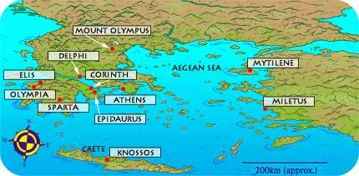

Slide 3
Thucydides 1.94.1-2
(LACTOR 1, 7)

Slide 4
Thucydides 1.95.1
(LACTOR 1, 7)

Slide 5
Thucydides 1.95.2-7
(LACTOR 1, 7)

Slide 6
Thucydides 1.96-7.1
(LACTOR 1, 11 & 15)

Slide 7
Aristotle, Constitution of the Athenians, 23.4-5
(LACTOR 1, 16)

Slide 8
Thucydides 1.130 & Plutarch Aristeides 23
(LACTOR 1, 8 & 10)

