Slide 1
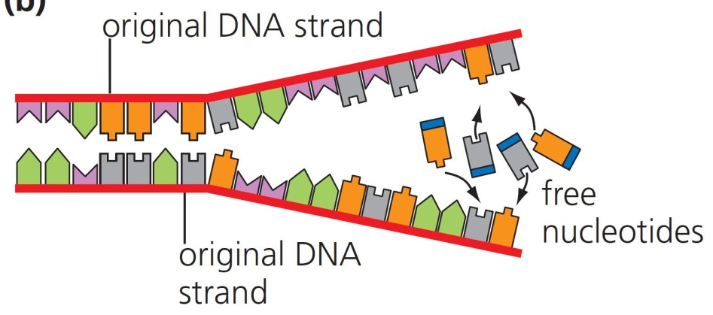
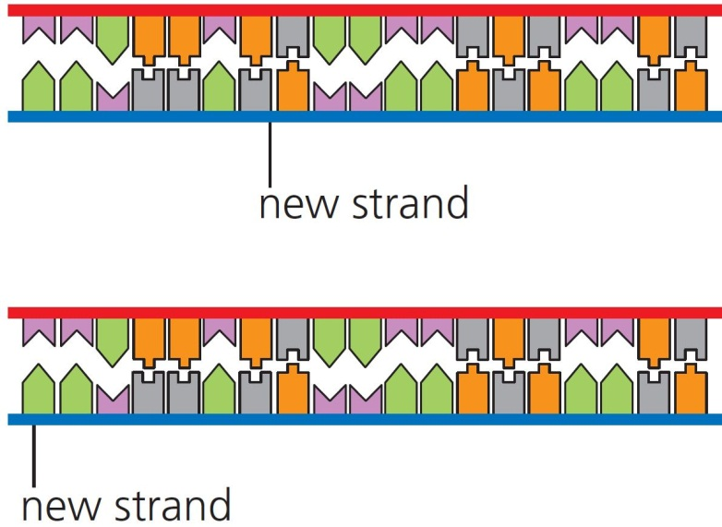
5 The cell cycle Summary
DNA replication
Helicase splits the DNA double helix.
DNA polymerase synthesises two new DNA strands.
Half of each new DNA strand is the same as the original – semiconservative replication.
© Hodder & Stoughton 2015

Slide 2
5 The cell cycle Summary
Mitosis
DNA polymerase can only work in one direction, so produces one continuous strand and one fragmented strand.
Parental
DNA
5’
Leading
strand
5’
Okazaki fragments
3’
3’
Lagging
strand
© Hodder & Stoughton 2015

Slide 3
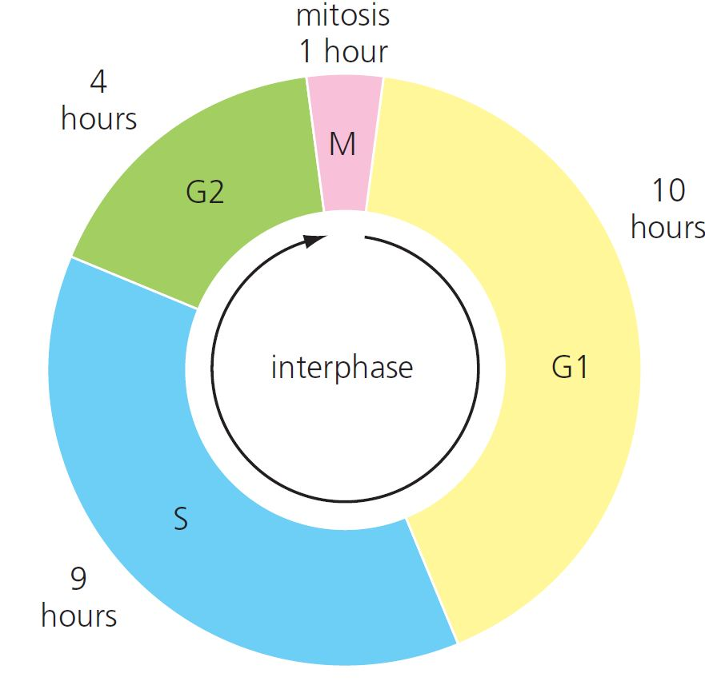
5 The cell cycle Summary
The cell cycle
G1: cell increases in size
S: DNA replicates
G2: organelles replicate
M: mitosis
Once divided, most cells differentiate.
In cancer, uncontrolled cell division may form tumours.
© Hodder & Stoughton 2015

Slide 4
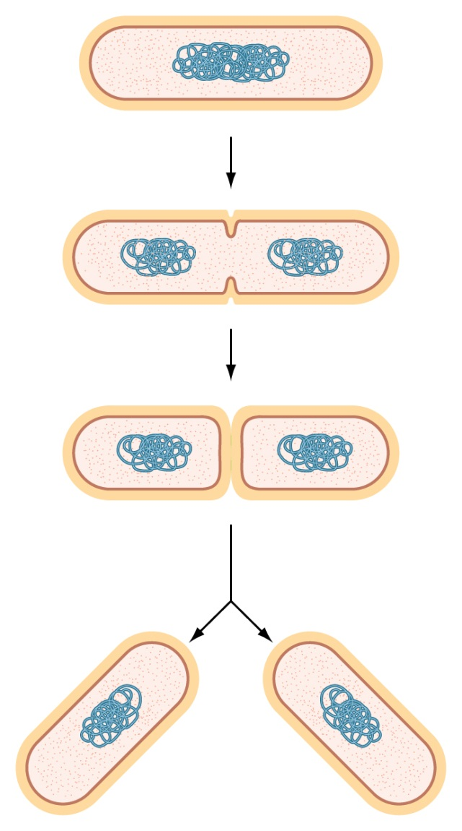
5 The cell cycle Summary
Bacterial division
Prokaryotes divide by splitting in two – binary fission.
© Hodder & Stoughton 2015

Slide 5
5 The cell cycle Summary
Questions
Describe the roles of:
helicase
DNA polymerase.
Explain why Okazaki fragments are produced during DNA replication.
What is meant by semiconservative replication?
At what stages of the cell cycle would chromatids be visible?
Explain the importance of mitosis.
© Hodder & Stoughton 2015

