Slide 1
Personal Role Radio

Slide 2
Aims
By the end of this lesson, you will be able to:
Describe the safety considerations connected with the use of the PRR
Setup and operate the PRR Safely
So that you can use the PRR on exercises to communicate within your section

Slide 3
Safety
All electronic transmitting devices emit energy in the form of electromagnetic radiation
The PRR presents a very small radiation hazard from the antenna when transmitting
Hazards of Electromagnetic Radiation (HER) can affect:
People
Ordnance (electrically initiated explosive devices)
Fuel (petrol)
To manage these hazards, safety distances are in place which MUST be followed at all times when using the PRR

Slide 4
Safety
The safety requirements for the PRC 710 are:
HERP (People)
4cm from the eyes to the antenna for CFAV & Cadets
HERO (Ordnance)
Do not operate near electrically initiated ordnance
HERF (Fuel)
Do not operate near fuel filling stations
CFAVs will manage the distances for HERO and HERF

Slide 5
Safety
The radio must only be operated within the supplied pouch
Batteries contain harmful chemicals
They must be stored, handled, and disposed of correctly
If short-circuited, batteries may overheat and released harmful gases or catch fire
Batteries must always be removed from the radio after use
To protect hearing, the radio should not be operated on the loudest volume setting for long periods of time
Always use the lowest volume setting you can on the radio
The AmpliVox ear defenders fit over the top of the headset to protect hearing when in noisy environments

Slide 6
Any Questions?
?

Slide 7
PRR Specification
The PRR is a small, UHF man-pack transceiver
It fulfils the role of an intra-section radio enabling members of a section to talk to each other
Frequency 2.4000 - 2.4835GHz
Channels 256 (grouped in sets of 16)
Power 2 x AA batteries
Battery Life ~24 Hours (dependant on use)
RF Power Output 50mW (0.05W)

Slide 8
PRR Specification
Ranges
Outside up to 500m
Inside up to 50m (3 floors)
Headset tones to indicate status
Power on - three short, high tones
Power off - five medium, low tones
Battery low - four tones alternating in frequency
Volume / channel changes - one beep per step

Slide 9
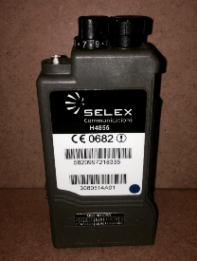
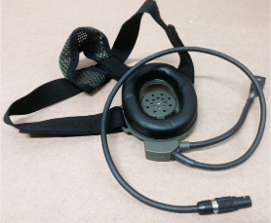
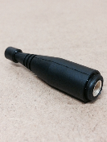
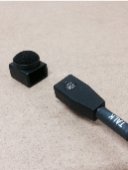
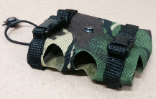
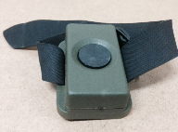
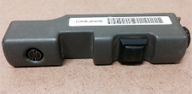
PRR components

Slide 10
PRR Setting up and Operation
Ensure the radio is off
Insert the headset connector
Select / check channel
Insert batteries
Fit carry pouch
Turn on the radio (three short tones should be heard)
Carry out functional checks
Depress pressel switch and speak into the microphone
Sidetone should be heard in the headset
Repeat with wireless PTT if required
The microphone is noise cancelling so should be placed approximately 1-2cm (a thumbs-width) from the lips
To disassemble the radio, carry out the above in reverse

Slide 11
Any Questions?
?

Slide 12
Final Confirmation
Assemble the radio
What is the minimum safety distance from the antenna to a person?
How many batteries do you need for the radio?
Disassemble the radio

Slide 13
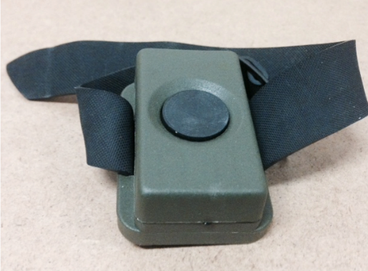
Optional – Wireless PTT

Slide 14
Affiliating Wireless PTT
Ensure the PRR is off
Position WPTT with “Program” label placed beneath the single pressel on the radio
Turn on the PRR
An ascending set of 8 tones should be heard in the headset

Slide 15
Affiliating Wireless PTT
Press and hold WPTT button until 8 ascending tones heard again
If unsuccessful, or time expires, 8 descending tones will be heard in the headset
Take care when affiliating around others as the WPTT has a range of 2-3m

Slide 16
Deaffiliating Wireless PTT
Ensure PRR is switched off
Position WPTT with “Program” label placed beneath the single pressel on the radio
Turn on PRR
An ascending set of 8 tones should be heard in the headset

Slide 17
Deaffiliating Wireless PTT
Move the WPTT away from the radio and return it 5 or more times
Ascending set of 8 tones heard if successful
If unsuccessful, or time expires, descending set of 8 tones will be heard in the headset

