Slide 1
Maps

Slide 2
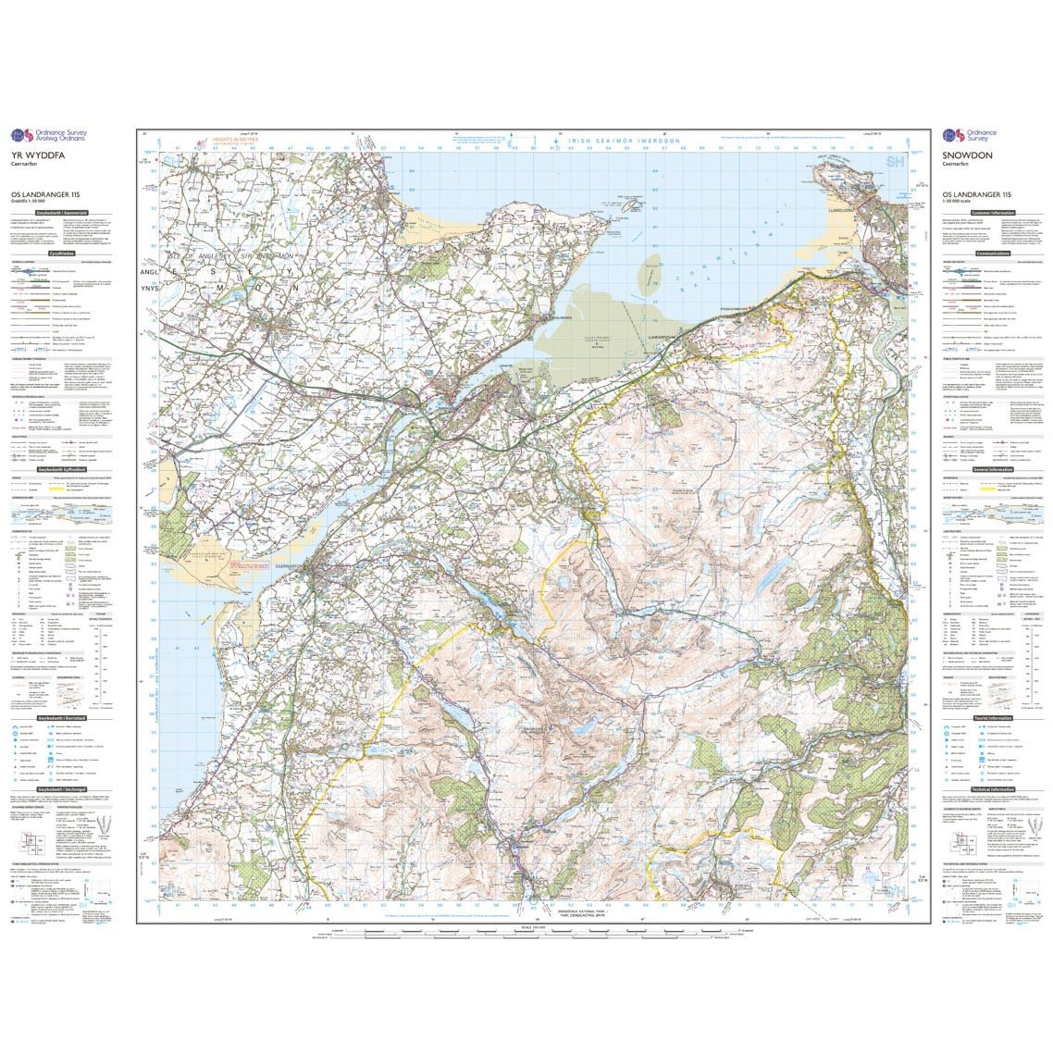
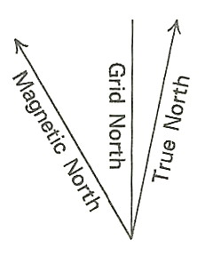
NB: A map is only completely accurate when it is being drawn
Scale, distances in miles, nautical miles and kilometers

Slide 3
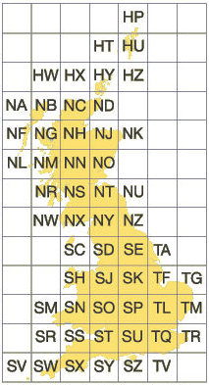
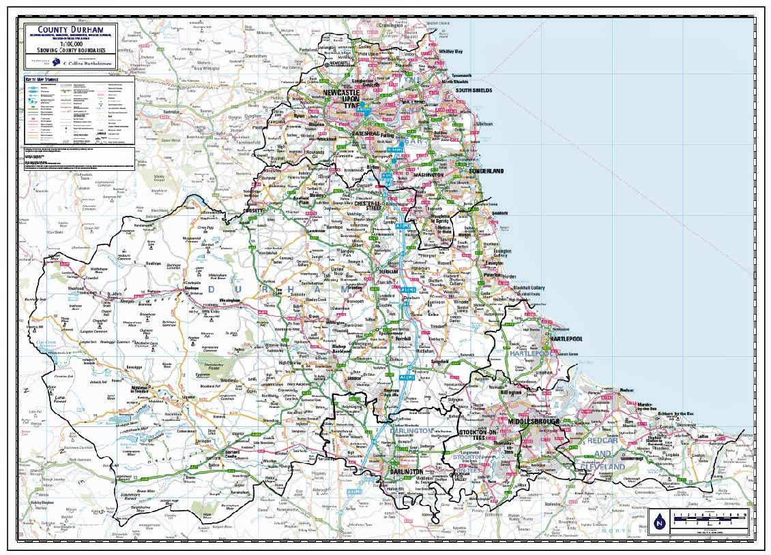
National Grid
Each square is 100km by 100km and has a unique code
Every map represents one square
Maps have squares numbered 00 to 99 on both eastings and northings

Slide 4
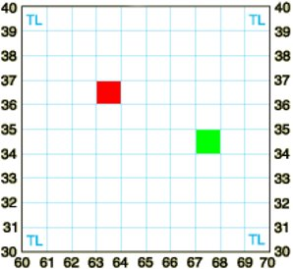
Basic grid references
63 36
67 34
Give eastings, then northings

Slide 5
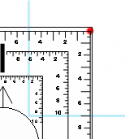
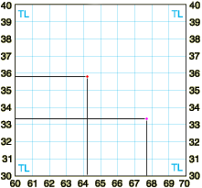
6 figure grid references
358
642
677
333

