Slide 1
ATP and phosphorylation
1 Energy transfer Key concepts
Next
© Hodder & Stoughton 2015

Slide 2
1 Energy transfer Key concepts
Introduction
All organisms require energy to drive their metabolic processes. Metabolism comprises all the chemical reactions that take place in living cells. ATP or adenosine triphosphate is the energy currency of cells. An ATP molecule consists of adenine, ribose sugar and three inorganic phosphate groups. ATP stores energy in its phosphate bonds. When the bonds are hydrolysed, energy is released. This energy can be used to drive all endergonic (energy requiring) reactions in the cells and tissues.
Next
© Hodder & Stoughton 2015

Slide 3
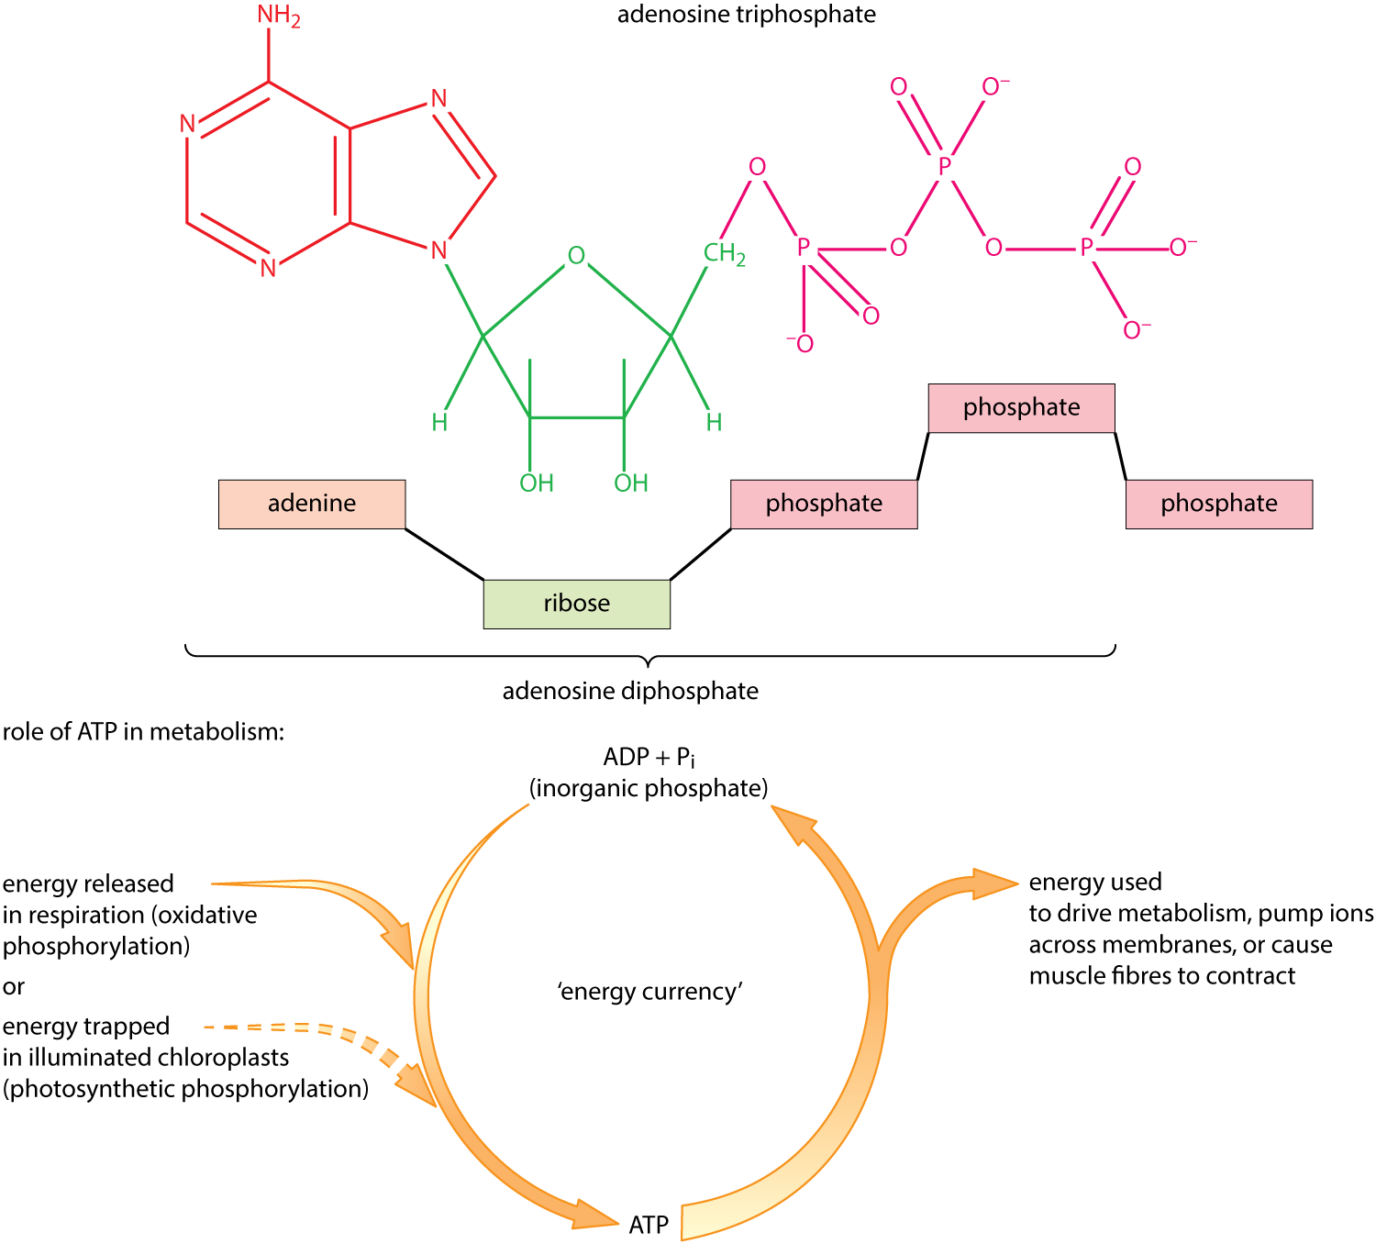
1 Energy transfer Key concepts
The diagram shows the structure of ATP.
Choose the correct labels from the list for each of the empty boxes. Click on each box to see if you are correct.
THYMINE
PENTOSE SUGAR
HEXOSE SUGAR
PHOSPHATE
ATP
ADP
ADENINE
GUANINE
CYTOSINE
phosphate
adenine
phosphate
phosphate
ribose
ADP
ATP
Next
© Hodder & Stoughton 2015

Slide 4
1 Energy transfer Key concepts
Universal energy currency
ATP is a small, soluble molecule. It is found universally in all living organisms, both eukaryotes and prokaryotes. It can be moved around cells. It can also be transferred between cells by facilitated diffusion. ATP formation or breakdown can be coupled with energy-releasing or energy-requiring reactions.
Next
© Hodder & Stoughton 2015

Slide 5
1 Energy transfer Key concepts
Universal energy currency
ATP is a small, soluble molecule. It is found universally in all living organisms, both eukaryotes and prokaryotes. It can be moved around cells. It can also be transferred between cells by facilitated diffusion. ATP formation or breakdown can be coupled with energy-releasing or energy-requiring reactions.
ATP can be hydrolysed into ADP and inorganic phosphate (Pi). This reaction releases 30.6 kJ of energy.
When glucose is broken down during respiration the energy released can join ADP and Pi to form ATP.
Next
© Hodder & Stoughton 2015

Slide 6
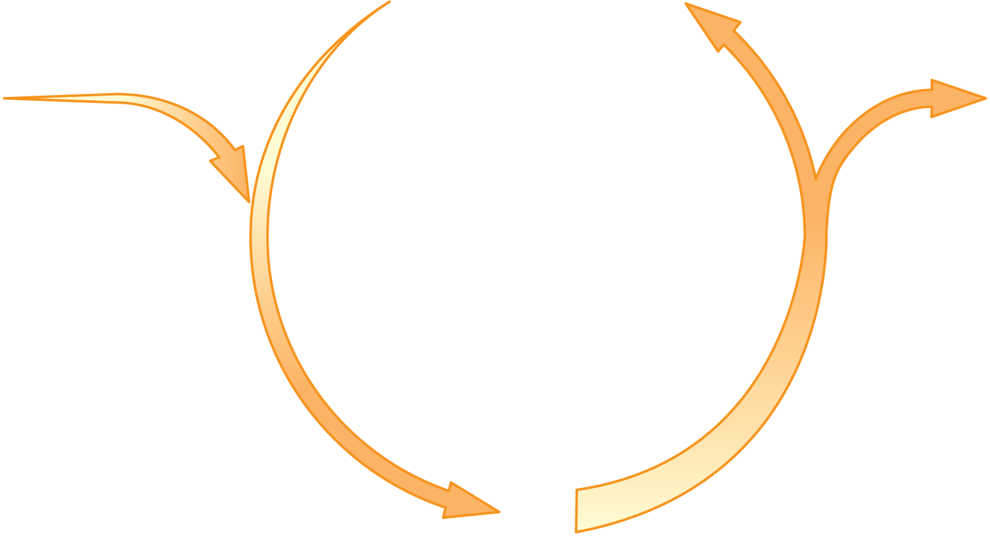
1 Energy transfer Key concepts
Universal energy currency
ADP + Pi
(inorganic phosphate)
Energy released during respiration of glucose
Energy released for metabolic processes
ATP synthetase
condensation reaction
hydrolysis reaction
ATP
Next
© Hodder & Stoughton 2015

Slide 7
1 Energy transfer Key concepts
Universal energy currency
ATP is required by cells for:
Next
© Hodder & Stoughton 2015

Slide 8
1 Energy transfer Key concepts
Universal energy currency
ATP is required by cells for:
Active transport of minerals into root hair cells against a concentration gradient.
Next
© Hodder & Stoughton 2015

Slide 9
1 Energy transfer Key concepts
Universal energy currency
ATP is required by cells for:
Active transport of minerals into root hair cells against a concentration gradient.
Flagella and cilia require the energy of ATP to move their contractile filaments.
Next
© Hodder & Stoughton 2015

Slide 10
1 Energy transfer Key concepts
Universal energy currency
ATP is required by cells for:
Active transport of minerals into root hair cells against a concentration gradient.
Flagella and cilia require the energy of ATP to move their contractile filaments.
DNA nucleotides are phosphorylated before attaching to the template strand during DNA replication.
Next
© Hodder & Stoughton 2015

Slide 11
1 Energy transfer Key concepts
Universal energy currency
ATP is required by cells for:
Active transport of minerals into root hair cells against a concentration gradient.
Flagella and cilia require the energy of ATP to move their contractile filaments.
DNA nucleotides are phosphorylated before attaching to the template strand during DNA replication.
Uptake of nutrients into the gut and translocation of sucrose in the phloem sieve tube elements.
Next
© Hodder & Stoughton 2015

Slide 12
1 Energy transfer Key concepts
Universal energy currency
ATP is required by cells for:
Active transport of minerals into root hair cells against a concentration gradient.
Flagella and cilia require the energy of ATP to move their contractile filaments.
DNA nucleotides are phosphorylated before attaching to the template strand during DNA replication.
Uptake of nutrients into the gut and translocation of sucrose in the phloem sieve tube elements.
Synthesis reactions such as the formation of proteins from amino acids or starch from monosaccharides.
Next
© Hodder & Stoughton 2015

Slide 13
1 Energy transfer Key concepts
Phosphorylation
ATP is formed when ADP is phosphorylated. This means that a phosphate group is added. The word phosphorylation is commonly used to describe the formation of ATP. There are several different ways in which ATP can be created. Click on each bullet to learn more.
Photophosphorylation is the formation of ATP using light energy.
It takes place during the light dependent stage of photosynthesis.
Substrate level phosphorylation generates ATP when a chemical reaction releases a phosphate group. The phosphate combines with ADP.
This occurs during glycolysis and Krebs cycle.
Photophosphorylation
Oxidative phosphorylation is the formation of ATP when electrons from reduced co-enzymes are transferred to oxygen.
This uses the electron transport chain on the mitochondrial cristae.
Substrate level phosphorylation
Oxidative phosphorylation
Next
© Hodder & Stoughton 2015

Slide 14
1 Energy transfer Key concepts
Photophosphorylation
The diagram shows how light energy is used to create ATP.
3. excited electron picked up and passed down electron carriers
6. the energy from this electron also used to generate ATP
2. excited electron ejected
photo-system I
NADP
NADPH
ATP
5. light energy hits photosystem ejecting another electron
photo-system II
ADP + P_{i}
1. light energy hits the photosystem
4. energy released by electron is used to create ATP
Next
© Hodder & Stoughton 2015

Slide 15
1 Energy transfer Key concepts
Questions
Explain the role of light energy in the formation of ATP during photophosphorylation?
The light energy energises the electrons. It is the energy that they release as they pass down the electron carriers that is used to combine ADP and Pi to form ATP.
What is the ATP used for that is made by this process?
It is used in the light-independent reactions (Calvin cycle) or for other active processes within the plant.
Answers
Next
© Hodder & Stoughton 2015

Slide 16
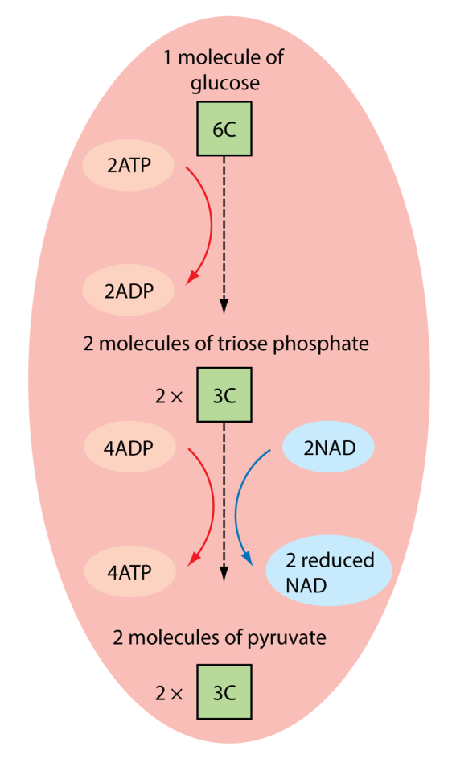
1 Energy transfer Key concepts
Substrate level phosphorylation
The diagram shows the breakdown of glucose into pyruvate. This is the first stage of respiration. It is called glycolysis. During glycolysis four molecules of ATP are generated by substrate level phosphorylation.
Next
© Hodder & Stoughton 2015

Slide 17
1 Energy transfer Key concepts
Questions
Suggest why two molecules of ATP are required at the start of glycolysis.
The glucose has to be converted into two molecules of triose phosphate. This requires energy from ATP.
What is the net gain of ATP from glycolysis?
Net gain is two ATP molecules.
What do the numbers in the green boxes refer to?
These are the number of carbon atoms in the molecules.
Answers
Next
© Hodder & Stoughton 2015

Slide 18
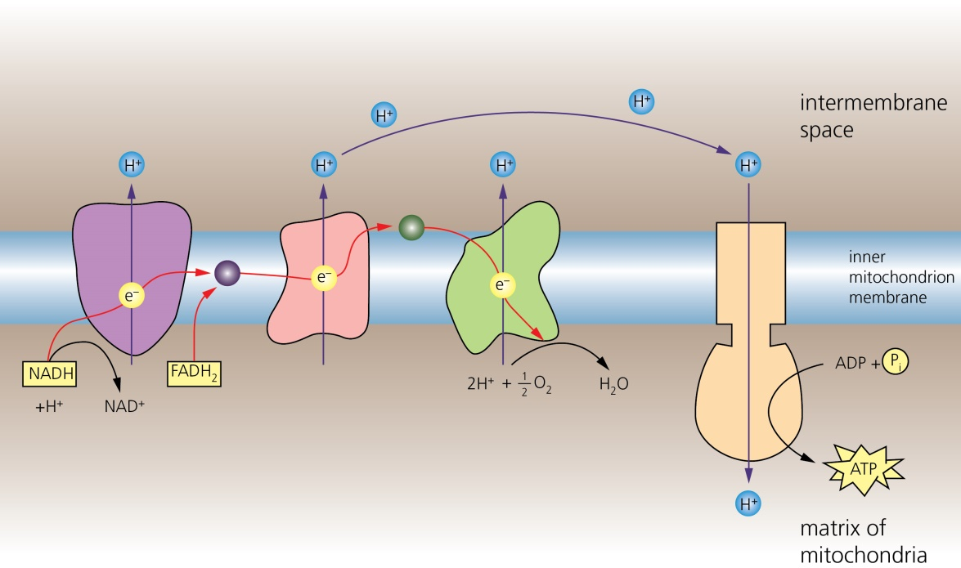
1 Energy transfer Key concepts
Oxidative phosphorylation
The diagram shows how ATP is generated by the electron transport chain. The hypothesis that explains this process is called chemiosmosis.
Find the six hotspots on the diagram below to learn more.
energy released by electrons pumps protons into the intermembrane space
protons flow down a proton gradient through ATP synthase molecule
protons and electrons are split off from co-enzymes NAD and FAD
the electro-motive force generated by proton flow combines ADP and Pi
electrons pass down electron transport chain
oxygen acts as the final proton and electron acceptor forming water
Reveal
Next
© Hodder & Stoughton 2015

Slide 19
1 Energy transfer Key concepts
This is the end of the presentation
Back to start
© Hodder & Stoughton 2015

