Slide 1
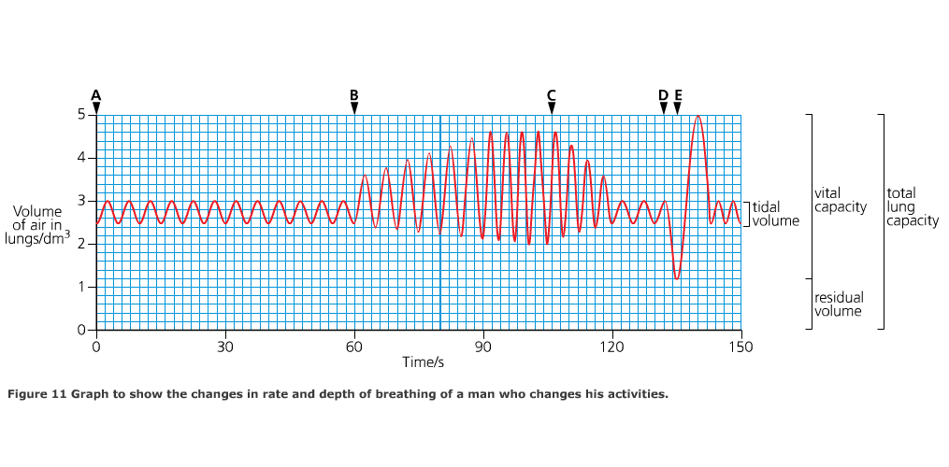

Slide 2
From A-B the person is at rest
- shallow steady breathing/tidal volume

Slide 3
At B exercise starts (deeper breaths/increased TV)

Slide 4
At C exercise stops - breathing begins to return to ‘normal’

Slide 5
At D maximum breath out
- any air left in lungs is the residual volume

Slide 6
At E maximum breath in
- maximum in and out is vital capacity

Slide 7
pulmonary ventilation rate (dm³min⁻¹) = tidal volume (dm³) x breathing rate (min⁻¹)
Calculate the pulmonary ventilation rate of a person who takes 17 breaths in a minute with a mean tidal volume of 600cm³. Show your working.
Answer: 10.2 dm³min⁻¹

Slide 9
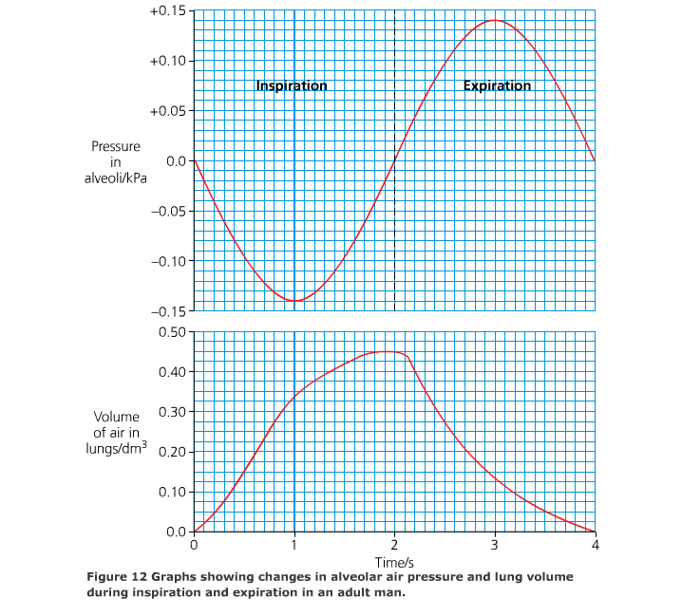

Slide 10
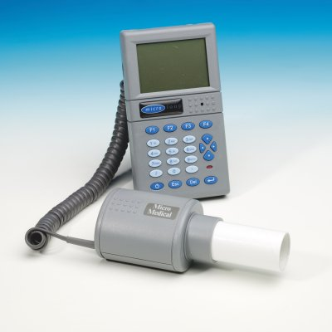

Slide 13
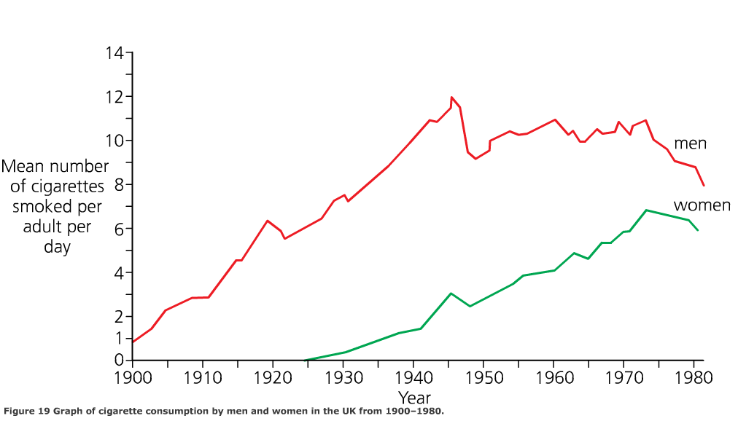

Slide 14
