Slide 1
Formation of Tissue Fluid and Lymph
9 Mass transport in animals Key concepts
Next
© Hodder & Stoughton 2015

Slide 2
9 Mass transport in animals Key concepts
Introduction
Blood is a tissue composed of red and white cells and platelets in a liquid matrix. The matrix is called plasma. Plasma is about 55% water. Plasma contains dissolved glucose, proteins, salts, hormones, urea and ions. The blood transports these materials to and from the cells and tissues of the body.
Arteries transport blood away from the heart. These thick walled vessels sub divide into smaller arterioles. Arterioles branch into narrow, thin walled capillaries. Capillaries are where materials are exchanged between the blood and tissues.
Next
© Hodder & Stoughton 2015

Slide 3
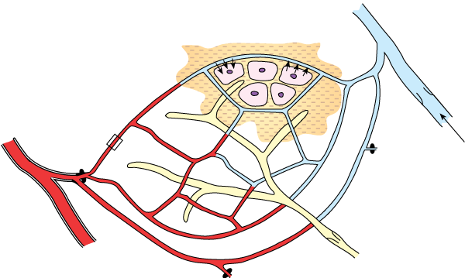
9 Mass transport in animals Key concepts
The Structure of a Capillary Network
Capillary networks permeate the tissues so that every cell is very close to a blood supply. Click to reveal the five hotspots.
enlarged section of capillary wall.
Venule carrying deoxygenated blood and waste products from the cells.
Arteriole carrying oxygenated blood under high pressure.
Direction of blood flow
Cells are surrounded by capillaries which supply them with nutrients and oxygen.
Capillary network branching off the arteriole.
Lymphatic vessel
Reveal
Next
© Hodder & Stoughton 2015

Slide 4
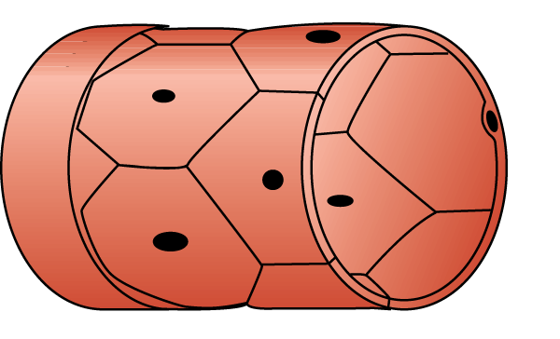
9 Mass transport in animals Key concepts
The Structure of a Capillary Network
Capillary networks permeate the tissues so that every cell is very close a blood supply.
capillary wall is one cell thick
cells do not fit snugly together leaving pores or fenestrations
A thin basement membrane covers the capillary
narrow lumen
Next
© Hodder & Stoughton 2015

Slide 5
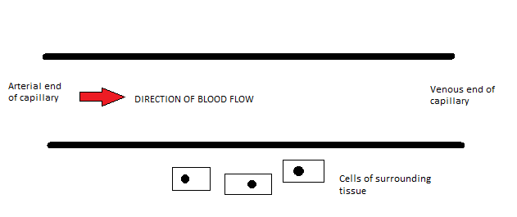
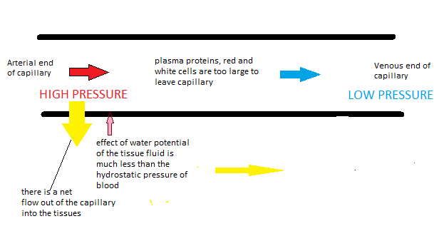
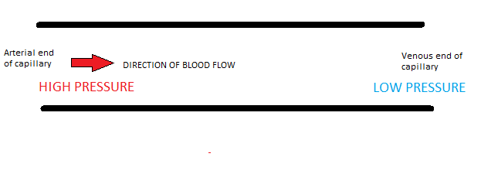
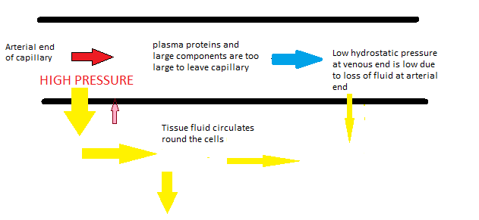
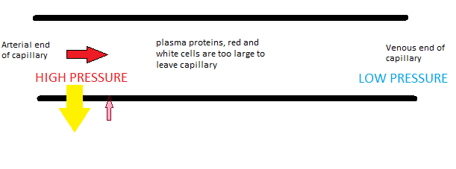
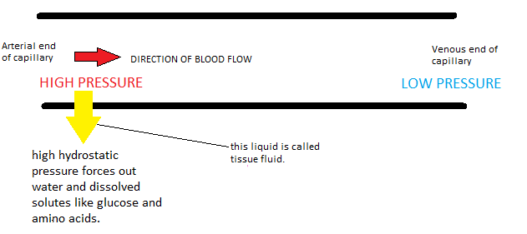
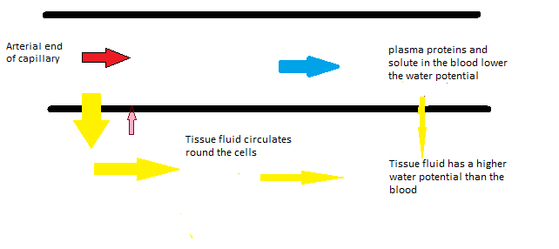
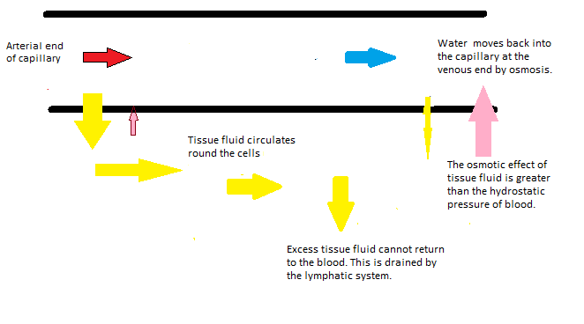
9 Mass transport in animals Key concepts
Movement of materials into and out of a capillary
Click the arrow to move through the cycle.
Next
© Hodder & Stoughton 2015

Slide 6
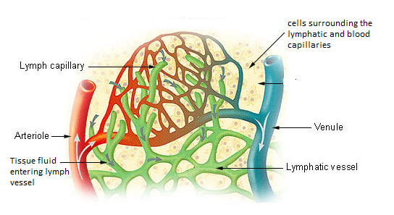
9 Mass transport in animals Key concepts
Lymphatic system
The lymphatic system is a network of blind ending tubes which are closely associated with capillaries.
Next
© Hodder & Stoughton 2015

Slide 7
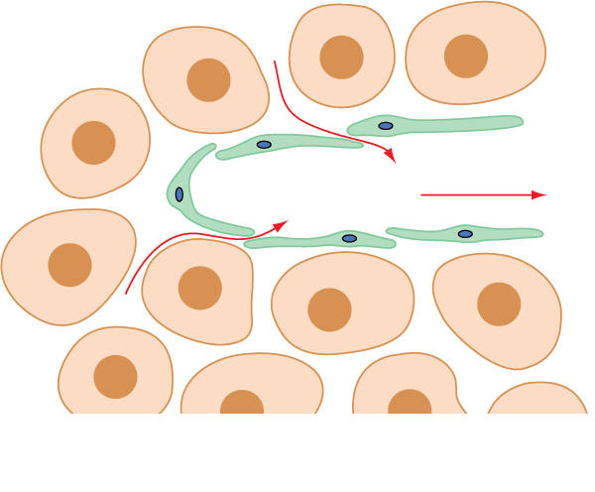
9 Mass transport in animals Key concepts
Lymphatic system
The fluid carried is called lymph. Lymph is excess tissue fluid which cannot drain back into the capillaries. The fluid moves by compression of surrounding muscles. Lymph vessels have pocket valves to prevent backflow of the lymph fluid.
Cells of surrounding tissue
Valve in wall of lymph vessel allows large molecules to pass through
Flow of tissue into the vessel. This is now called lymph.
Lymph vessel wall composed of endothelial cells
Next
© Hodder & Stoughton 2015

Slide 8
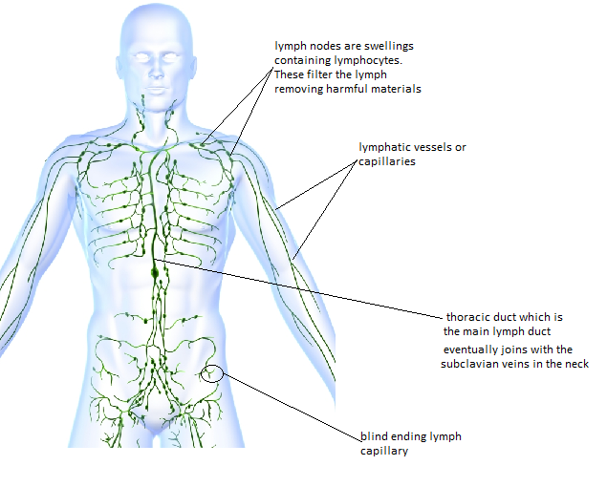
9 Mass transport in animals Key concepts
Lymphatic system
The lymphatic vessels eventually join with the subclavian veins in the neck and the fluid is returned to the circulation.
Next
© Hodder & Stoughton 2015

Slide 9
9 Mass transport in animals Key concepts
Differences between blood tissue fluid and lymph
The cardiac cycle is initiated by the pacemaker. A wave of electrical impulses are transmitted across the atria to the atrio ventricular node. The AVN is located in the septum between the two ventricles. From the AVN impulses move down conducting fibres to the base of the ventricles. The conducting fibres then transmit the impulses through the walls of the ventricles.
Next
© Hodder & Stoughton 2015

Slide 10
9 Mass transport in animals Key concepts
The table shows the main differences between the blood system, tissue fluid and the lymphatic system. Add the terms below into the correct gaps.
Erythrocytes High levels Circulates freely Some
Lymphocytes only No erythrocytes Always low
Feature | Blood system | Tissue Fluid | Lymph
Type of vessel | Arteries, veins capillaries |  | Lymphatic vessels
Erythrocytes |  | No erythrocytes or.
Leucocytes | All types present | Not present
Proteins | Plasma proteins | Proteins secreted by cells
Oxygen |  | Low (absorbed by cells) | Less
Pressure | High pressure in arteries. Low in veins. |  | Always low
Circulates freely
Erythrocytes
No erythrocytes
Lymphocytes only
Some
High levels
Always low
Answers
End
© Hodder & Stoughton 2015

