Slide 2
CCF RN Uniform Types, Wearing of Uniform, Brassards and Badges.
Welcome
Notes:
CCF RN Uniform Types – Wearing of Uniform, Brassards and Badges

Slide 3
Aim
To provide you with the information required to ensure Cadets are dressed according to the approved CCF RN Uniform Regulations and that the Uniform is worn correctly.
Notes:
“To provide you with the information required to ensure Cadets are dressed according to the approved CCF RN Uniform Regulations and that the Uniform is worn correctly".

Slide 4
Objectives
No 3 Uniform
No 4 Uniform
Brassards
Badges
Summary
Questions.
Notes:
By the end of this lesson, you will understand the following.
No 3 Uniform
No 4 Uniform
Brassards
Badges

Slide 5
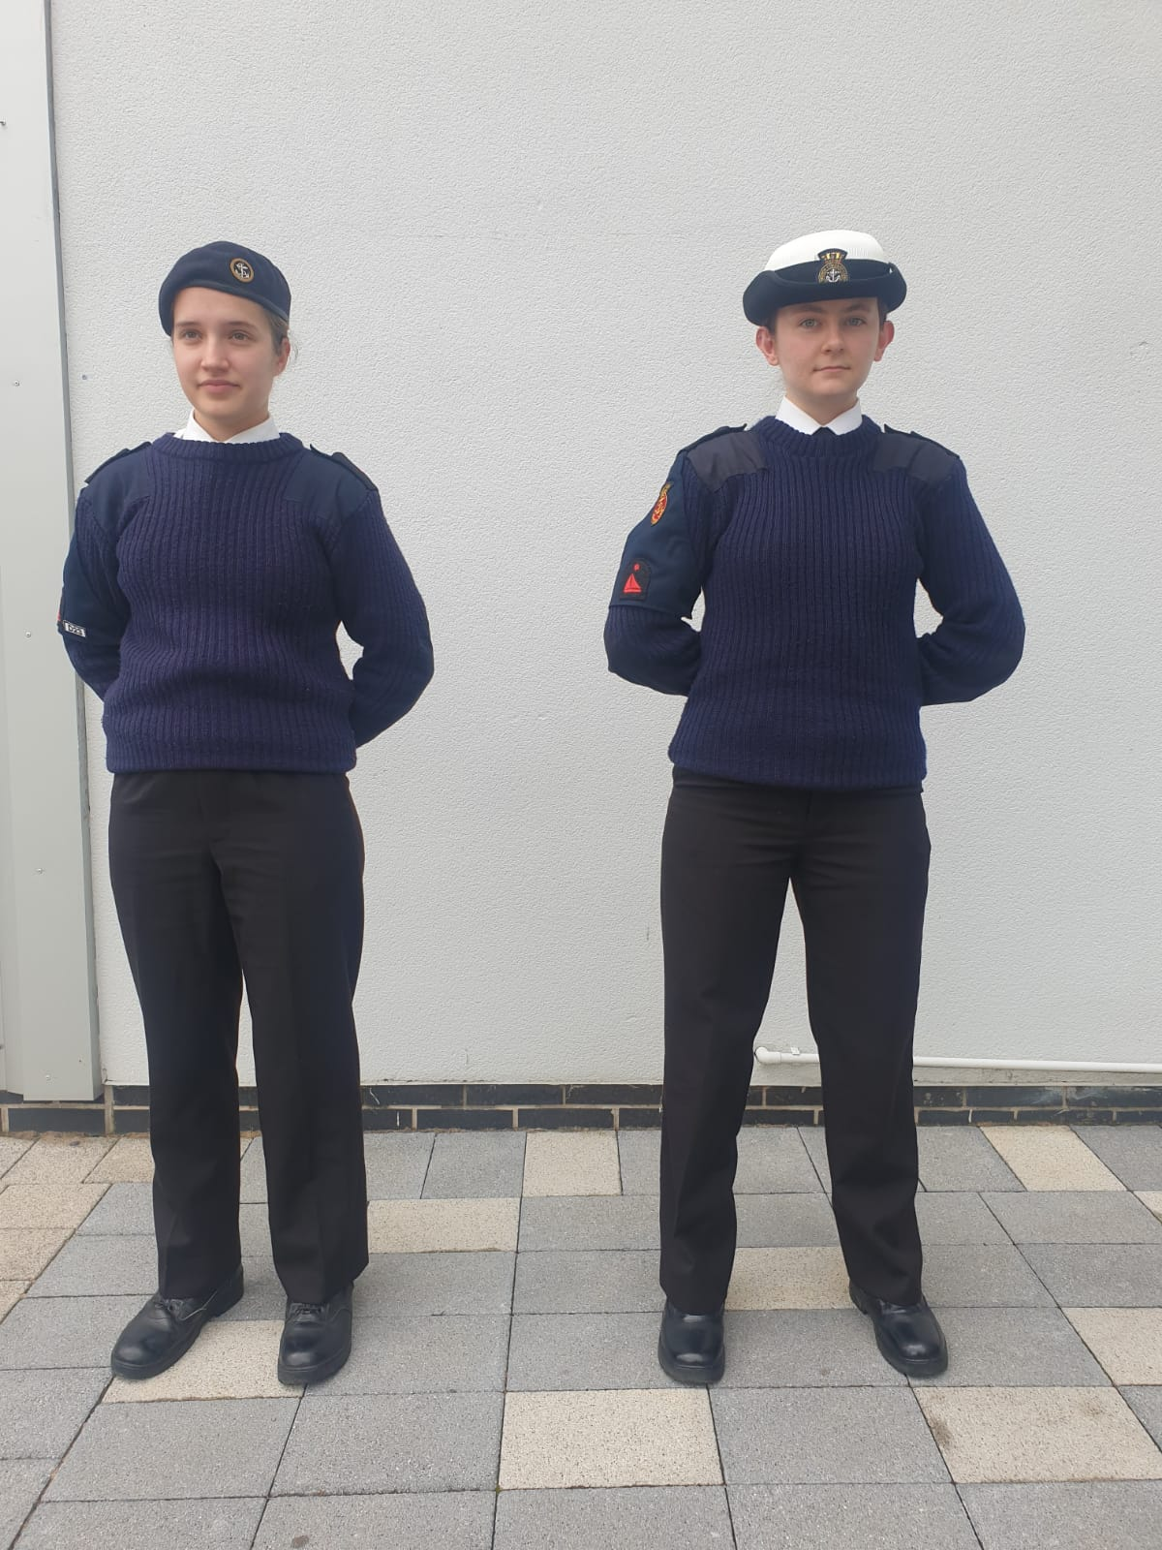
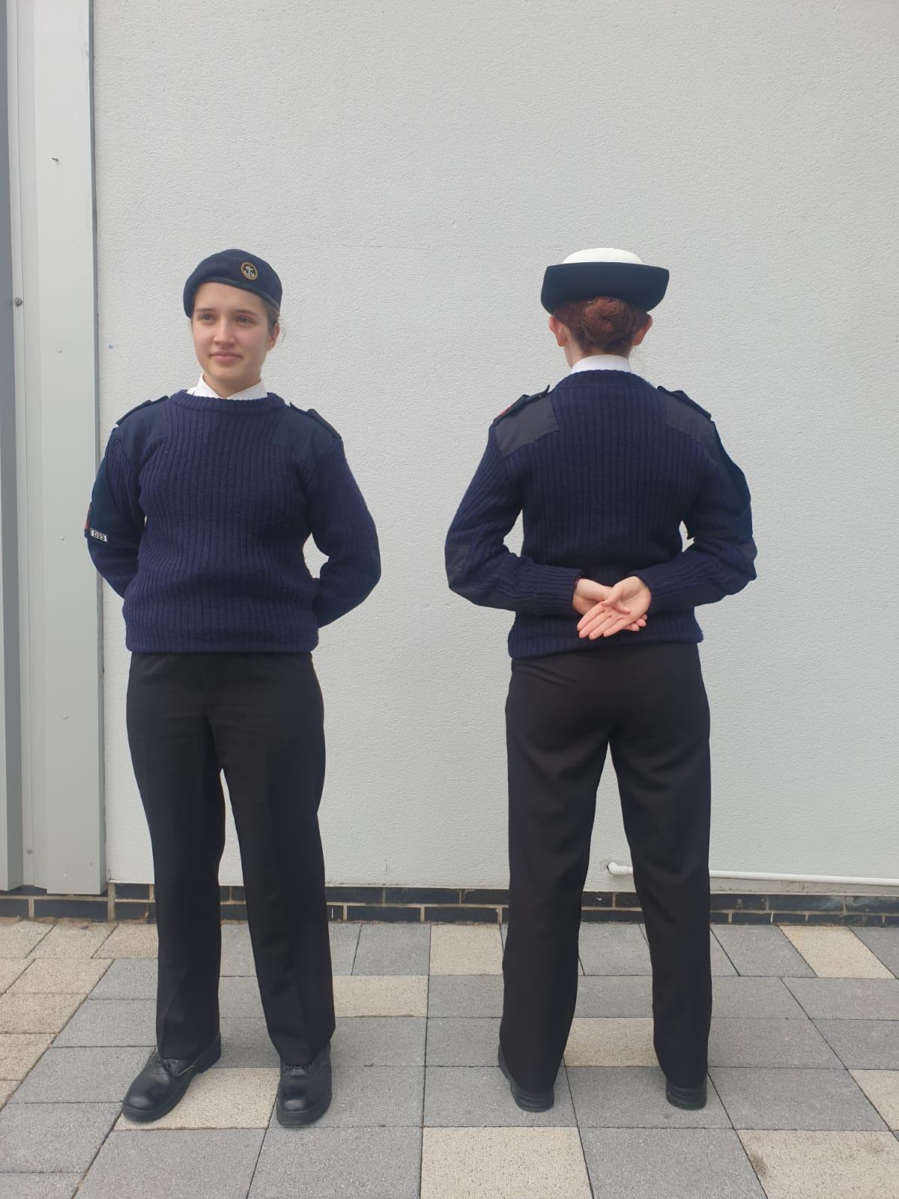
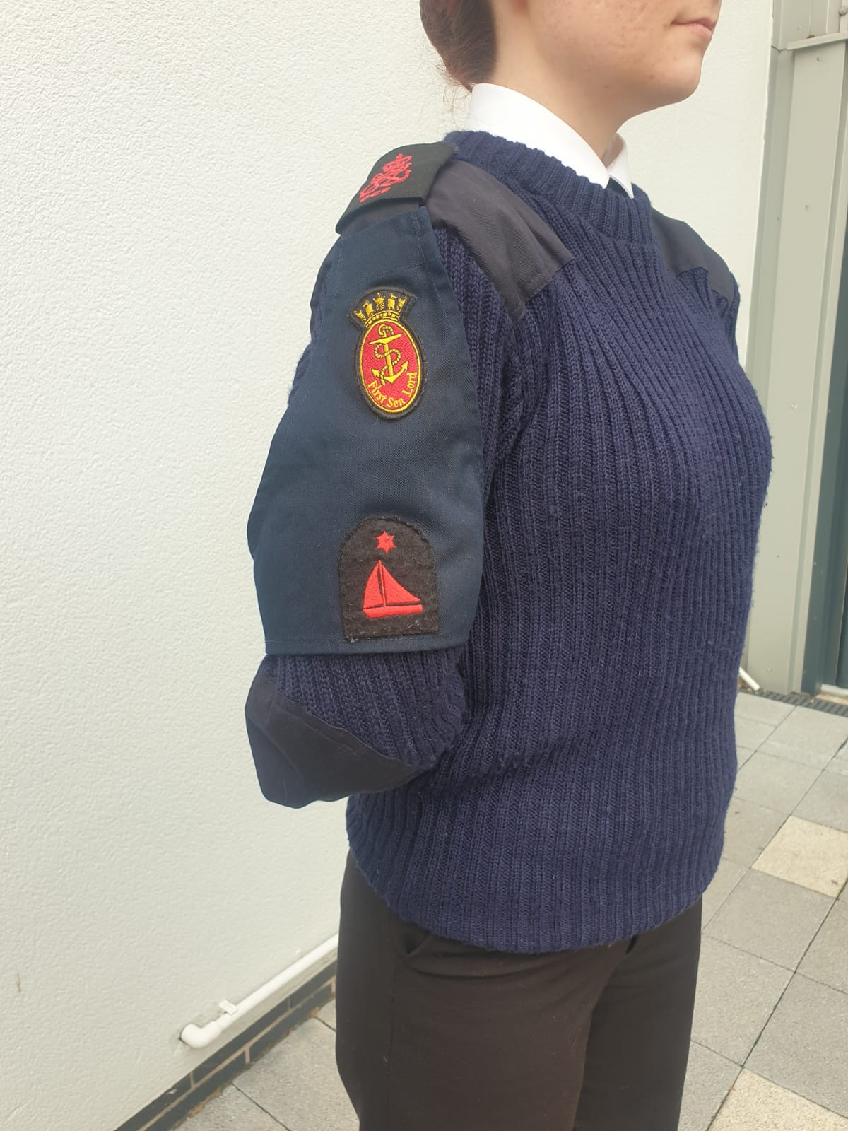
No 3 Dress with Brassard
Parade Uniform
Cadet No 1 Uniform
Beret
White Long Sleeve Shirt
Black Tie
Blue Jersey
Brassard on the Right Arm
Black Trousers
Belt
Black Shoes.
Notes:
The CCF is extremely fortunate that its RN Uniforms are supplied to the RN sections at Crown Expense. To this end it is essential that CCF RN Sections and more importantly the Cadets take great care of the uniform that is supplied to them.
No3 Dress is normally the Parade uniform for the CCF, it is a smart Uniform that should be worn for Inspections, Parades, Remembrance Services or any other event where the RN contingent will be required to look extremely smart. It is sometimes referred to by sections as their Cadet Number 1 Uniform.
White Shirt, this is only worn with sleeves rolled down, top button done up and worn with a black tie, brassard on the right arm, black trousers with a crease down the centre, black belt with brass buckle and black smart bulled shoes

Slide 6
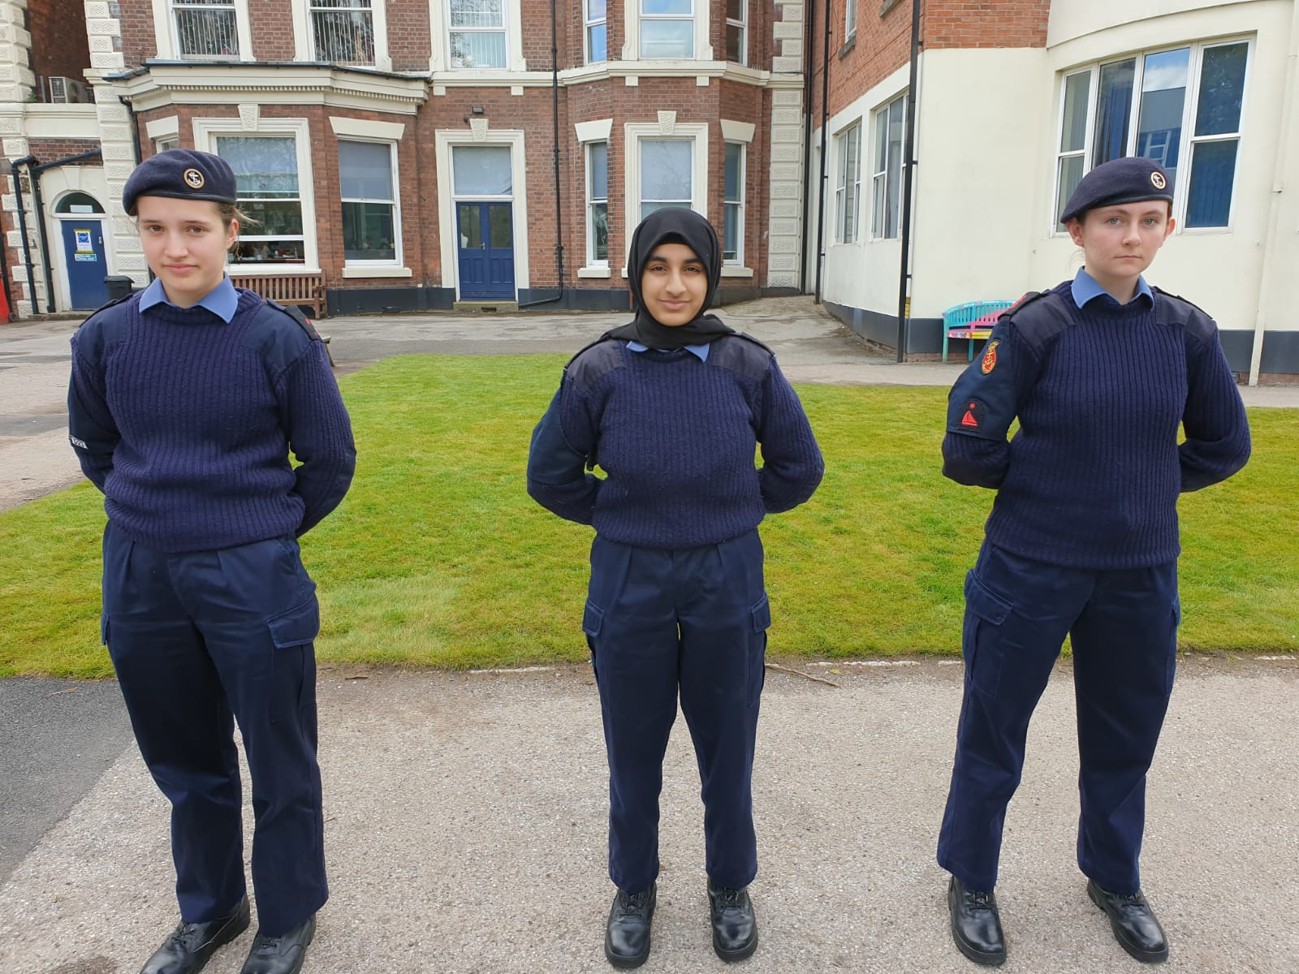
No 4 Dress Action Working Dress(AWD)
Fire Retardant
Blue Shirt
Rank Epaulette to be worn
Blue Trousers
Blue Jersey
Beret (Outdoor Only)
Black DMS Boots.
Notes:
The Royal Navy Action Working Dress (AWD) Uniform was replaced in 2015 by a blue version of PCS, it is not envisaged that the roll out to RN CCF will begin anytime soon. As a result of this, all RN Cadets will continue wearing the issued AWD.
This was the standard working uniform of the Royal Navy, in one form or another it has been in existence for over 60 years. Something, which all contingents and cadets should be mindful of is that this uniform is fire retardant and the laundry instructions should be adhered to. The AWD uniform can by its nature if not looked after, end up looking a very scruffy uniform.
This is to be worn at all parades and everyday working.
Blue shirt, top button is not done up, sleeves can be worn either rolled up or buttoned down. Epaulettes are worn on the shirt. The shirt is always worn tucked into the trousers.
Blue Trousers, when new these trousers are inflexible! They can be ironed with a steam iron and creases can be put into them. There is a large size range available so there should be a pair to fit any size cadet.
Blue Jersey Heavy Wool, this is normally worn during the Autumn and winter terms, epaulettes are worn with this jumper.
Headgear, for Junior Cadets is a beret, with the RN brass badge secured into the eyelets on the beret (cloth beret badges may continue to be used), the badge is worn above the left eye.
If the beret is new it will need to be “Shaped”, for Senior Cadets a peaked cap can be worn, the cloth CCF badge is sewn on centrally.
Before every parade, you must Polish shoes, iron uniform, check for wear and tear, ensure you're clean shaven, long hair is tied up, be discreet on makeup and remove any excessive jewellery

Slide 7
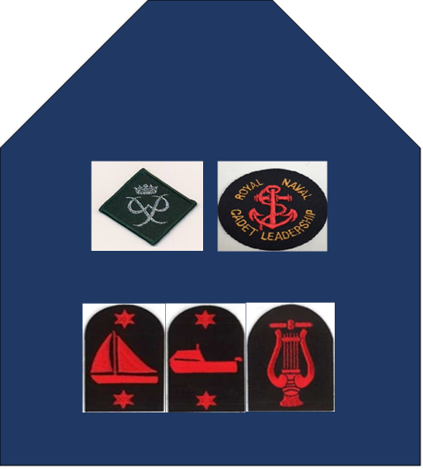
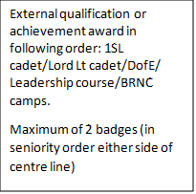
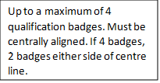
Brassards
Notes:
Brassards are worn on the right arm Only
The School or Section name is to be centrally aligned at the top of the brassard
Flashes are supplied by the School or Section - not CCF RN
The lettering may be embroidered directly onto the brassard in Red Thread, again this is at school or section cost.

Slide 8
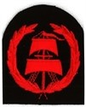
Badges
RYA Offshore Competent Crew
RYA Offshore Sail Day Skipper
RYA Offshore Sail Watch Leader
BCU 1 Star.
Notes:
Only the following Badges may be worn with the approved Brassard
Top Left - RYA Offshore Competent Crew
Top Right - RYA Offshore Sail Day Skipper
Bottom Left - RYA Offshore sail Watch Leader
Bottom Right - BCU 1 Star

Slide 9
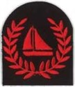
Badges cont;
BCU 2 Star
RYA Sail Level 1
RYA Sail Level 2
RYA Sail Dinghy Instructor.
Notes:
Top Left - BCU 2 Star
Top Right - RYA Sail Level 1
Bottom Left - RYA Sail Level 2
Bottom Right - RYA Sail Dinghy Instructor.

Slide 10
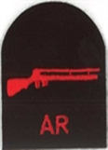
Badges cont;
RYA Windsurfing
RYA Windsurfing Level 2
Musician
Air Rifle.
Notes:
Top Left - RYA Windsurfing
Top Right - RYA Windsurfing Level 2
Bottom Left - Air Rifle
Bottom Right - Musician.

Slide 11
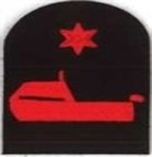
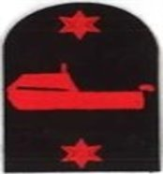
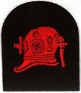
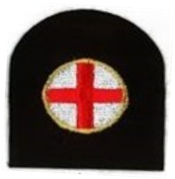
Badges cont.
RYA Power Level 1 – Powerboat
RYA Power Level 2 – Powerboat
Diver
First Aid.
Notes:
Top Left - RYA Power Level 1 – Powerboat
Top Right - RYA Power Level 2 – Powerboat
Bottom Left - Diver
Bottom Right - First Aid.

Slide 12
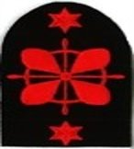
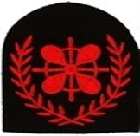
Badges cont;
Offshore Power Seamanship & Navigation
Offshore Power Seamanship & Navigation Advanced
Offshore Power Watch Leader.
Notes:
Top Left - Offshore Power Seamanship & Navigation
Right hand side - Offshore Power Seamanship & Navigation Advanced
Bottom Left - Offshore Power Watch Leader.

Slide 13
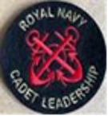
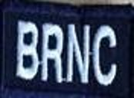
Badges cont;
Completed Junior Leadership Course
Completed Senior Leadership Course
Completed any CCF RN AT Course
Attended BRNC Summer Camp.
Notes:
Top Left - Completed Junior Leadership Course
Top Right - Completed Senior Leadership Course
Bottom Left - Completed any CCF RN AT Course
Bottom Right - Attended BRNC Summer Camp.

Slide 14
Badges cont;
Flying Course Bronze
Flying Course Silver
Flying Course Gold.
Notes:
These Badges are not held by CCF RN; they are awarded on completion of the respective course.
Flying Course Bronze
Flying Course Silver
Flying Course Gold

Slide 15
Summary
No 3 Uniform
No 4 Uniform
Brassards
Badges.
Notes:
Cover 2-3 bullet points from each objective
No 3 Uniform
No 4 Uniform
Brassards
Badges
Summary
Questions.

Slide 16
Questions

