Slide 1
Ventilation of the Lungs
7 Gas exchange Key concepts
Next
© Hodder & Stoughton 2015

Slide 2
7 Gas exchange Key concepts
Introduction
The lungs are the organs of gas exchange in a mammal. The airways are permanently open for unrestricted passage of air into the lungs.
Next
© Hodder & Stoughton 2015

Slide 3
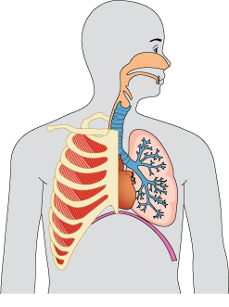
7 Gas exchange Key concepts
Click to reveal the thirteen hotspots.
Nasal passages
Cartilage bands in the trachea
Epiglottis
Ribs
Larynx
Left bronchus tube
Sternum
Left lung
External intercostal muscles
Heart
Bronchioles forming bronchial tree
Internal intercostal muscles
Diaphragm
Reveal
Next
© Hodder & Stoughton 2015

Slide 4
7 Gas exchange Key concepts
Questions
What is the role of the epiglottis?
The epiglottis closes over the windpipe when swallowing food.
Why are there bands of cartilage in the trachea, bronchus tubes and bronchioles?
The bands of cartilage hold the airways permanently open.
What is the role of the intercostal muscles?
Intercostal muscles move the rib cage up and down.
Answers
Next
© Hodder & Stoughton 2015

Slide 5
7 Gas exchange Key concepts
Ventilation
A ventilation system operates to draw air into and out of the lungs. Ventilation is brought about by the action of the rib cage and the diaphragm.
Next
© Hodder & Stoughton 2015

Slide 6
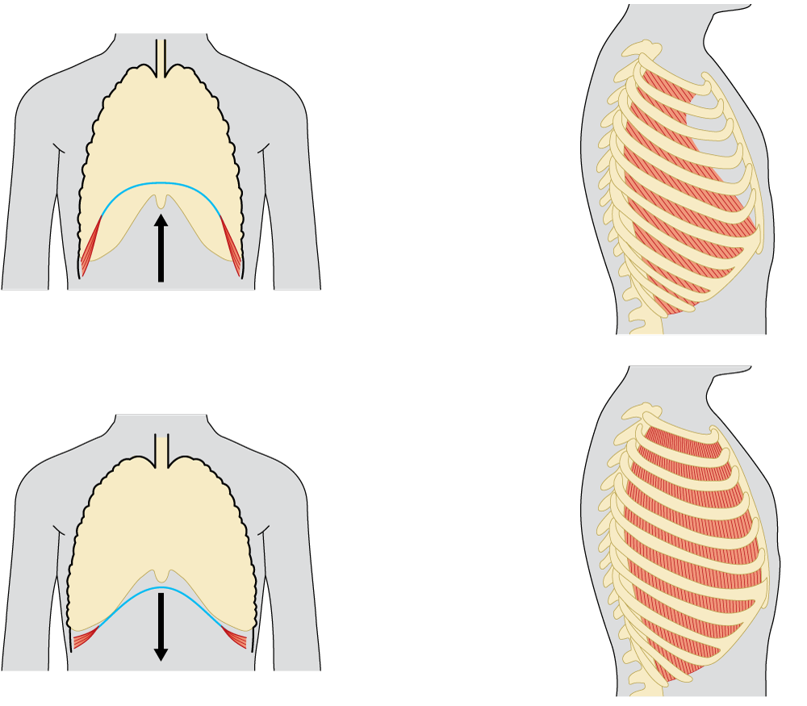
7 Gas exchange Key concepts
Ventilation
Inhalation is an active process. Click on the four hotspots to learn more.
Position of diaphragm during inhalation
Position of ribcage during inhalation
external intercostal muscles contract.
the muscles around the edge of the diaphragm contract pulling the whole structure downwards.
the ribcage is pulled upwards and outwards.
the ribs pivot on the vertebral column.
diaphragm gets flatter
Reveal
Next
© Hodder & Stoughton 2015

Slide 7
7 Gas exchange Key concepts
Ventilation
Exhalation is a largely passive process. Click on the six hotspots to learn more.
the sternum or breastbone attached to the ribs at the front.
Position of diaphragm during exhalation
Position of ribcage during exhalation
the ribcage is pulled down and in.
the muscle of the diaphragm relaxes.
ribs articulate with the thoracic vertebrae.
the internal intercostal muscles contract and the external intercostal muscles relax.
diaphragm is dome shaped
the diaphragm resumes its domed position.
Reveal
Next
© Hodder & Stoughton 2015

Slide 8
7 Gas exchange Key concepts
The table summarises the effects of the diaphragm and the ribcage on the volume and pressure in the thorax. Add the terms below into the correct gaps in the table.
Diaphragm Volume decreases Relax Volume increases
Into lungs Pressure falls below atmospheric pressure
Contract and move ribcage down and in Out of lungs
Inspiration | Structure/Action | Expiration
Muscles contract, flattens, pushing down on abdomen |  | Muscles relax, pressure from abdomen pushes up into dome shape.
Contract and move rib cage up and out | External intercostal muscles
Relax | Internal intercostal muscles
 | Volume of thoracic cavity
 | Pressure of thoracic cavity | Pressure rises above atmospheric pressure
 | Air flow direction
Diaphragm
Relax
Contract and move ribcage down and in
Volume increases
Volume decreases
Pressure falls below atmospheric pressure
Into lungs
Out of lungs
Answers
Next
© Hodder & Stoughton 2015

Slide 9
7 Gas exchange Key concepts
Gas Exchange
Each lung has a huge surface area for the exchange of gases. The lung is composed of tiny air sacs or alveoli. Each alveolus has a dense capillary network.
The concentration of oxygen in the alveolar air is high. The concentration of oxygen in the blood is low. Oxygen moves down the concentration gradient.
Next
© Hodder & Stoughton 2015

Slide 10
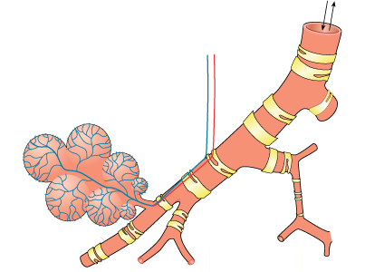
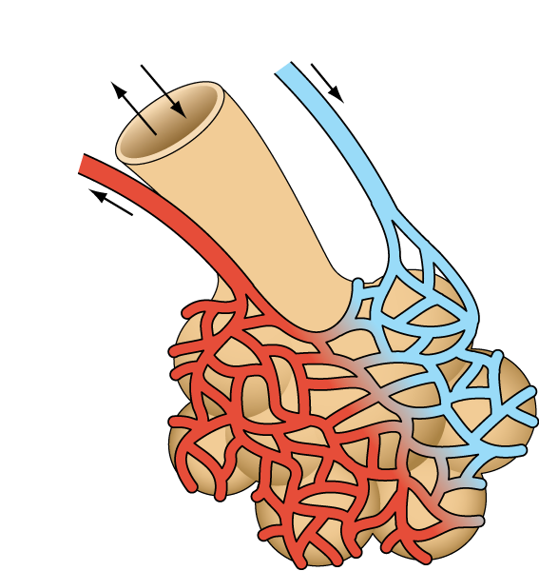
7 Gas exchange Key concepts
Gas Exchange
movement of air
cartilage bands hold airways open
deoxygenated blood passes through the capillary network around the alveoli
blood supply to alveoli
branch of pulmonary vein
alveoli
branch of pulmonary artery
capillary network
oxygenated blood leaves alveolus
bronchioles
as blood passes through the capillaries it becomes oxygenated
Next
© Hodder & Stoughton 2015

Slide 11
7 Gas exchange Key concepts
Questions
What are the features of the alveolus to help maximise the diffusion of gases between the bloodstream and the airway.
Thin walled. Permeable to gases. Large surface area. Moist internal surface.
What is a diffusion or concentration gradient?
A concentration gradient is the difference in concentration of molecules between two regions. One region has a high concentration and the other has a low concentration. Molecules diffuse from high to low concentration.
How is a steep diffusion gradient set up?
Air entering the alveolus has a higher concentration of oxygen. Blood in the capillary has a lower oxygen concentration. The blood flow is constant and the air in the alveoli is refreshed by inhalation and exhalation. The concentration gradient is maintained.
Answers
Next
© Hodder & Stoughton 2015

Slide 12
7 Gas exchange Key concepts
The table shows the composition of gases in inspired, alveolar and expired air.
Why is the percentage of nitrogen in exhaled air the same as that inhaled air?
Nitrogen does not move into the blood. Nitrogen diffuses into the alveoli from the atmosphere and is exhaled again.
Explain the difference in the percentages of oxygen in inspired, expired and alveolar air.
The percentage of oxygen in atmospheric air is about 20%. Only about 6% of this oxygen diffuses across the alveolus into the blood. The alveolar air contains the oxygen that is not taken into the blood. The percentage of oxygen in expired air is slightly higher because alveolar air mixes with inspired air that has a higher oxygen content.
What causes the saturation of the air with water vapour?
The water vapour that is exhaled has evaporated from the moist surfaces of the alveoli.
 | percentage of each gas present/%
 | inspired air | alveolar air | expired air
Oxygen | 20 | 14 | 16
Carbon dioxide | 0.04 | 5.5 | 4.0
Nitrogen | 79 | 81 | 79
Water vapour | variable | saturated | saturated
Answers
Next
© Hodder & Stoughton 2015

Slide 13
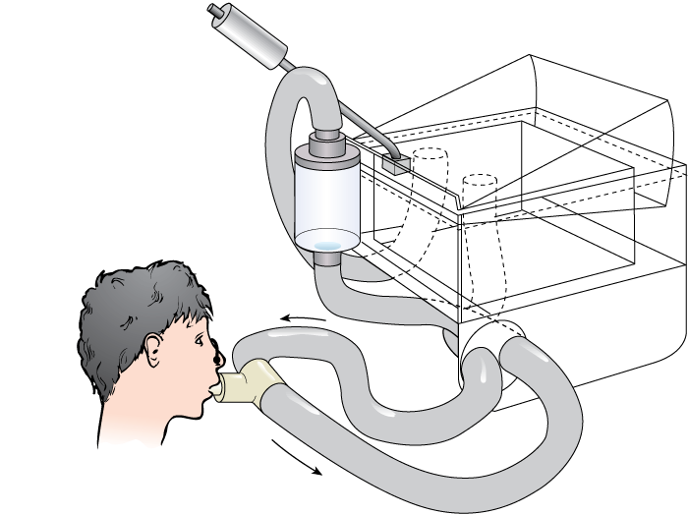
7 Gas exchange Key concepts
The volume of inhaled and exhaled air can be measured using a spirometer.
The subject wears a nose clip and breathes in and out of the mouthpiece.
The float moves up during exhalation. It moves down during inhalation.
The pen attached to the rotating disc creates a trace.
The apparatus can be used to measure different volumes of air moved in and out of the subject.
counterweight
floating chamber with medical-grade oxygen
soda lime absorbs carbon dioxide
nose clip
water-filled chamber
sterile mouthpiece
Next
© Hodder & Stoughton 2015

Slide 14
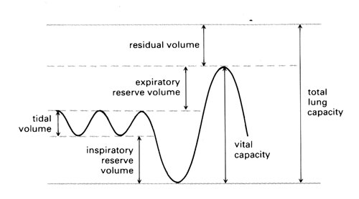
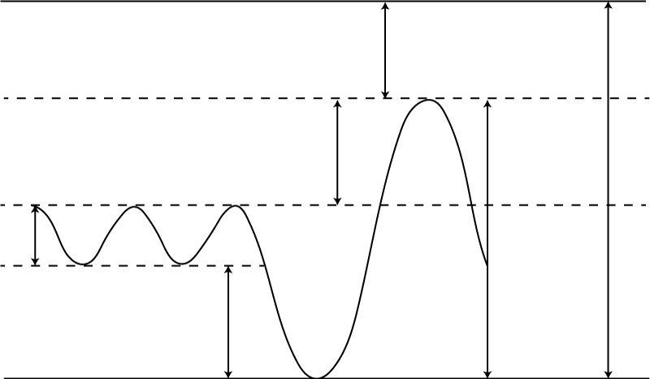
7 Gas exchange Key concepts
Click on the labels of the diagram to reveal more.
Residual volume is the air that is always trapped in the lungs.
residual volume
Total lung capacity is the vital capacity plus the residual volume.
Expiratory reserve volume is the volume of air that can be forcibly exhaled.
expiratory reserve volume
tidal volume
total lung capacity
vital capacity
Tidal volume is the volume of air breathed in and out during relaxed breathing.
inspiratory reserve volume
Inspiratory reserve volume is the volume of air that can be forcibly inhaled.
Vital capacity is the maximum volume that can be forcibly inspired and forcibly expired.
Next
© Hodder & Stoughton 2015

Slide 15
7 Gas exchange Key concepts
The graph shows the trace from a spirometer for a man who changes his activity over the 150 second period.
What is the tidal volume for the man when he is at rest?
How many breaths per minute does the man take when at rest?
What is the vital capacity for the man?
What is the total lung capacity of the man?
0.6 dm³
12
2.8 dm³
5 dm³
Answers
End

