Slide 1
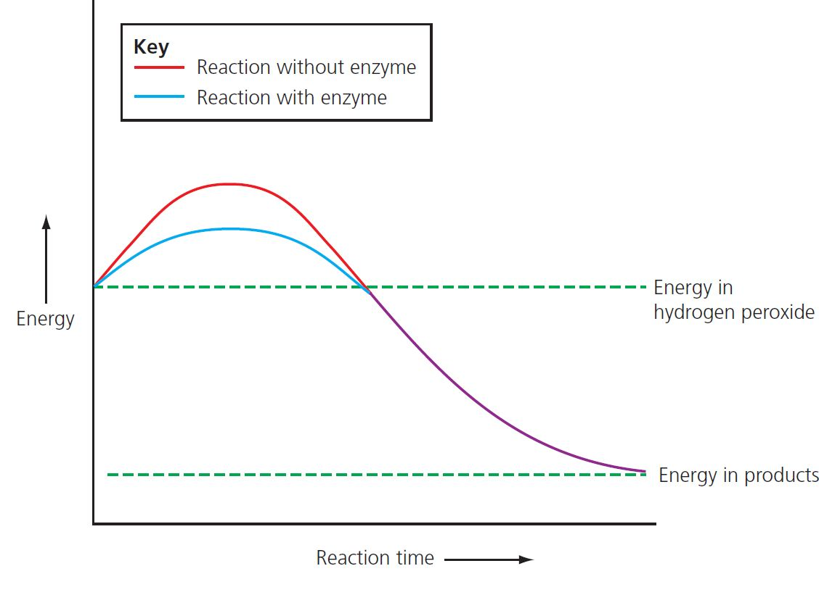
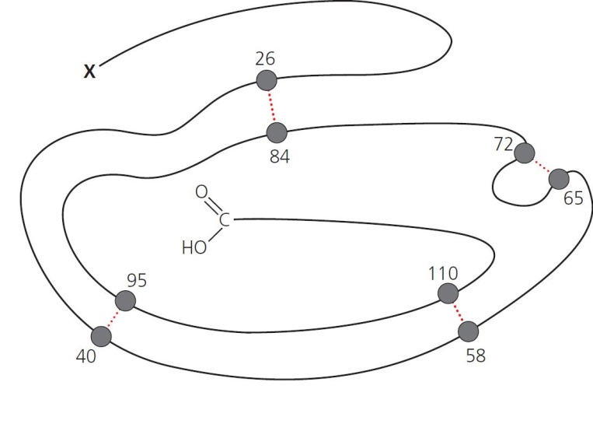
2 Enzymes Summary
Enzymes are biological catalysts
Enzymes are proteins
Enzymes reduce the activation energy.
Folding produces a specific active site.
Polypeptide chain – tertiary structure held in place by bonding.
© Hodder & Stoughton 2015

Slide 2
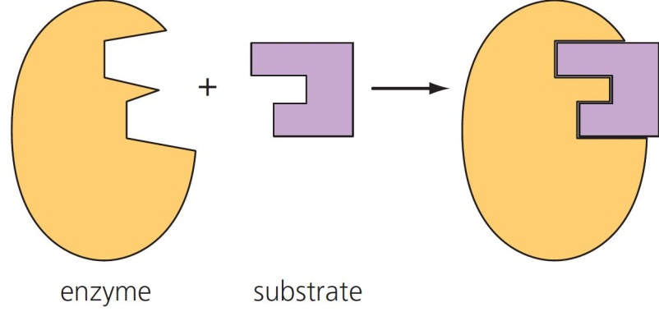
2 Enzymes Summary
Enzyme function: Lock and key hypothesis
Enzyme function: Induced fit hypothesis
© Hodder & Stoughton 2015

Slide 3
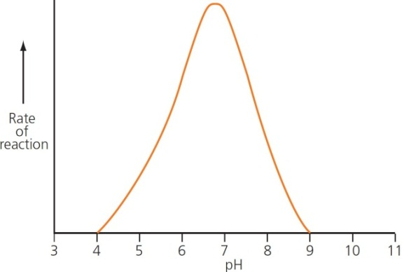
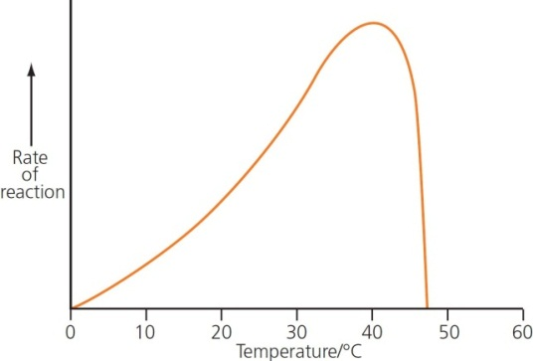
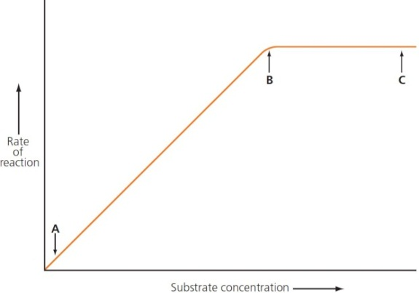
2 Enzymes Summary
Enzymes are affected by temperature
Enzymes are affected by pH
Changing the pH affects the charge on amino acids, so changing the active site.
Enzymes are denatured by high temperatures.
Enzymes are affected by substrate concentration
More substrate means a faster rate, until the active site is saturated and the rate levels off.
© Hodder & Stoughton 2015

Slide 4
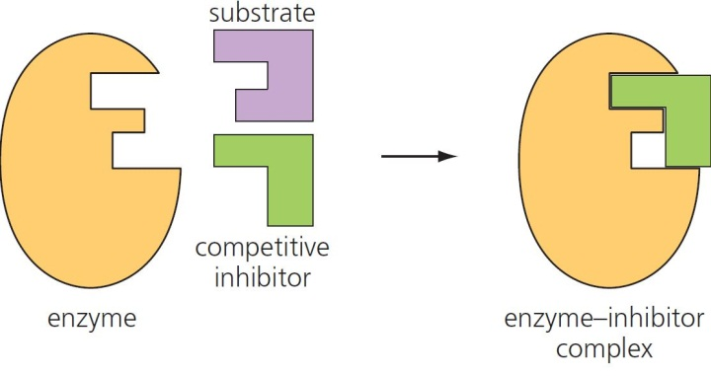
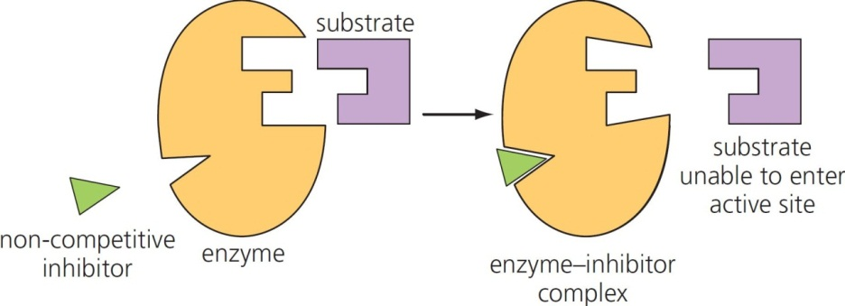
2 Enzymes Summary
Enzymes are affected by competitive inhibitors
The inhibitor competes with the substrate for the active site.
Enzymes are affected by non-competitive inhibitors
The inhibitor binds to a secondary site, altering the active site so that the substrate cannot bind.
© Hodder & Stoughton 2015

Slide 5
2 Enzymes Summary
Questions
How do enzymes catalyse reactions?
What is meant by the lock and key mechanism of enzyme action?
Describe the effects on enzymes of:
temperature
pH
enzyme concentration
substrate concentration.
Distinguish between competitive and non-competitive inhibitors
© Hodder & Stoughton 2015

