Slide 1
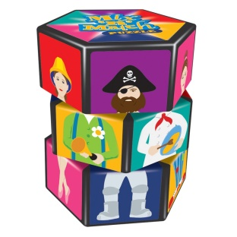
Mix and Match
Match the minimalism key words on the left with the correct description from the right.
Metamorphosis | Repeating a motif or pattern over and over again
Additive Melody | Continuous, uninterrupted sounds, long-held notes often in the bass
Looping | Moving a motif so that it becomes out of sync with the original
Isorhythmic Overlap | Extending a motif by the gradual addition of extra notes
Augmentation | Performing the motif backwards
Diminution | Sound is heard from one speaker and not the other
Retrograde | Changing the intervals to opposites between notes of a motif
Inversion | Combining two motifs or patterns of different lengths
Retrograde Inversion | Two or more different rhythms performed simultaneously
Drones | Performing the inverted motif backwards
Polyrhythms | Lengthening a motif by doubling the note values
Panning | Changing a motif by the gradual alteration of the pitches of notes
Phase Shifting | Shortening a motif by halving the note values
© WWW.MUSICALCONTEXTS.CO.UK

