Slide 1
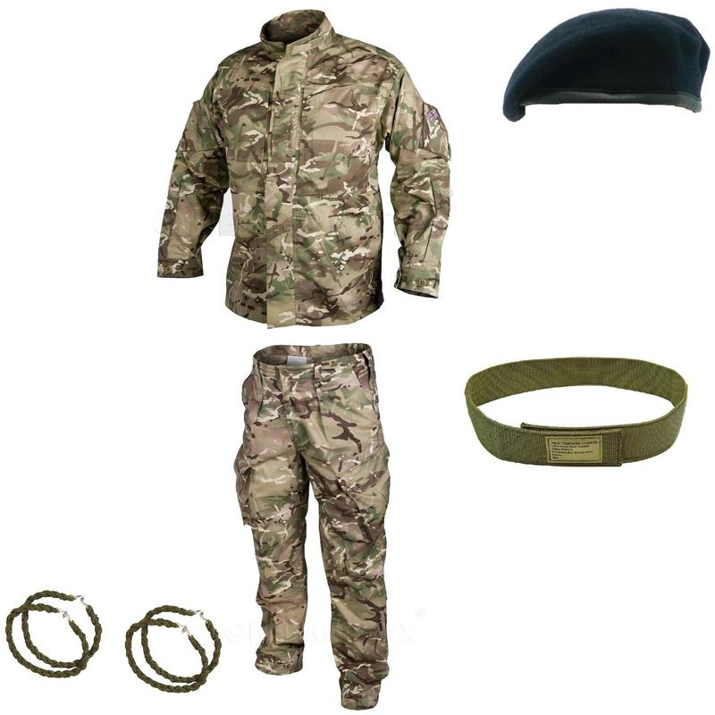
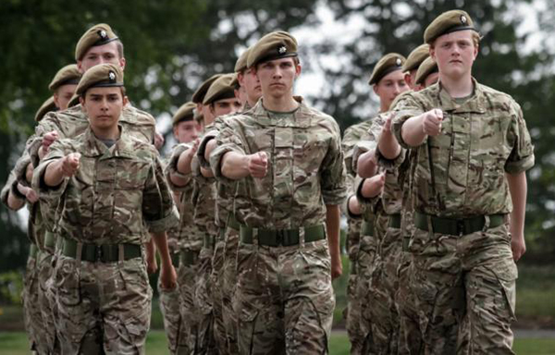
How to Wear your Uniform Correctly

Slide 2
To start with…
Please put on your:
CCF Trousers
CCF Green under t-shirt
DISCIPLINE: It is your responsibility to listen to these instructions and be able to follow them at home. It isn’t your Mum/Grannie/Ex Reg parent/butler’s responsibility to do this for you.
NB the uniform fabrics have changed over time, and so have these instructions.

Slide 3
Trousers
Trousers should be ironed but should not have creases down the middle. If you have new trousers, these central creases need to be ironed out.
Pockets should be pressed flat and fastened closed.
Trouser ties must be drawn so the bottom of the trousers look neat, this be be achieved rolling under can help hide the lace and end of the trouser (making sure trousers cover over the top of your boots)
Any laces (boot or trouser ties) must be hidden out of sight. Safety pins can help here but make sure they cannot be seen from the outside.
Twistees can also be used as an easier method however, they don’t work as well

Slide 4
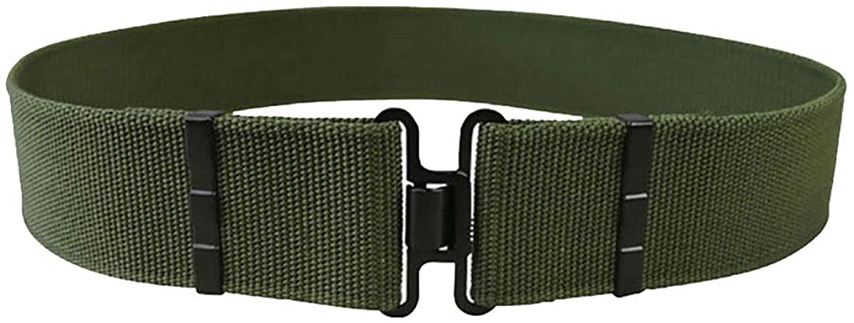
Belts
Belt must be tight and slides pushed to the centre as far as possible (not like the picture below). Ends are folded to the inside.
Male part (hook) on the right, female on the left.
You can use a hot knife/lighter to gently deal with any frayed ends.
If your belt ends are already frayed, let us know now and we can fix it.

Slide 5
Under T-shirt
Must be tucked in
This is an under t-shirt
It is not to be seen during the normal working day around school or in any lessons.
On rare occasions we may say you can remove other layers if the weather is very hot, this is only likely to happen during CCF training.
You may wear other t-shirts under your shirts but these must be entirely plain, of a similar colour so as not to stand out, and free of any slogans or logos or offensive words.

Slide 6
Jacket
Jacket (looks like a shirt) must be tucked in with the creases gathered at the side
Notepads and pencil should also be in left pocket on your chest
Sleeves are to be folded (not just rolled) neatly with a 3-finger width
Sleeves are much easier to fold when you are not wearing the jacket
The fold should not extend above the bottom corner of the blanking plates
Once folded correctly, ironing them down help to hold their shape

Slide 7
Collar & Blanking Plates
Collar must be ironed flat with lower edge parallel to the top of chest pockets
The collar must also meet centrally forming a 90-degree angle
EC CCF badge (blue circle) needs to be sewn onto the blanking plate with the Union flag. Identify the centre of the EC badge. This should be underneath and aligned with the line in the centre of the flag
The Union flag goes at the top and on the left sleeve
The blank blanking plate is for your CCF achievements and goes on the right sleeve.

Slide 8
Smocks
Smock (looks like a jacket) can be worn in the case of bad weather
A ‘waist’ should be formed by using the laces inside, these can simply be tied into knots on either side (make sure you’re able to adjust them)
The bottom must be tied and tucked under to form a ‘skirt’.
The hood should be neatly rolled. You may need to help each other.
All pockets should be fastened

Slide 9
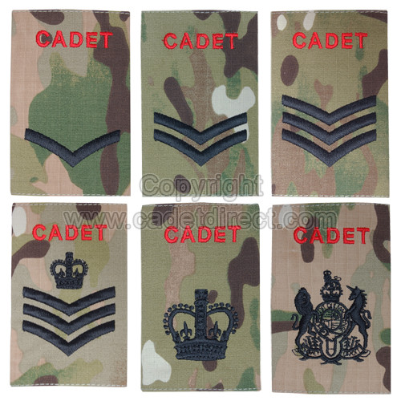
Rank Slides and Name badges
Rank slide must be worn with ‘Cadet’ at top on the outermost layer
If you only have one, it must be changed when you swap between jacket/smock
Name badges are worn on the outermost layer, above left chest pocket

Slide 10
Hair and beards
Before Friday, all cadets need to be clean shaven
This may mean some of you need to shave every Thursday evening, or even every Friday morning.
Whilst College regulations state that hair must be neat and clear of eyes…
MOD regulations also apply as per information given when signing up for CCF.
For male cadets this includes that hair must be off the collar and of a natural colour.
For female cadets, hair must be tied back. EC CCF Female cadets are strongly encouraged to wear a neat bun with a hairnet to match the hair colour, for safety reasons.

Slide 11
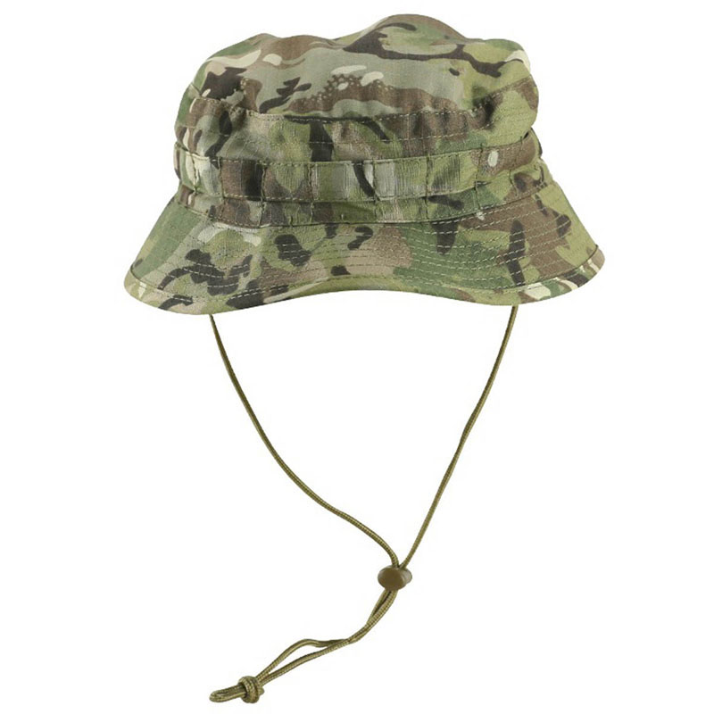
Head dress
Head dress includes bush hats or beret.
Wearing our head dress is an essential part of representing His Majesty the King. Wear it with pride.
You must always wear your head dress when travelling to/from school, outside around school in the day and when on parade. If there is nothing above your head, put your head dress on.
If you wear a helmet (cycle or motorcycle) put your head dress on the moment you remove your helmet.
All head dress is to be kept on you at all times, even when you have taken it off. Head dress is never to be the object of silly play.
Neck strap does not have to be worn under the chin.

Slide 12
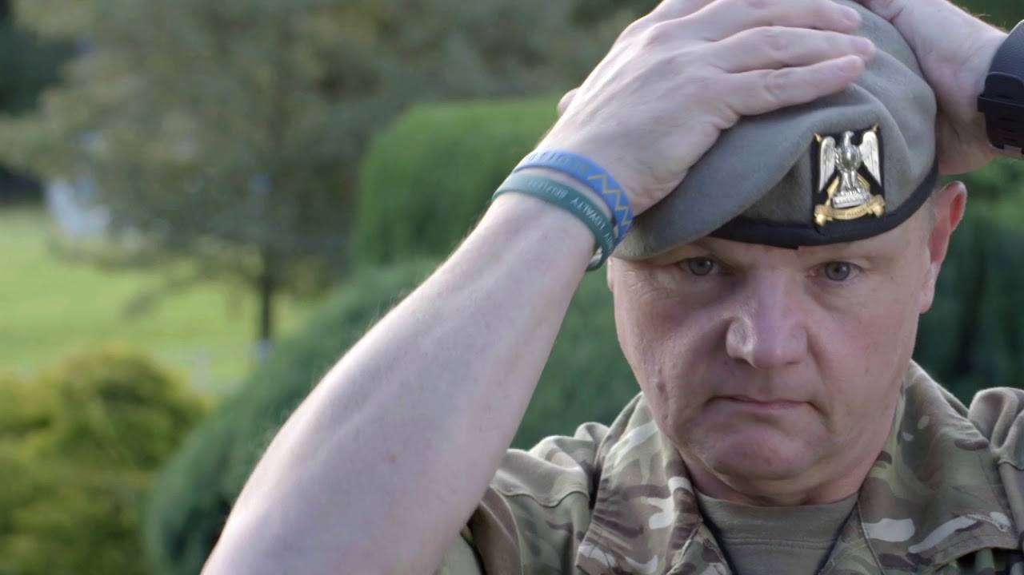
Berets
Elizabeth College CCF Berets will be awarded to cadets who have passed their basic assessments.
The aim is to achieve these by the end of term. With hard work and following the instructions given to you, you will achieve this.
PWRR Army Berets are awarded to Army Seniors upon successful completion of their recruit year, following attendance and participation at Annual Camp and October Training.
Berets can be moulded using warm and cold water, taking care not to get the leather band wet.
https://www.youtube.com/watch?v=M9YJbt_SHAc

Slide 13
Boots
Comfortable socks should be worn below to support your foot (especially in new boots). Some of you may need a second (thinner) pair as well as your thicker warmer ones.
Laces must be secure and as tight as comfortable (the end of the laces should be tucked under or round the lips of the boots
Boots must be polished sufficiently every week with no scuffs from playing football etc.
You need to add at least one but preferably more layers of good quality polish to your boots every week to build up greater water-resistance.

Slide 14
Now check
Check your kit fits – boots cannot be exchanged once they have been worn outside. Now is the only time to exchange boots.
Other kit should fit if your sizing chart is correct. If kit does not fit, see Lt Mitchinson.
Times for kit exchange are Mon, Wed or Thurs breaktime or lunchtime.
LC girls may make alternative appointments directly with the SSI by communication via email.

Slide 15
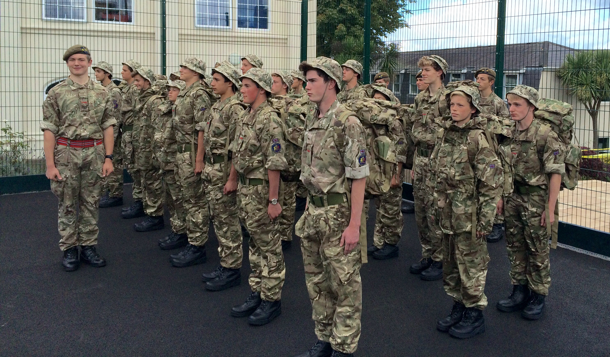
Buddy Buddy System
It is always worth checking over each other’s uniform before going onto the parade square.
Go from head to toe checking that everything on this PowerPoint is achieved to an acceptable standard

