Slide 1
Subcellular Organelles
3 Cells Key concepts
Next
© Hodder & Stoughton 2015

Slide 2
3 Cells Key concepts
Animal Cells
When viewed under a light microscope, the nucleus is the only part of an animal cell that can be seen clearly. With an electron microscope, a whole range of different organelles are visible within the cytoplasm.
Next
© Hodder & Stoughton 2015

Slide 3
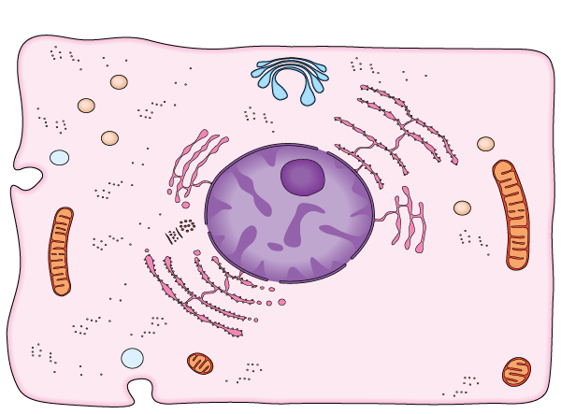
3 Cells Key concepts
Animal Cells
Click on each hotspot to find out more about each organelle. There are nine in total.
nucleus enclosed by nuclear envelope
rough endoplasmic reticulum transports proteins
smooth endoplasmic reticulum involved in making lipids
lysosome contains powerful lytic enzymes
Golgi apparatus processes and packages proteins
mitochondrion is the site of aerobic respiration
cell surface membrane controls the materials entering and leaving the cell
ribosomes are the site of protein synthesis
vesicle forming in cell surface membrane
Reveal
Next
© Hodder & Stoughton 2015

Slide 4
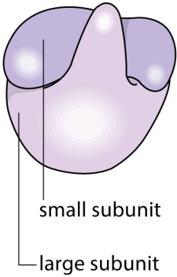
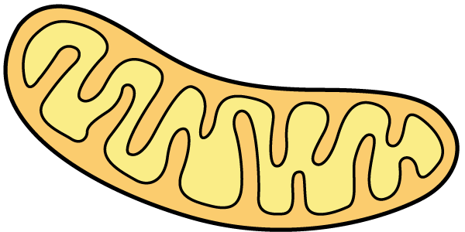
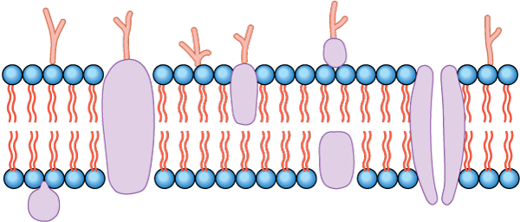
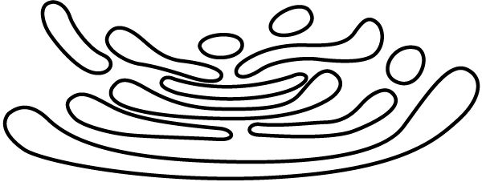
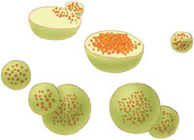
3 Cells Key concepts
The organelles inside the nucleus are bounded by membranes. They form enclosed compartments. The conditions (e.g. pH) inside the compartments may vary. Each organelle has a specific function.
Match the picture of the organelle on the left with its function on the right.
Composed of phospholipid molecules and proteins. Forms a boundary around the cell. It controls movement of materials in and out.
Small, spherical organelles containing hydrolytic enzymes. Created by the Golgi apparatus. They are prominent in phagocytes.
Tiny organelles (25nm in diameter) which are not membrane bound. Consist of two subunits. Found in vast numbers in cells. The site of protein synthesis.
A stack of flattened sacs like a pile of plates. Hormones and enzymes are synthesised and packed into the vesicles.
Length up to 10 µm. Found in virtually all cells. Have a double membrane: the inner one is highly folded. Play a role in aerobic respiration.
Answers
Next
© Hodder & Stoughton 2015

Slide 5
3 Cells Key concepts
Plant Cells
Plant cells have a cellulose cell wall. This gives them a fixed shape. Plant cells are usually larger than animal cells. Under the light microscope the nucleus and chloroplasts are visible.
The cytoplasm contains many organelles which are also found in animal cells.
Next
© Hodder & Stoughton 2015

Slide 6
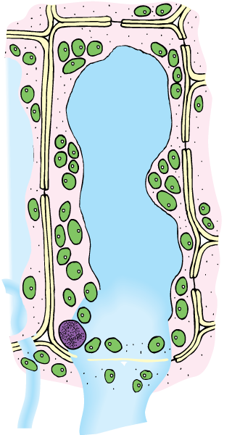
3 Cells Key concepts
Plant Cells
Click on each hotspot to find out more about each structure and its role in the plant cell. There are seven in total.
chloroplast contains chlorophyll to absorb light energy for photosynthesis
cell surface membrane lies next to the cell wall
cellulose cell wall enables the plant cell to expand and not burst when water enters
tonoplast is the membrane enclosing the vacuole
mitochondrion contains the enzymes for aerobic respiration
middle lamella is a layer of pectin holding adjacent cells together
plasmodesmata are cytoplasmic bridges between adjacent plant cells
Reveal
Next
© Hodder & Stoughton 2015

Slide 7
3 Cells Key concepts
Add the organelles below into the correct gaps in the table.
chloroplast centriole rough ER nucleolus
mitochondria ribosomes
chloroplast
centriole
nucleolus
rough ER
mitochondria
ribosomes
The organelles of photosynthesis
Responsible for organising the spindle
Present inside the nucleus
Collects and packages proteins
Carry out aerobic respiration
Assist with the formation of proteins
Answers
Next
© Hodder & Stoughton 2015

Slide 8
3 Cells Key concepts
Questions
Which organelles are only present in plant cells but not animal cells?
Chloroplasts, centrioles
Which organelles are not membrane bound?
Ribosomes
Answers
Next
© Hodder & Stoughton 2015

Slide 9
3 Cells Key concepts
Prokaryotic and Eukaryotic Cells
Plant and animal cells are eukaryotic. Eukaryotic means having a ‘true nucleus’. Eukaryotes have a cell membrane and membrane bound organelles. Prokaryotic cells lack a nucleus and other membrane bound organelles. Bacteria are prokaryotic.
Next
© Hodder & Stoughton 2015

Slide 10
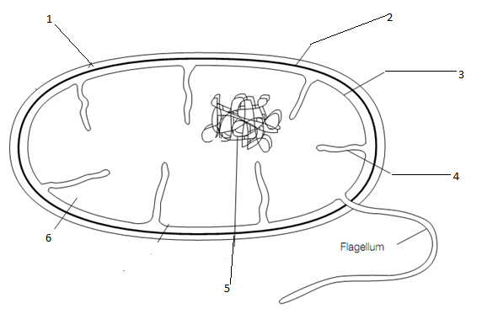
3 Cells Key concepts
Prokaryotic and Eukaryotic Cells
Click on each number to see the information about the structure and function.
capsule provides an outer protective layer
cell wall composed of peptidoglycan
cell membrane has the same composition as eukaryotic membrane
mesosome is an infolding of the cell membrane. This helps DNA move during cell division.
cytoplasm contains small ribosomes and enzymes
naked DNA present as a single looped structure
Next
© Hodder & Stoughton 2015

Slide 11
3 Cells Key concepts
Questions
How does prokaryotic DNA differ from eukaryotic DNA?
DNA in prokaryotes is a circular structure.
It has no associated proteins.
It is not divide up into individual chromosomes
How does the cell wall of a prokaryote differ from a plant?
Bacterial cell walls are composed of peptidoglycans. Plant cell walls are made of cellulose.
What is the role of the flagellum?
Flagella are used for locomotion.
Answers
Next
© Hodder & Stoughton 2015

Slide 12
3 Cells Key concepts
Comparing Prokaryotic and Eukaryotic Cells
Prokaryotic cells tend to be much smaller and simpler than those of eukaryotes. They do not have many of the eukaryotic structures. There are some structures which are present in both.
Next
© Hodder & Stoughton 2015

Slide 13
3 Cells Key concepts
Add the terms below into the correct gaps in the table.
Absent Chloroplasts 30nm in diameter
Made of peptidoglycans 20nm in diameter Present
Structure | Prokaryotic Cell | Eukaryotic Plant Cell
Ribosome
 | Absent | Present
Cell surface membrane |  | Present
Nucleus |  | Present
Cell wall |  | Made of cellulose
20 nm in diameter
30 nm in diameter
Chloroplasts
Present
Absent
Made of peptidoglycans
Answers
End
© Hodder & Stoughton 2015

