Slide 1
12 Species and taxonomy Summary
Systems of classification
3 domains
Eukarya
Archaea
Bacteria
Kingdom
Phylum
Class
Order
Family
Genus
Species
Species: organisms of the same species are able to breed together and produce fertile offspring.
© Hodder & Stoughton 2015

Slide 2
12 Species and taxonomy Summary
Binomial naming
All organisms are named using a binomial system:
Generic name
Specific name
Crataegus monogyna
© Hodder & Stoughton 2015

Slide 3
12 Species and taxonomy Summary
Classification based on DNA sequence
The DNA nucleotide sequences from different species can be compared.
© Hodder & Stoughton 2015

Slide 4
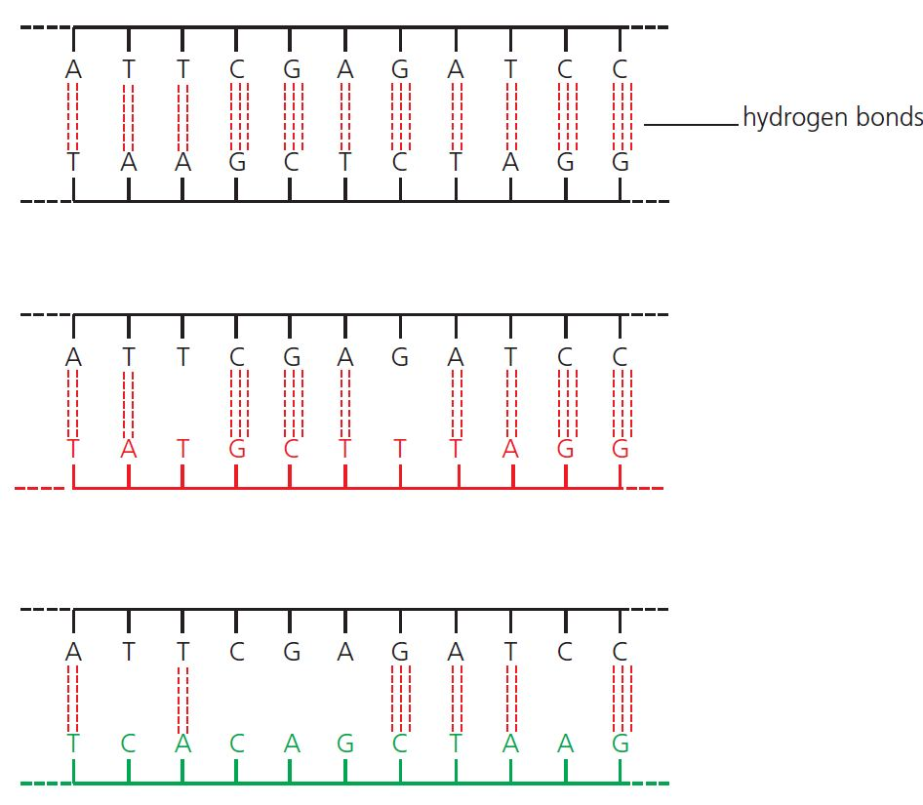
12 Species and taxonomy Summary
Classification based on DNA hybridisation
The DNA of two different species is split by heating and then cooled so that complimentary bases of the two species join. The more similar the species, the more binding occurs, so the more stable is the hybrid DNA.
Species A
Species A + B hybrid DNA
Species A + C hybrid DNA
© Hodder & Stoughton 2015

Slide 5
12 Species and taxonomy Summary
Classification based on proteins
The amino acid sequences from the proteins of different species can be compared.
© Hodder & Stoughton 2015

Slide 6
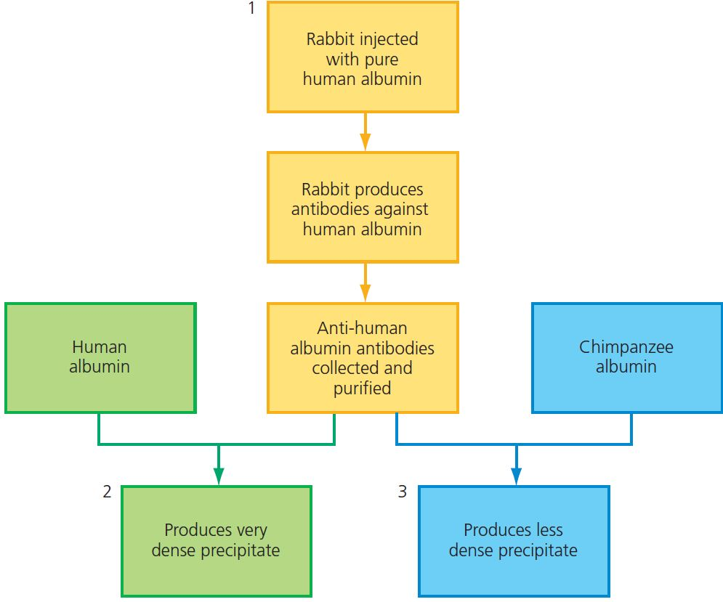
12 Species and taxonomy Summary
Classification based on immunology
Antibodies are produced against a protein for species A. The antibodies are then added to protein from species B and C The more clotting, the closer the relationship.
© Hodder & Stoughton 2015

Slide 7
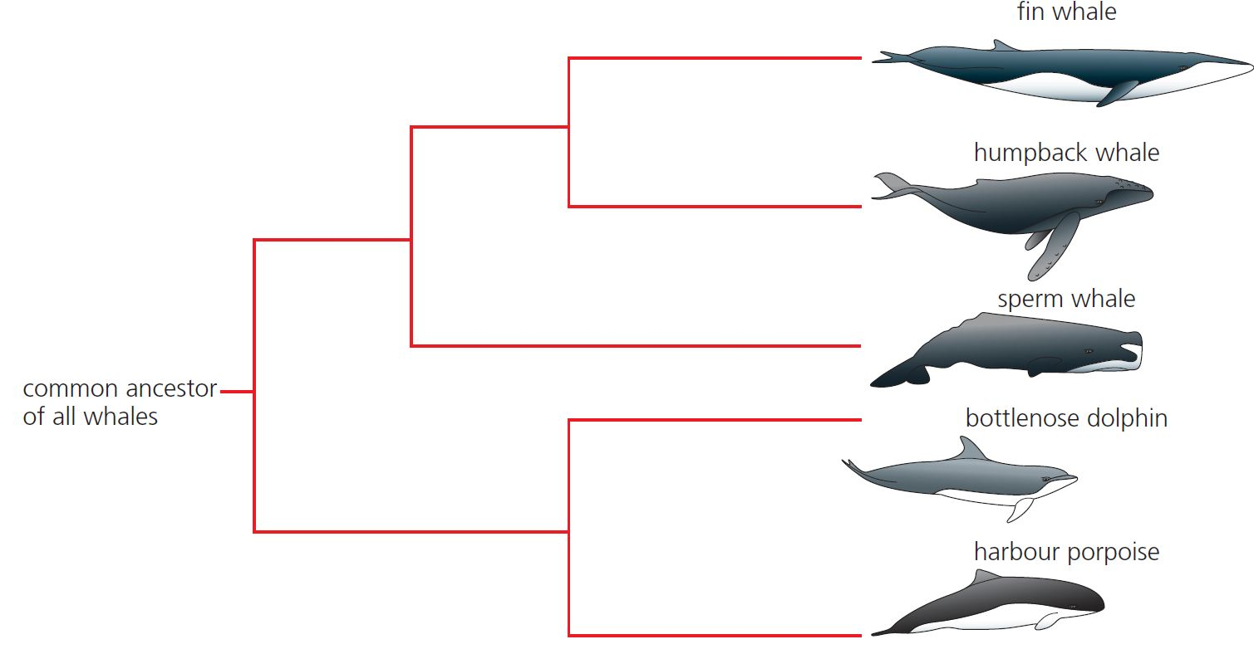
12 Species and taxonomy Summary
Phylogenetic trees
The similarities between different species can be shown on a branching diagram.
© Hodder & Stoughton 2015

Slide 8
12 Species and taxonomy Summary
Questions
Why is it sometimes difficult to determine a species?
What defines the Eukarya?
Name the genus of the Ruddy duck (Oxyura jamaicensis).
Explain how the stability of hybrid DNA could be established.
Explain why immunological clotting occurs with antibodies of a similar species.
© Hodder & Stoughton 2015

