Slide 1
Notes:
Read each heading – compare to their answers

Slide 2
Naval Ethos and Core Values
Welcome
Notes:
1. Read out
Naval Ethos and Core Values
Welcome

Slide 3
Aim
“To enable Cadets to understand Naval Ethos and the
Core Values of the Royal Navy whilst in the
Combined Cadet Force(CCF)”.
Notes:
Read out
“To enable Cadets to understand Naval Ethos and the
Core Values of the Royal Navy whilst in the
Combined Cadet Force(CCF).”

Slide 4
Objectives
Ethos Statement
Royal Navy Core Values
Example of Core Values used in Action
Summary
Questions.
Notes:
1. Read out
Ethos Statement
Royal Navy Core Values
Example of Core Values used in Action
Summary
Questions.

Slide 5
Royal Navy Ethos
The enduring spirit derived from our people’s loyalty to their ship, unit or team sustained by high professional standards and strong leadership, that gives us courage in adversity and the determination to fight and win”.
“The “Can Do” Attitude.
Notes:
1. Read out

Slide 6
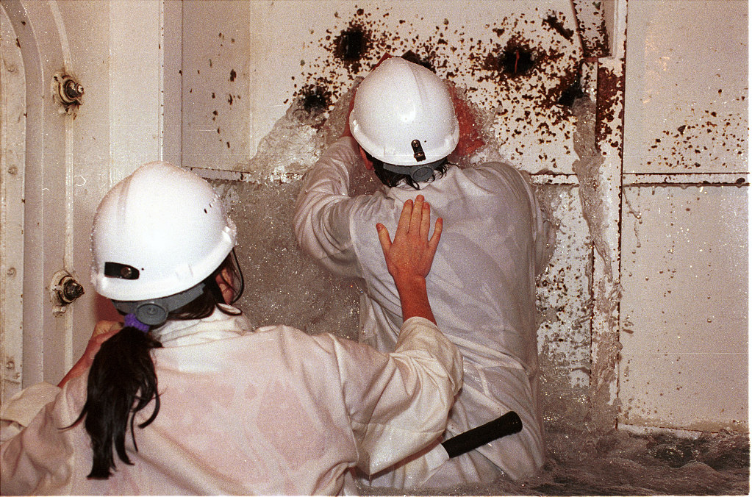
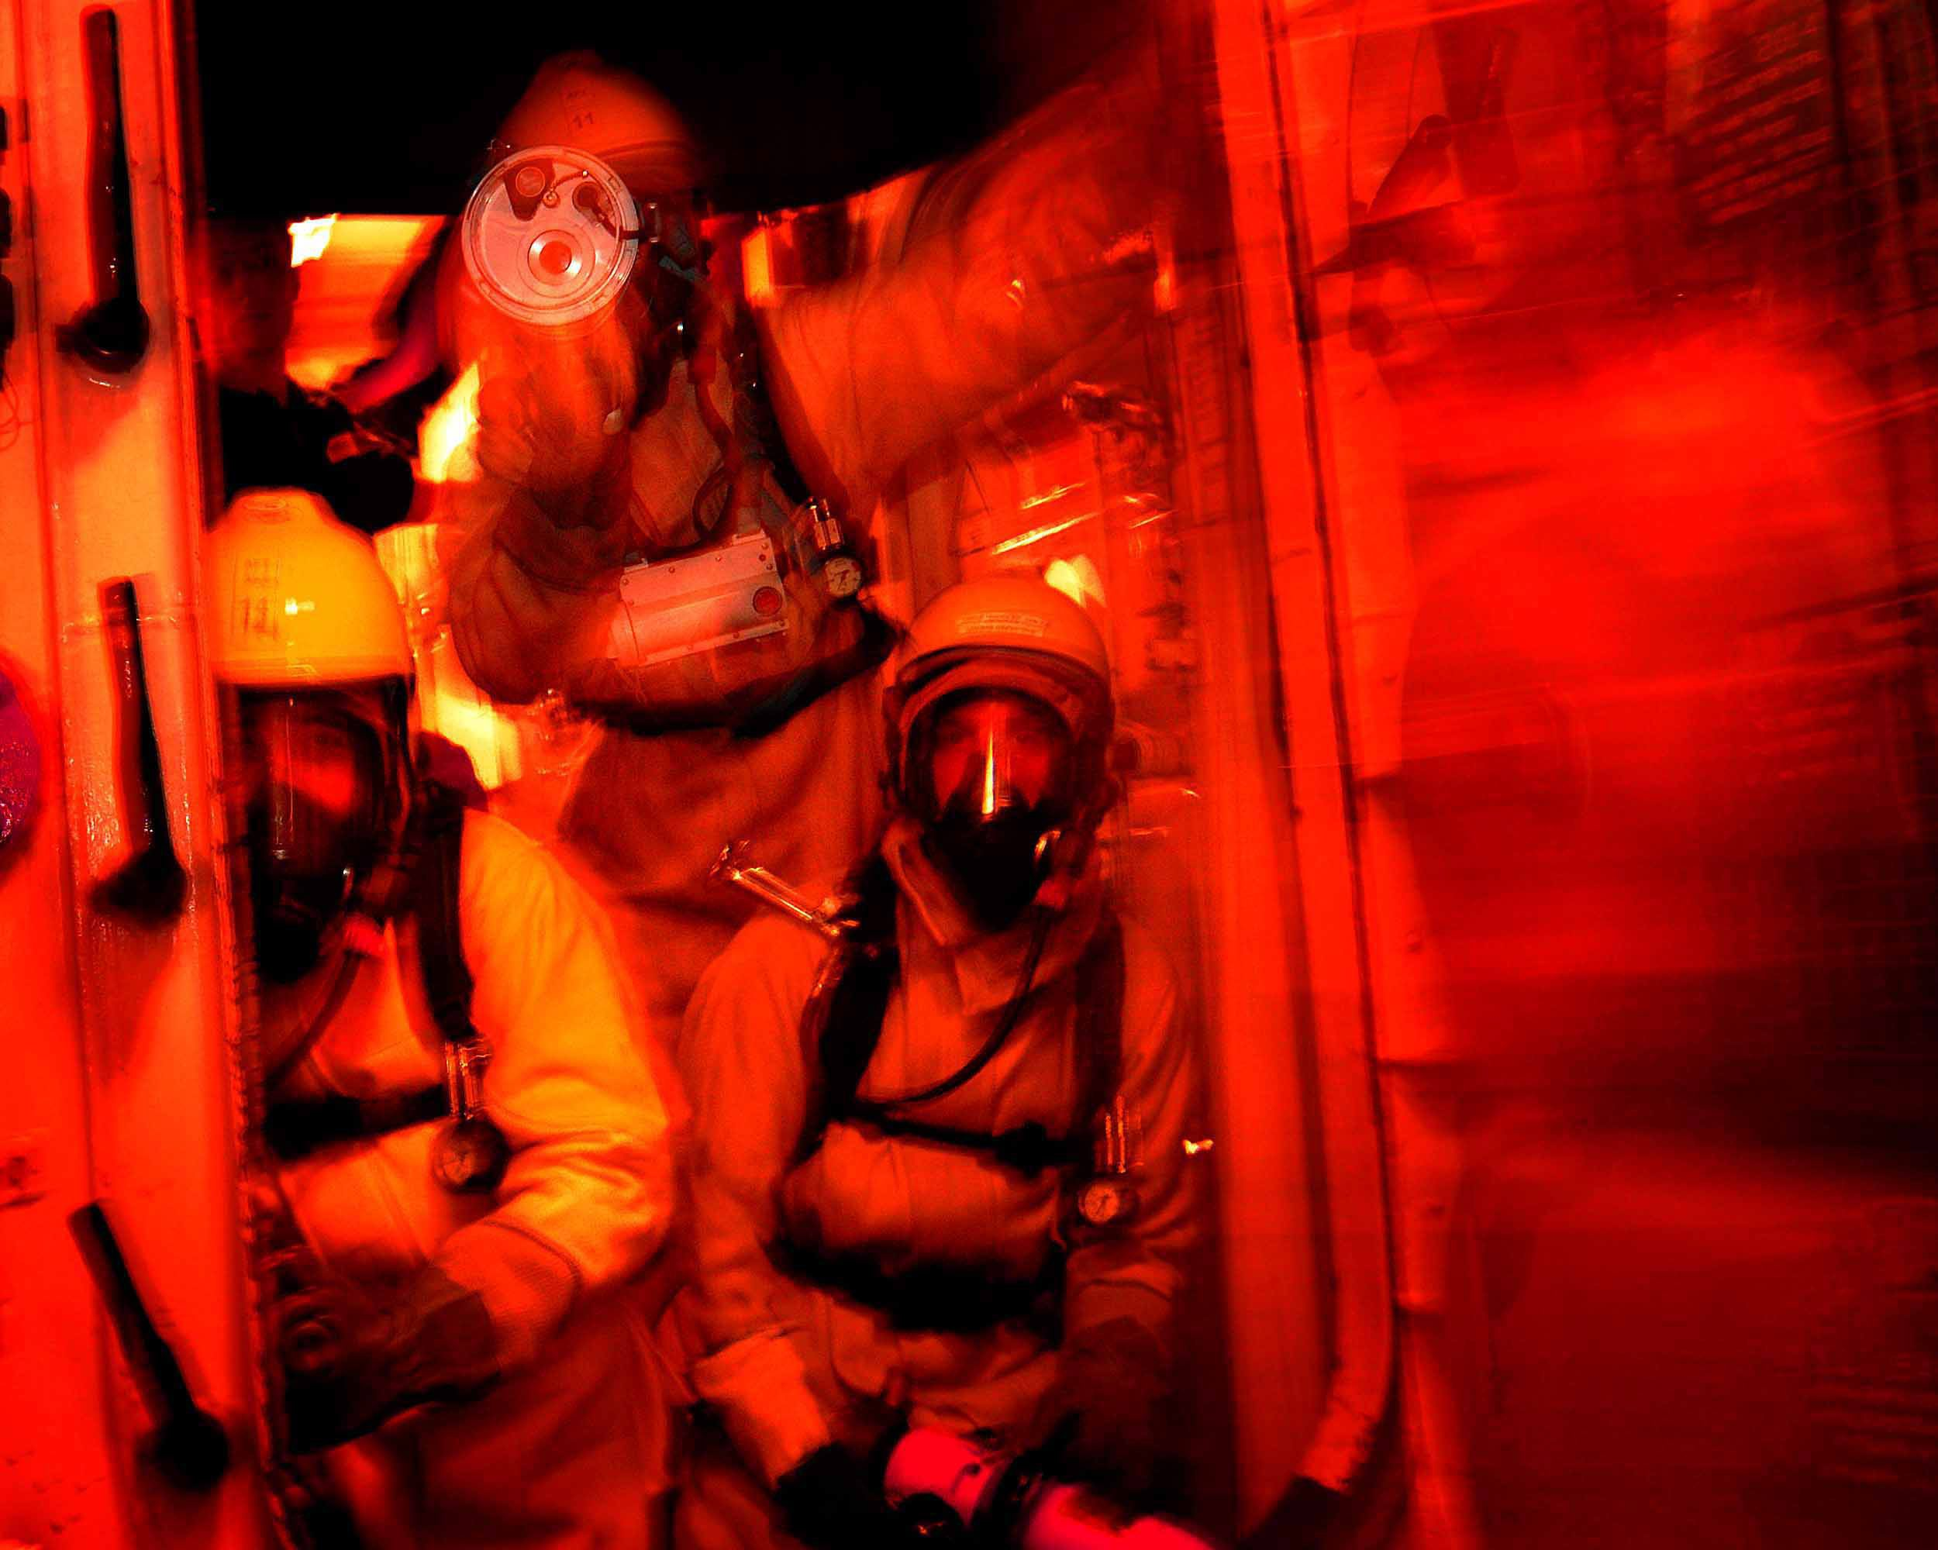
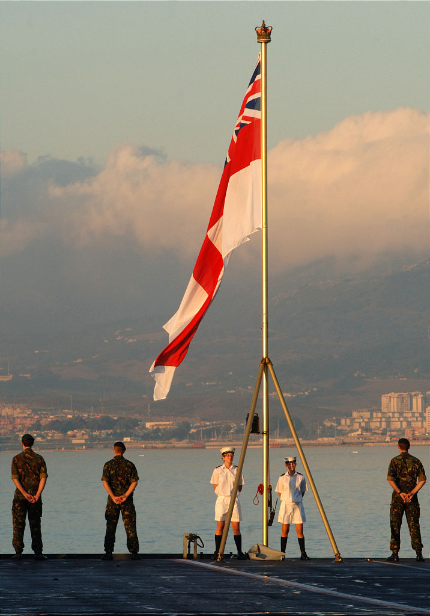
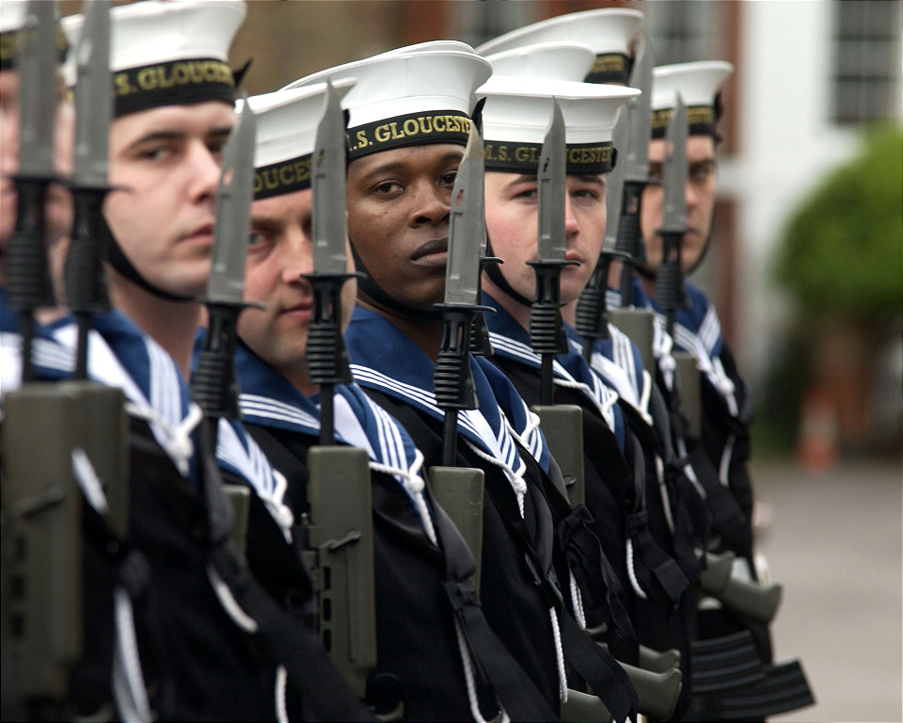
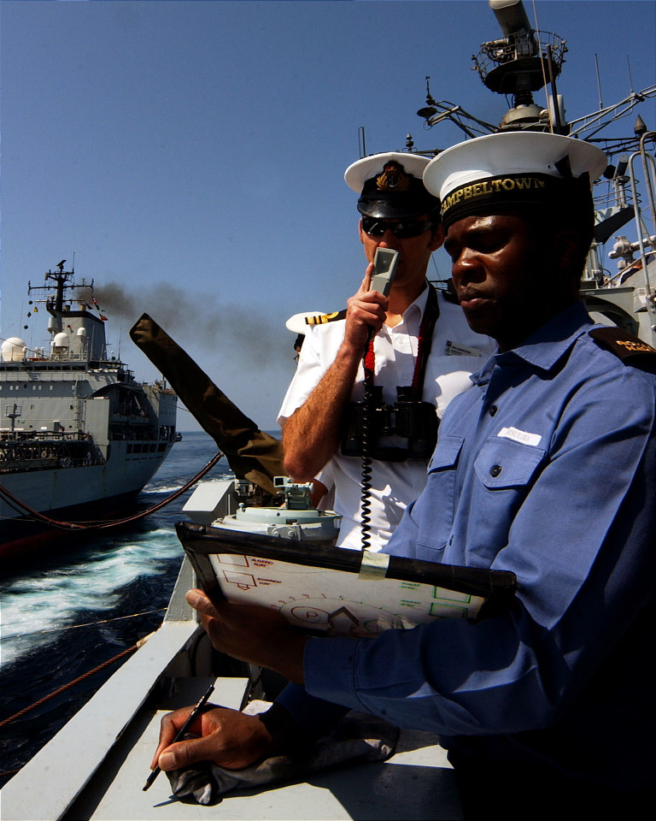
Royal Navy Core Values
Commitment
Courage
Discipline
Respect
Integrity
Loyalty
C2DRIL
Notes:
1. Read out – Explain each value will be looked at individually

Slide 7
Commitment
Selfless personal commitment
Serve whenever and wherever we are required and deliver to the highest standards
Put the needs of the mission and of our team ahead of our own interests.
Notes:
1. Read out – discuss how this transpires across into the CCF and their unit

Slide 8
Courage
Courage creates the strength on which fighting spirit depends which is an essential element of a fighting force
Physical courage to carry on with our task regardless of danger and discomfort
Moral courage always to do what we know is right.
Notes:
1. Read out – discuss how this transpires across into the CCF and their unit

Slide 9
Discipline
The RN must be a disciplined service to be effective
We must obey all lawful orders from our superiors
Self-discipline - ability to discipline ourselves earns respect and trust and helps cope with difficult individual decisions.
Notes:
1. Read out – discuss how this transpires across into the CCF and their unit

Slide 10
Integrity
Integrity encompasses honesty, sincerity, reliability, and unselfishness
Essential requirement of leadership and comradeship
Unless we maintain our integrity, others will not trust us, and the teamwork will suffer.
Notes:
1. Read out – discuss how this transpires across into the CCF and their unit

Slide 11
Loyalty
The Nation, RN and those with whom we serve rely on our commitment, dedication and support
We must therefore be loyal to our leaders, those that we lead, our team, and our duty
Pass this test and we will never let others down.
Notes:
1. Read out – discuss how this transpires across into the CCF and their unit

Slide 12
Respect for Others
We will sometimes have to live and work under extremely difficult conditions
Imperative we show the greatest respect, tolerance and compassion for others - teamwork depends on it
We have the fundamental right to expect to be treated with the same degree of respect and dignity by all.
Notes:
1. Read out – discuss how this transpires across into the CCF and their unit

Slide 13
Name the Core Values
Notes:
1. Ask class to state Core Values (quiz can be created)

Slide 14
Royal Navy Core Values
Commitment
Courage
Discipline
Respect
Integrity
Loyalty
C2DRIL
Notes:
1. Get class to give verbally what the Core Values are as a recap

Slide 15
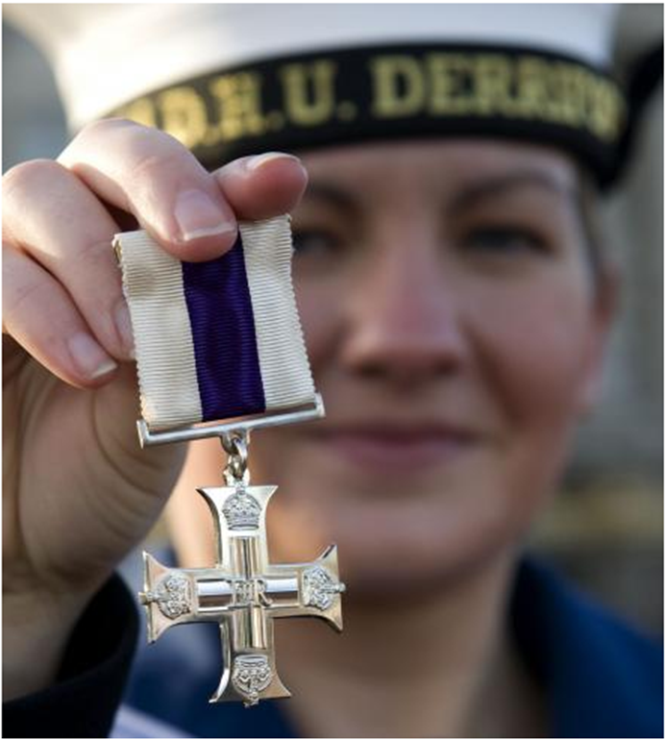
MA Kate Nesbitt – Military Cross
Notes:
1. Explain this is just one situation where a member of the military has displayed the Core Values

Slide 16
MA Kate Nesbitt
Kate Louise Nesbitt MC
Pharmacy Technician
First Female Member in the RN
Afghanistan, March 2009
Recognition of Exemplary Gallantry
during Active Service.
Notes:
Read out
'Kate Louise Nesbitt MC is a pharmacy technician in the Royal Navy. Nesbitt was the first female member of the Royal Navy, and the second woman in the British Armed Forces, to be awarded the Military Cross. The award was a result of her actions in Afghanistan in March 2009. This award is given in recognition of exemplary gallantry during active service.

Slide 17
12th March 2009
On 12th March 2009 while under fire from Taliban Forces, Nesbitt administered emergency medical treatment which saved the life of Lance Corporal John List, a 22-year-old Soldier of 1st Battalion, The Rifles.
On that day, List’s unit was undertaking a 5-day operation securing areas for forthcoming elections. In the mid-afternoon, during a Taliban ambush and ensuing gun-battle, List was shot in the neck.
Nesbitt, on being informed by radio of a “Man Down” and the location, ran 60 to 70 metres under fire and found List struggling to breath as, the bullet had gone through his top lip rupturing his jaw and came out of his neck.
Notes:
1. Read out or let class read to themselves

Slide 18
12th March 2009 Cont.
Nesbitt administered First Aid for around 45 minutes, stemming the blood loss and providing List with another airway.
During treatment they were subjected to gun and rocket fire from the Taliban Forces. Later List was Air lifted to Hospital.
Nesbitt returned from Afghanistan 3 weeks after the ambush at the end of her tour.
Nesbitt next met List back in England in May 2009 at a Medals Parade. This was the first time List was able to speak and thanked Nesbitt.
Notes:
1. Read out or let class read to themselves

Slide 19
MA Kate Nesbitt – Citation
'Nesbitt’s actions throughout a series of offensive operations were exemplary; under fire and under pressure her commitment and courage were inspirational and made the difference between life and death. She performed in the highest traditions of her service.'
Notes:
Read out or let class read to themselves
1- Discuss what elements of C2dril she displayed during her actions

Slide 20
Summary
Ethos Statement
Royal Navy Core Values
Example of Core Values used in Action
Summary
Questions.

Slide 21
Questions

Slide 22
Notes:
Read each heading – compare to their answers

