Slide 1
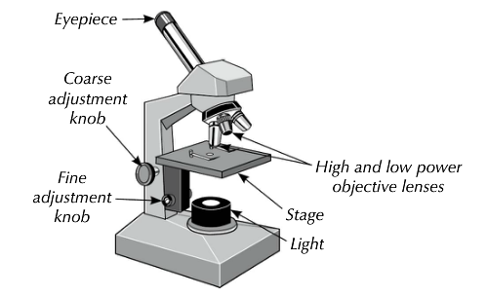
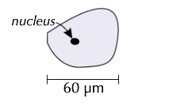
Required practical 1: Using a light microscope
Briefly describe the method for preparing an onion slide
State 2 advantages of an electron microscope compared to a light microscope
2
Write the following in standard form
0.025
0.004
0.0000006
3
Estimate the size of the nucleus
5
7

Slide 2
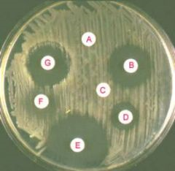
Required practical 2: Antibiotics (Triple Only)
Briefly describe the different aseptic techniques involved in plating
8mm
3mm
14mm
4
Why are agar plates grown at a maximum of 25°C in schools?
Evaluate the effectiveness of the antiseptics and explain why?
2
Calculate the area of agar cleared by antiseptics D, E and G.
5
7

Slide 3
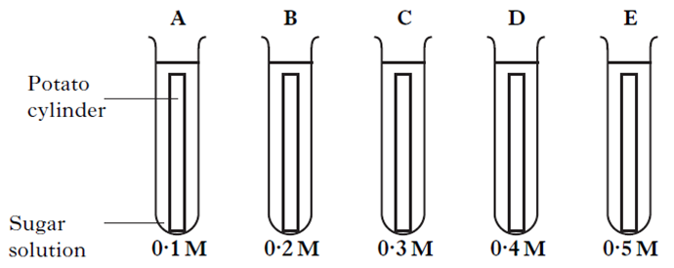
Required practical 3: Osmosis practical
State what is meant by osmosis
2
Draw a sketch of expected results, with ‘Change in mass in g’ on the y-axis against ‘Concentration of sugar solution’ on the x-axis.
Identify two control variables in the experiment
3
5
Write a detailed conclusion for the experiment
7

Slide 4
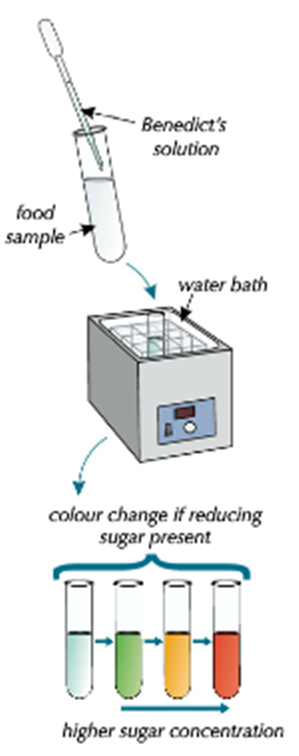
Required practical 4: Food Tests
What is the name of the test for sugar, protein, lipids and starch?
Write out a risk assessment for the test for sugar
2
What are the colour changes for positive results in each test?
3
5
Write out step by step method to test for lipids in butter. Explain the results
7

Slide 5
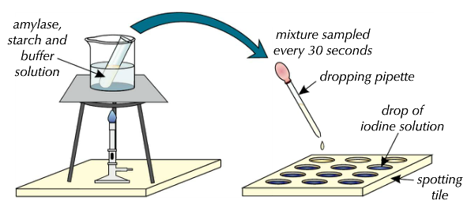
Required practical 5 The effect of pH on enzyme activity
Identify two control variables in the experiment
3
Draw a sketch of expected results, with ‘pH’ on the X- Axis and ‘Time’ for starch to be broken down on the Y-axis
Write a detailed conclusion for the experiment
5
7

Slide 6
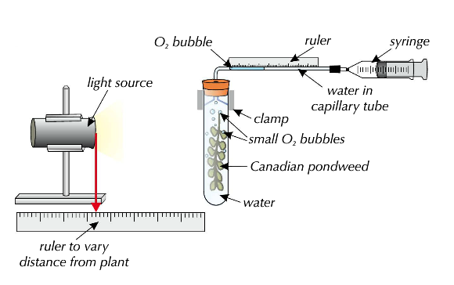
Required practical 6: The effect of light intensity on photosynthesis
Identify two control variables in the experiment
2
When the lamp is 2cm away from the pondweed the gas bubble was 20mm long after 4 mins. When the lamp is 10cm away, the gas bubble was 8mm long after 4 mins. Calculate the rates of photosynthesis and explain the results.
Draw a sketch of expected results
5
7

Slide 7
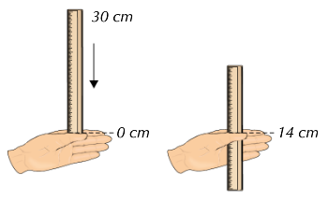
Required practical 7: Human reaction time
Identify factors affecting reaction time
2
Identify 3 control variables in the experiment
Write out how you could test the effect of caffeine on human reaction time
3
How could you improve the practical in the drawing and how does it?
7
5

Slide 8
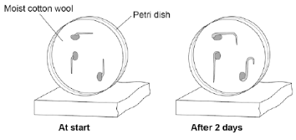
Required practical 8: Effect of gravity on seedlings (Triple Only)
Describe the growth of the roots in the diagram and give a reason for this response
2
Explain why newly germinated mustard seeds are used in the investigation?
3
What are the different variables in this investigation and how could you further investigate?
Name an example of 2 plant hormones and describe 3 uses for each
5
7

Slide 9
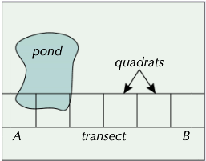
Required practical 9: Measuring the population size of a species
Calculate the mean number of bulrushes
2
Why is sampling used?
3
A scientist used a 0.5m² quadrat to randomly sample daisies in a field. The scientist found a mean of 8 daises per quadrat. The field had an area 900m². Estimate the total population of daisies.
Quadrat | 1 | 2 | 3 | 4 | 5 | 6
Bulrushes | 2 | 1 | 5 | 17 | 51 | 29
Bulrushes grow best in moist soil. Does Quadrat 1 start at A or B on the transect? Explain why.
5
5
Write a detailed method of observing the distribution of organisms across an area
7

Slide 10
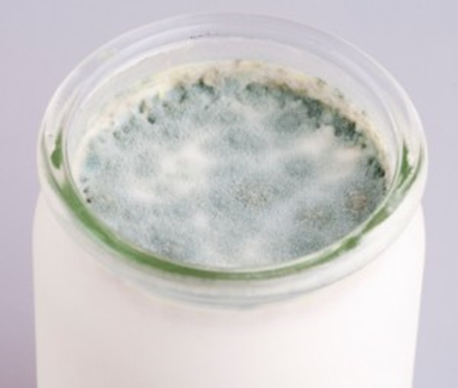
Required practical 10: Effect of temperature on the rate of decay (Triple Only)
What conditions are needed for decay?
2
How would you measure the pH of the milk and why?
4
Why will the pH change with temperature change?
What health and safety implications are there in this practical?
5
5
Outline the method for the practical and what results would you expect to get?
7

