Slide 1
Movement Across Membranes
3 Cells Key concepts
Next
© Hodder & Stoughton 2015

Slide 2
3 Cells Key concepts
Introduction
The plasma membrane surrounds the cells of eukaryotes and prokaryotes. It is partially permeable and is composed of phospholipids and proteins. Lipid soluble materials pass directly through the phospholipid layer. Water soluble molecules and charged particles must pass through protein channels. Molecules like oxygen, carbon dioxide and water pass directly through the phospholipid layer. Eukaryotes have membrane bound compartments in the cytoplasm.
Next
© Hodder & Stoughton 2015

Slide 3
3 Cells Key concepts
Questions
What are prokaryotes?
Prokaryotes are simple organisms like bacteria. They do not have a nucleus or other membrane bound organelles.
Name some of the membrane bound compartments that are found in eukaryotic cells.
Membrane bound compartments are organelles like lysosomes, endoplasmic reticulum, the Golgi apparatus, plastids like chloroplasts, the nucleus.
Why can water molecules pass through the membrane even though they are polar molecules?
Water molecules are small enough to slip between the phospholipid molecules.
Answers
Next
© Hodder & Stoughton 2015

Slide 4
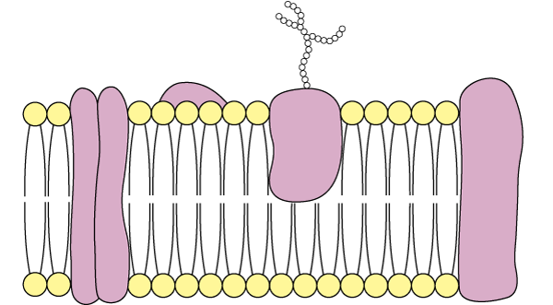
3 Cells Key concepts
A phospholipid molecule has a phosphate head and two fatty acid tails. The phosphate head is water soluble (hydrophilic). The fatty acid tails are water insoluble (hydrophobic). Both the inside and the outside of the cell has a watery environment. The plasma membrane is composed of a double layer of phospholipids molecules. The phospholipids are arranged with the phosphate heads on the outside. These hydrophilic molecules surround the fatty acid tails, keeping them away from water. Transport proteins in the membrane carry polar molecules across.
Carbohydrate chain attached to protein acts as a receptor site
Phosphate head is polar
Extrinsic protein
Protein molecules spanning the bilayer act as transport proteins
Fatty acid tails are non-polar
Next
© Hodder & Stoughton 2015

Slide 5
3 Cells Key concepts
Diffusion
Small molecules like water, oxygen and carbon dioxide diffuse directly through the membrane. They move from an area of high concentration to an area of lower concentration down a concentration gradient.
Next
© Hodder & Stoughton 2015

Slide 6
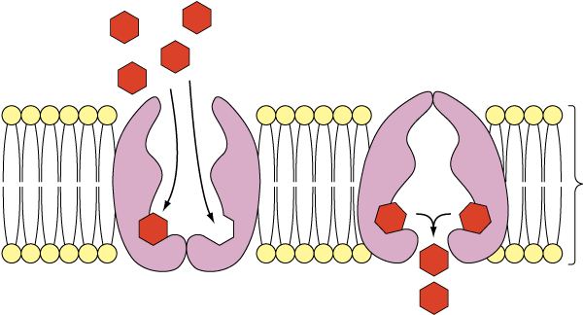
3 Cells Key concepts
Facilitated diffusion
This is diffusion of molecules through hydrophilic channel proteins, down a concentration gradient.
Water soluble molecules move by facilitated diffusion.
High concentration of molecules on outside of cell
Carrier protein is correct shape for molecule being transported
Phospholid bilayer is impermeable to the molecule being transported
Low concentration of molecules on inside of cell
Molecules are moving in down their concentration gradient
Next
© Hodder & Stoughton 2015

Slide 7
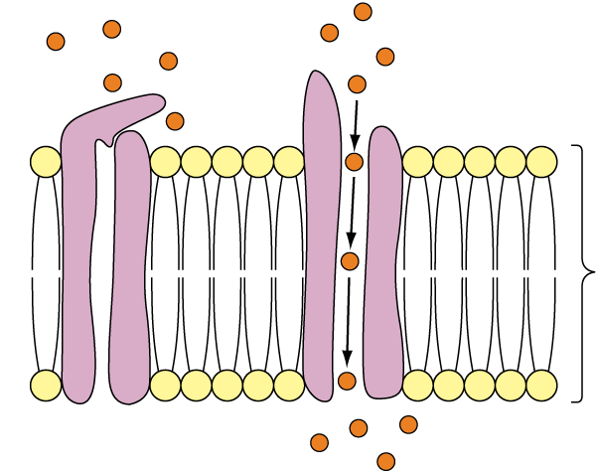
3 Cells Key concepts
Facilitated diffusion
This is diffusion of molecules through hydrophilic channel proteins, down a concentration gradient.
Ions cross the membrane through ion channels.
Ions in high concentration outside the cell
Cell surface membrane
Ion channel protein spanning the membranes
Ions move down their concentration gradient
Next
© Hodder & Stoughton 2015

Slide 8
3 Cells Key concepts
Osmosis
Osmosis is the diffusion of water molecules.
The tendency of water molecules to move is called the water potential. Water moves from higher to lower water potential across a membrane by osmosis. The difference in water potential between the two areas is called the water potential gradient. Pure water has the greatest water potential. It is given the value of 0. Solutes dissolved in the water will lower the water potential and make this figure more negative.
Next

Slide 9
Needs new artwork – one in Word file is ‘from Google’
3 Cells Key concepts
Osmosis
Click to reveal the five hotspots.
Some water molecules do move back through the membrane. The net flow is in the opposite direction.
Molecule of salt (solute) surrounded by water molecules in a solution. The solute lowers the water potential.
Partially permeable membrane allows small molecules like water through. It acts as a filter.
Net movement of water molecules from the higher water potential to the lower water potential, down the water potential gradient.
Water molecules in pure water.
Reveal
Next
© Hodder & Stoughton 2015

Slide 10
3 Cells Key concepts
Questions
Which side has the lower water potential?
The salt solution has the lower water potential.
What is the water potential of the other side?
The other side is pure water. Water potential = 0.
Is osmosis an active or passive process? Explain your answer.
Osmosis is a passive process. No additional energy is required to move the molecules.
How could the rate of osmosis be increased? Explain your answer.
Increasing the temperature would increase the rate. This is because the molecules would have increased kinetic energy. They would move faster.
Answers
Next
© Hodder & Stoughton 2015

Slide 11
3 Cells Key concepts
Active Transport
If molecules are moved from an area of lower concentration to an area of higher concentration, this is going against the concentration gradient. The process requires the energy from ATP. It is called active transport. Active transport across a membrane requires transport or carrier proteins. The protein changes shape when it binds to ATP. A molecule enters the protein. The ATP causes the carrier to change shape and the molecule is pushed through the membrane.
Next
© Hodder & Stoughton 2015

Slide 12
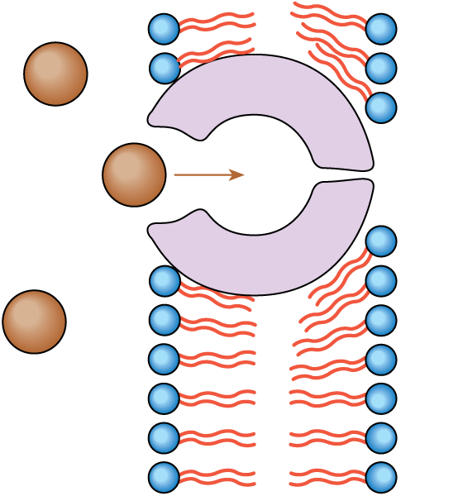
3 Cells Key concepts
Active Transport
Lower concentration of molecules outside cell
High concentration of molecules inside cell
Molecule to be transported enters carrier protein
Next
© Hodder & Stoughton 2015

Slide 13
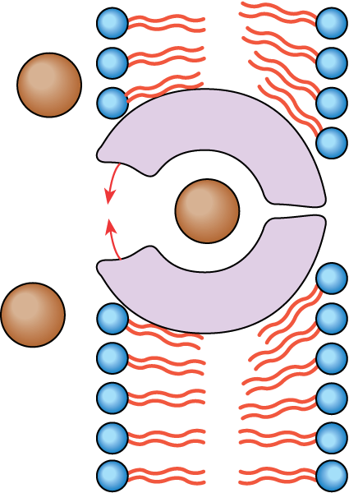
3 Cells Key concepts
Active Transport
ATP combines with carrier protein
Next
© Hodder & Stoughton 2015

Slide 14
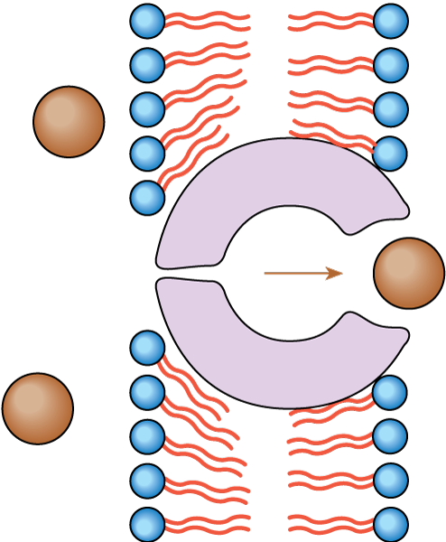
3 Cells Key concepts
Active Transport
Change in shape of carrier protein flips molecule across the membrane
When ATP is hydrolysed to ADP + Pi, the carrier protein changes shape
ADP + Pi are released
Next
© Hodder & Stoughton 2015

Slide 15
3 Cells Key concepts
Add the terms below into the correct gaps in the table to show how molecules move across membranes.
OSMOSIS ACTIVE TRANSPORT FACILITATED DIFFUSION DIFFUSION ACTIVE PASSIVE
Example | Type of movement | Energy required | Active or passive
Water enters plant cell |  | No
Nitrate ions moving into root hair cell |  | Yes
Glucose enters the bloodstream via gut wall |  | No
Carbon dioxide leaving bloodstream in alveolus |  | No
Loading sugar into phloem |  | Yes
Osmosis
Active transport
Facilitated diffusion
Diffusion
Active transport
Passive
Active
Passive
Passive
Active
Answers
End
© Hodder & Stoughton 2015

