Slide 1
Space Lesson 1
Introduction to space 12.6.13

Slide 2
Learning objectives
To understand the contents of space and our solar system
To understand the sheer vastness of space

Slide 3
Earth
Venus
Mars
Mercury
Pluto

Slide 4
Jupiter
Saturn
Uranus
Neptune
Earth
Pluto

Slide 5
Sun
Earth
Jupiter
Pluto

Slide 6
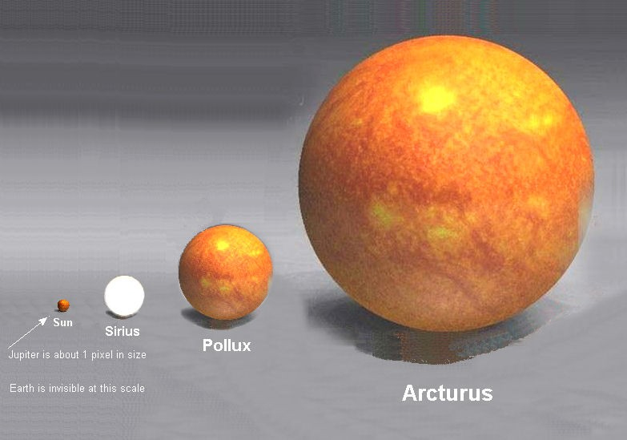

Slide 7
