Slide 1
Hercules The Roman Hero

Slide 2
The story is told in The Aeneid. Book 8
The story of the Aeneid so far.

Slide 3
Aeneas a Trojan Hero

Slide 4
The fall of Troy

Slide 6
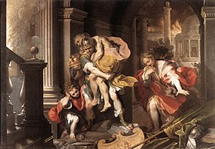
Aeneas has survived Troy. and escaped taking his father and the sacred flame of Rome.

Slide 7
He arrives in Italy

Slide 8
Meets king Evander who tells him the story of Hercules and Cacus.

Slide 9
Hercules on his 10th labour had to go looking for the cattle of Geryon.

Slide 10
Hercules stops in Italy on his route.

Slide 11
And fights Cacus

