Slide 1
Hazard Precautions 12.05.15
Hazards Revision
Starter(5 mins): In your notes, sketch the hazard symbols from memory
Success criteria:
2 – OK
3 – good
5 – Fantatsic!

Slide 2
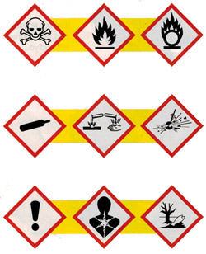
How many can you remember?
Work on your own.

Slide 3
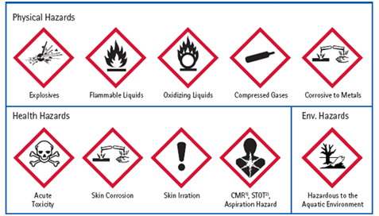

Slide 4
Lesson objectives
Use the hazard symbols to identify the necessary precautions for using specific chemicals
Understand the difference between a hazard and a risk
Understand how to work out a risk

Slide 5
Task 1: Identifying general precautions Copy and complete the table
Category | Symbol | Precaution | Safety
External risks
Internal risks
Combustion risks

Slide 6
Category | Symbol | Precaution | Safety
External risks | Irritant X_{I} | Wear goggles and gloves | Rinse well with water
 | Corrosive | Gloves/goggles/
Internal risks | Carcinogenic | Gloves/goggles/Fume cupboard | Seek medical advice if swallowed
 | Toxic | Gloves/goggles/ fume cupboard(if a gas)
 | Harmful to the environment | Don’t put down sink
Combustion risks | Flammable/ oxidising/ explosive | No naked flames/lids on bottles/handle carefully | Store carefully and separately (remind them of fire triangle)

Slide 7
Task 2: Identifying precautions for specific chemicals Copy and complete following table
Name of chemical | Hazard symbol | Suitable precautions
Do not open bottles!

Slide 8
Check point:
I am the symbol for flammable.
True / False.

Slide 9
Check point:
I am the symbol for compressed gas
True / False.

Slide 10
Check point:
I am the symbol for something damaging to our health
True / False.

Slide 11
What is a hazard?
A specific danger
A hazard could be due to the chemical itself
It could be due to what we do with the chemical
For example, water is fairly non-hazardous by itself
If will spill it, it could cause a slip
If we carry it in a beaker, the glass could be smashed
If we heat it, there are lots of potential hazards

Slide 12
What is a risk?
A risk is how serious a hazard is
In order to establish a risk you have to consider the seriousness of the hazard and the likelihood of it happening
Risk can actually be calculated using the following formula
Risk = probability of hazard occurring x severity of hazard

Slide 13
Calculating a risk?
Risk can actually be calculated using the following formula
Risk = probability of hazard occurring x severity of hazard
Both the probability and severity can be rated 1-5
Where 1 = improbable/not severe
and 5 = highly likely/very severe

Slide 14
Example
An elephant sitting on you is low probability but
severe hazard
Risk = 1 x 5 = 5
Burning yourself whilst doing a heating
experiment is a fairly high probability but not too
severe
Risk = 4 X 2 = 8

Slide 15
Plenary: Missing words
Complete the missing words on the sheet

