Slide 1
Brigade/RPOC Structure
One Star Military Knowledge

Slide 2
Introduction
Interest
Need
Range
Objectives

Slide 3
The Brigade/RPOC
The Army delivers Cadet activities through HQ Regional Command, based in Aldershot. HQ Regional Command works through London District and the 9 Regional Points of Command (RPOCs), which oversee and support the CCFs in that area
In some areas the RPOC HQs are also Brigade HQs

Slide 4
The Brigade/RPOC
BRIGADE/RPOC HQ – ARMY
Brigade/RPOC Commander
BRIGADE/RPOC HQ – ARMY
Brigade/RPOC Deputy Commander
BRIGADE/RPOC HQ – CFAV
Brigade/RPOC Colonel Cadets
BRIGADE/RPOC HQ – ARMY
Brigade/RPOC SO2 Cadets
CADET TRAINING TEAM
Officer Commanding
(OC CTT)
BRIGADE/RPOC HQ – CFAV
Brigade/RPOC Deputy Colonel Cadets
CADET TRAINING TEAM
Training Safety Advisor (TSA)
CADET TRAINING TEAM
Training Officers & Sergeants

Slide 5
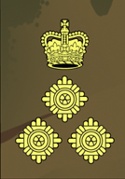
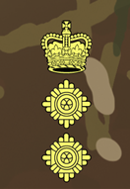
Key Appointments in the RPOC
RPOC Commander
Rank: Regular Army Major General/ Brigadier/ Colonel
Oversees the Cadet Forces in their geographical region
As they are also in overall command of the Army formations in that region, they delegate a proportion of the workload regarding the Cadet Forces to their Deputy Brigade/ RPOC Commander, who will keep them abreast of all important issues
Other responsibilities to the Cadet Forces in the RPOC include assigning Cadet Training Teams to their normal tasks and for arranging their location with a sponsor unit for administration

Slide 6
Key Appointments in the RPOC
RPOC Deputy Commander
Rank: Regular Army Brigadier/ Colonel
Supports and works closely with the RPOC Commander with all Cadet Force business

Slide 7
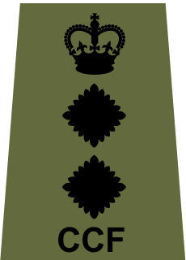
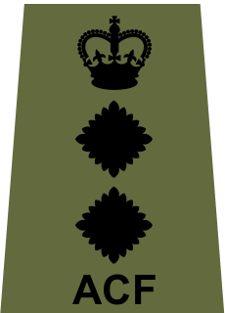
Key Appointments in the RPOC
RPOC Colonel Cadets
Rank: ACF/CCF Colonel
principal advisor to the RPOC Commander and Deputy Commander on all Cadet Force matters
Support the RPOC Commander in discharging their responsibilities for the direction and supervision of the Army Cadets and support the chain of command with the effective governance and oversight of all Army Cadets units (CCF and ACF) within the region
Visit Army Cadets at their units and events, to keep abreast of current training, activities and issues
The Colonel Cadets will oversee a staff of specialist Officers to advise on specific syllabus areas across the RPOC

Slide 8
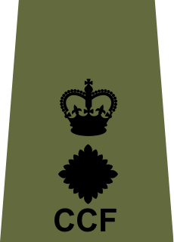
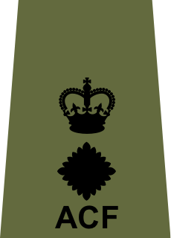
Key Appointments in the RPOC
RPOC Deputy Colonel Cadets
Rank: ACF/CCF Lieutenant Colonel
Assists the Colonel Cadets in their roles and responsibilities.
Deputises for the Colonel Cadets when necessary
Undertakes special projects for the RPOC Commander

Slide 9
Key Appointments in the RPOC
Staff Officer Cadets (SO2 Cdts)
Usually a Civil Servant, equivalent in rank to a Major
Responsible for the Cadet Forces at RPOC HQ
Provides administrative and some financial support for CCFs
Coordinates Regular and Reserve Army assistance for cadet training
Liaises with Regional Command HQ Cadets Branch
Organises annual conferences

Slide 10
Key Appointments in the RPOC
Officer Commanding Cadet Training Team (OC CTT)
Rank: FTRS Major
Manages the work of the Cadet Training Team
Supports Contingents within the RPOC
Plans and runs CCF annual camps and supports ACF camps, as well as courses and competitions for both adults and senior cadets

Slide 11
Key Appointments in the RPOC
Training Safety Advisor (TSA)
Rank: FTRS Warrant Officer Class 2
Responsible to the RPOC Commander for ensuring that Contingent Commanders and Cadet Commandants are fulfilling their responsibilities for the planning, management, coordination and delivery of safe and effective training

Slide 12
Key Appointments in the RPOC
Cadet Training Teams (CTT)
Teams of members of the Regular or Reserve Army on Full-Time Reserve Service (FTRS)
There are usually two or three teams covering each RPOC, each overseen and coordinated by a Training Officer
Support CCF Army Sections with the training of senior cadets, preparation of adult instructors for courses, and overseeing correct security and administrative processes
The Company Quartermaster Sergeant (CQMS) is responsible for providing Contingents with resources required for effective training and arranging maintenance of weapons and equipment

Slide 13
Any Questions?
Brigade/RPOC Structure

Slide 14
Consolidation
Summary
Questions

Slide 15
Final Confirmation
What is the name of your Training Safety Advisor?
[WO2 Chris Reid]
What rank does the RPOC Commander usually hold?
Major General/Brigadier/Colonel
Which of these roles is a volunteer role?
Company Quartermaster Sergeant / Colonel Cadets / Staff Officer Cadets
Colonel Cadets

Slide 16
Final Confirmation
What is the name of your Colonel Cadets?
Colonel M Palmer
What rank does the OC CTT usually hold?
Colonel / Staff Sergeant / Major
Major
Which of these is not a member of the Cadet Training Team?
Deputy RPOC Commander / Training Safety Advisor / Training Officer
Deputy RPOC Commander

Slide 17
Consolidation
Pack Kit
Look Forward

