Slide 1
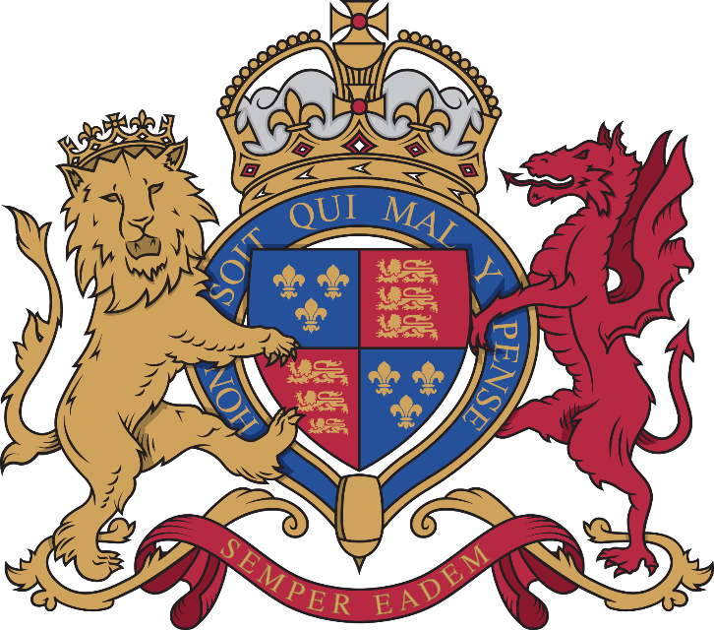
MILITARY COMMUNICATIONS HISTORY INTRODUCTION
Military communications have developed over time from basic forms such as vocal communication, to modern day communication information systems.

Slide 2
Vocal communication
Command on the battlefield was carried out by shouting orders and directions, its effectiveness was governed by the type of warfare engaged in and surrounding noise. This is used effectively today for drill commands and section battle drills.

Slide 3
runners
Runners passed messages on foot that were written or by word of mouth. Early forms of written message were on wax tablets or scrolls. It took a long time to carry messages over distances and written messages required educated people to read and write. In 490 BCE the Greeks fought the Persians at Marathon in Greece. Legend has it that Philippides a Greek messenger ran non-stop from the battlefield to Athens, to announce that the Persians had been beaten and then he dropped down dead. The modern marathon road race is named after this feat of endurance.
Runners were a vital part of a platoon. There were no telephones or radios on the battlefield and runners relayed information to the rear. Runners were skilled at fieldcraft and usually working at night they had to familiarise themselves with formation locations and safe routes.
Handwritten messages carried by runners could be difficult to read. The order issued by Lord Raglan that resulted in the ill-fated charge of the light brigade at Balaklava in the Crimea in 1854 was poorly written, as a result there was confusion as to which set of enemy guns and which location was to be engaged.

Slide 4
Sun reflections
Early mirrors of polished metal were used to reflect the sun to pass messages. Modern-day air crew carry a small metal mirror to attract the attention of rescue teams if they crash or are shot down. The Heliograph was used to send coded messages and is visible up to a distance of 30 miles.

Slide 5
fire
Beacons were an early warning system and were used to warn of invasion. Set at intervals, their use depended on a lookout and dry wood. Smoke from the fires could also be used to send signals.

Slide 6
Musical instruments
Horns have been used for millennia. Early horns were made of seashells and animal horns. The Egyptians used the horn to create noise on the battlefield and the Romans used the Cornu. This was used by a designated Cornicen to relay the commanders’ battle orders to legionnaires. There are different bugle calls for each manoeuvre or activity, which are used to the present day.
Armies have used drums for centuries. The Chinese used them for signalling at The Great Wall of China. West African nations used a kettle drum to create confusion and unnerve the opposition. On the battlefield soldiers used drums to pass on orders. Armies employed drummer boys aged 10-14, and some were awarded for bravery with Thomas Flynn, winning the Victoria Cross in 1857.

Slide 7
Flags and semaphore
Knights raised their own armies and carried identifying flags or standards. The Royal Navy still uses coloured flags for coded ship-to-ship communication, which is known as Semaphore. The development of the flags carried by knights can be seen in each ACF county and army regiment in its own standard, colours or flag, which is now generally worn as the county badge on uniform.
Semaphore was created by the Chappe brothers during the French Revolution. The original system worked using 2 black coloured wooden arms, operated by levers that inclined the wooden arms at different angles. The first successful messages sent by the Chappe Semaphore system, were between Paris and Lille in 1792, when it was used to carry messages about the war occurring between France and Austria. At this time, it was recorded that a symbol could travel 120 miles, through 15 semaphore stations in only 9 minutes, and a typical message of 36 codes took about 32 minutes.
The semaphore communication system has evolved to using 2 flags which when at sea are coloured red and yellow, and white and blue when on land. Semaphore is very cost effective, however it requires line of sight between the sending and receiving station and is therefore also dependent on weather conditions or time of day.

Slide 8
Official telegraphy & morse code
Telegraphy covers the sending of signals over long distances rather than face-toface including optical telegraph, Morse code and signal lamps for ship-to-ship communication. These are still used in modern warfare.
Morse code was developed in 1837 by Samuel Morse. An operator uses a ’key’ to turn on and off a power supply along a telegraph wire to create a ‘dot or dash’ signal. A trained operator can recognise the sender by their ‘fist’ – similar to recognising someone's regional accent. Jeremiah Denton was a US pilot shot down during the Vietnam war 1965- 75. He became a POW and was paraded in front of the cameras and managed to blink the word TORTURE so that the world could see how he was being mistreated.
There are a number of advantages to using Morse code over voice transmissions. It is very efficient to transmit messages because of the structure of the code. The most frequently used letters (such as the letter “E”) are given short codes. Morse code can easily be used internationally without needing to be fluent in the sending stations language, since all the words are spelt out letter by letter. Possibly the greatest advantage of Morse code is that it is much easier to communicate when poor radio conditions exist. Morse code is considered one of the first electronic types of digital communications ever used in the world.
The first transatlantic telegraph cable was laid between Ireland and Newfoundland, Canada in 1858 and was 1,950 miles long. The cable was laid from the middle by two ships, the Goliath and the Niagara and weighed 100 tons per mile and for most of its length it was laid at a depth of 4000m.

Slide 9
animals
Despatch Riders on horseback carried messages on the battlefield. Carrier Pigeons were trained to return to a specific location and carried messages in canisters strapped to their legs. They were parachuted into the trenches in crates, before being released to fly back.
Dogs were so effective at taking messages that bounties were placed on them by the enemy.
The Dicken Medal is awarded to animals for service in time of conflict and is known as the animal Victoria Cross.

Slide 10
Codes & ciphers
A code is a system of words, letters, numbers or symbols used to represent others. They developed to confuse and deny the enemy vital information. Many different types of code have been used from simple word swaps to those requiring a ‘key’, contained in a code book.
In WW2 Germany developed the Enigma Machine, which required a series of rotors to set the key for the message. The Enigma machine was very successful until Bletchley Park cracked the code and was able to read sent messages before they reached their destination. Alan Turing at Bletchley Park is credited with building and using the first computer nick-named the ‘Bombe’. Enigma code books were recovered from German submarine U-559 by the British which gave vital information for the code breaking activity.
In WW2 and the Korean war, America used Navajo (Native American) speakers as radio operators so the Japanese forces could not decode or understand what was being said. Various languages have been used in conflicts to confuse enemy forces.

Slide 11
telephones
Telephones were invented in 1876 and were of limited use by the armed forces relying on the small national network. Alexander Graham Bell is credited with introducing the word Hello into the English language.
During the Boer War (1899-1902) British Forces used the existing Afrikaans telegraph system – including their paperwork and codes.
As radios became more reliable, telephones began to be used at fixed points – sentry posts and headquarters. Calls had to be routed by an exchange operator by plugging wires into sockets to link circuits and callers together.
Telephone wires ran across the trenches in WW1 and were visible from the air and easily cut by artillery. Air observers in balloons or pilots could work out where communications centres were by the number of cables running into a bunker, dugout or house.

Slide 12
Telephones cont..
The first transatlantic telephone cable (TAT-1) was laid in 1956 and had capacity for 36 channels. Prior to this, transatlantic telephone calls were sent over a radio link. The first Trans-Atlantic telephone cable TAT-1 was laid between Scotland and Newfoundland, Canada and had 36 channels. Until this time, all Trans-Atlantic telephone traffic was sent using radio.
During WW2, Winston Churchill and Franklin D Roosevelt each had a secret telephone so they could discuss the war effort and upcoming plans. Due to the fact there was no transatlantic cable the conversations had to be transmitted via a radio. The Germans had listening posts along the Dutch border and were able to intercept the conversations, so an encryption system was introduced in 1941 to enable a more secure method of communication under the codename “Green Hornet”. This was the only encryption method NOT to be cracked in WW2.
Devices have been connected to telephone systems to send information such as Telex, Fax, ADSL modems / Broadband routers. Generally, all use signals from 300Hz to 3.3kHz, which is the capacity of a telephone line. It is important to consider telephone lines as a carrier of a signal, whether that be voice or other signals. The telephone system was originally designed for voice only, which uses very limited frequencies (300Hz to 3.3kHz), limiting the capacity and quality.

Slide 13
Telephones cont..
Telex machines are now virtually obsolete and worked by decoding telephone signals from a typewriter and sending messages to a printer. Fax machines enabled a graphical copy of a document to be transmitted down the telephone line and printed at a receiving machine. Modems / routers enable computers to communicate with each other. Modern modems and routers are all be fitted to a special socket on the telephone line which includes a filter to separate the voice and data signals without causing interference to each other. Without this filter, speaking on the telephone and even connecting additional cables would slow the speed of the data signal due to errors.

Slide 14
radio
The radio was first patented by Guglielmo Marconi in 1896. On December 12, 1901 Marconi successfully transmitted signals across the Atlantic Ocean.
Marconi’s equipment was installed on RMS Titanic and is credited with saving the lives of the survivors in 1912. The radio operators (Jack Phillips and Harold Bride) on the Titanic (1912) were not employed by White Star Lines, but by Marconi Communications to send telegraph messages to Newfoundland on behalf of the passengers onboard.
Following the sinking of the Titanic, there was adoption of SOS as the international distress signal and mandated 24 / 7 monitoring of marine radio with the banning of amateur radio operators from the safety channels. SOS continued until 1999 when GMDSS (Global Maritime Distress and Safety System) was introduced.
Prior to 1920, radios were primarily used to communicate with ships at sea usually using Morse. Reginald Fessenden made the first audio broadcast on Christmas Eve 1906 with his rotary spark gap transmitter.
The first military radio sets were huge and relied on a massive battery or generator. Battery technology improved allowing for the development of the ‘wireless’ portable radio. The most recent army radio sets are: Larkspur (1962), Clansman (1976), Bowman (2004). Each system has brought technological advances such as encryption and frequency hopping. The radios used within the Army Cadets are the Personal Role Radio - UK PRC 343 and the Mercury Radio System - UK PRC 710 / 715 / 720.

