Slide 1
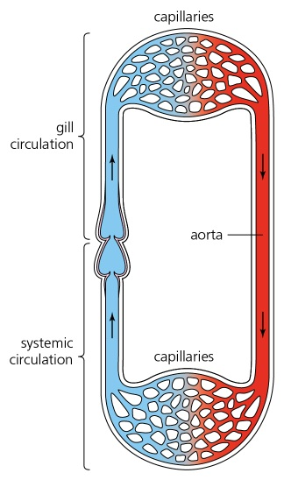
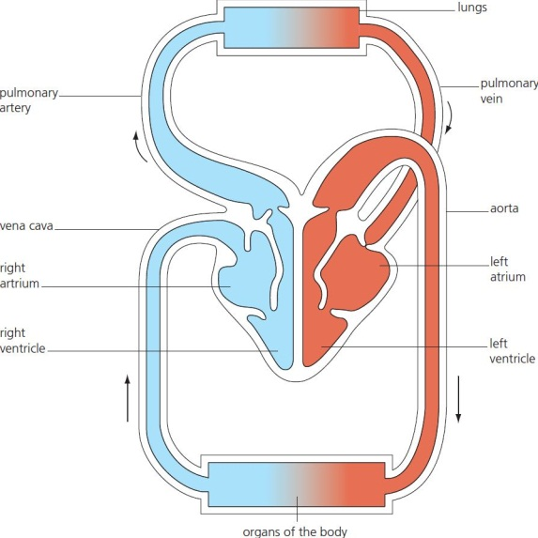
9 Mass transport in animals Summary
Animals
Circulation systems
Closed systems
Open systems (insects)
Closed systems
Single systems (fish)
Double systems (mammals)
© Hodder & Stoughton 2015

Slide 2
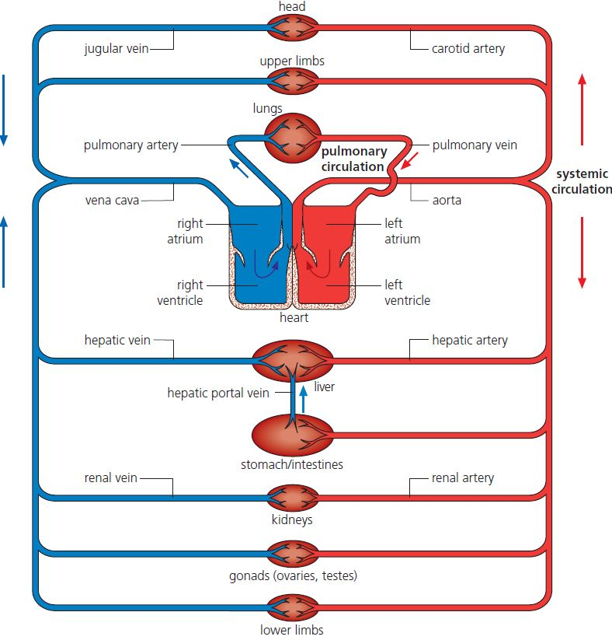
9 Mass transport in animals Summary
Circulation
Mammals have a double circulatory system:
Coronary → heart
Renal → kidney
Pulmonary → lungs
© Hodder & Stoughton 2015

Slide 3
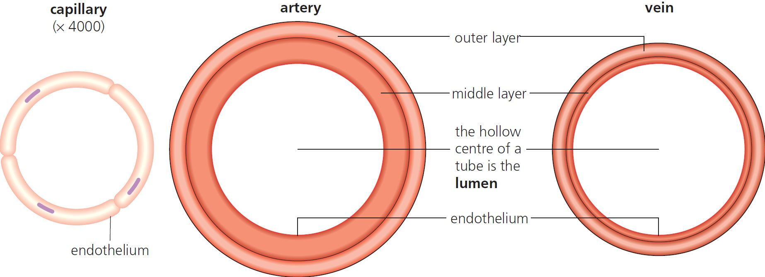
9 Mass transport in animals Summary
Blood vessels
Blood vessels are adapted for their function:
artery → arterioles → capillaries → venules → veins
© Hodder & Stoughton 2015

Slide 4
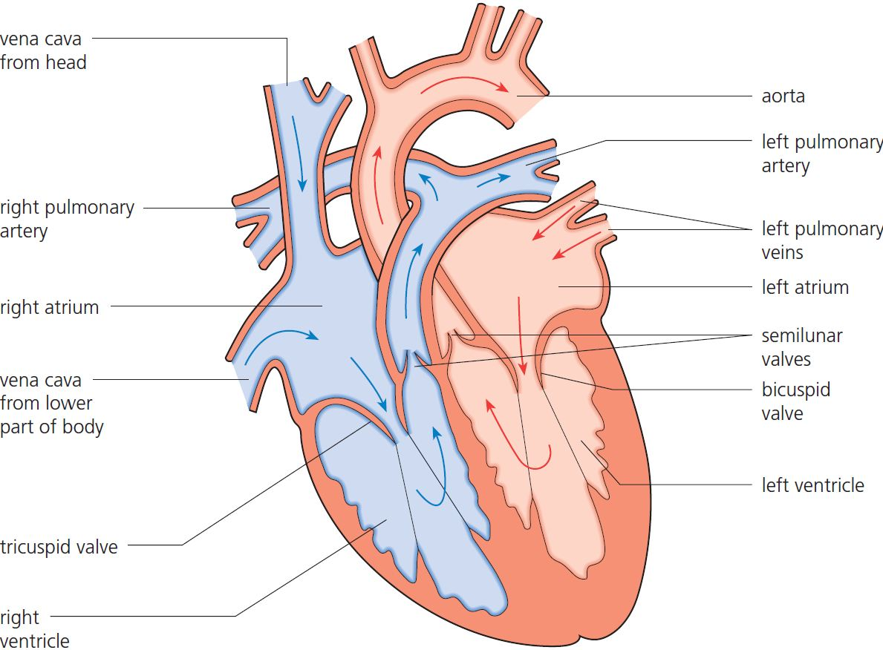
9 Mass transport in animals Summary
Heart
© Hodder & Stoughton 2015

Slide 5
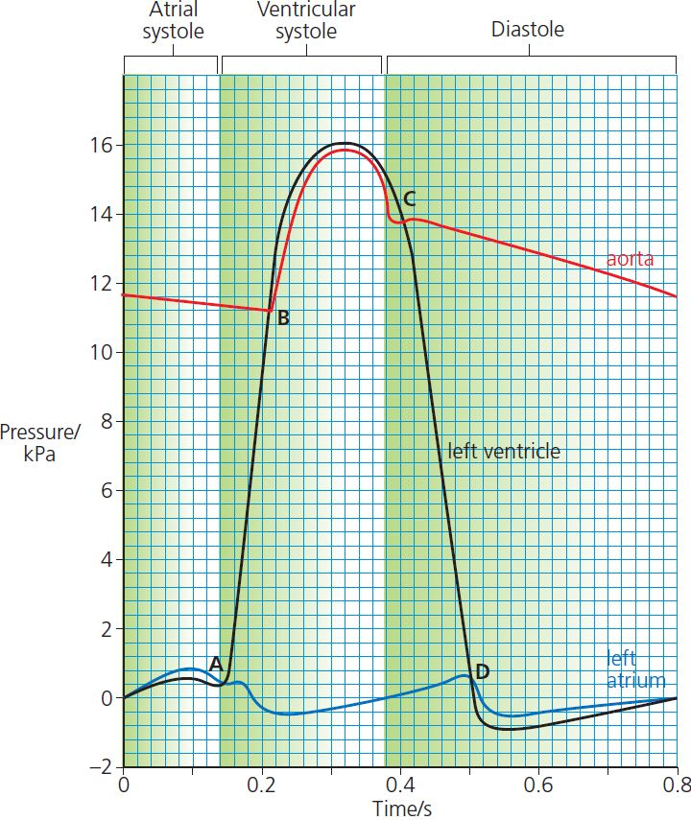
9 Mass transport in animals Summary
Cardiac cycle
As the heart contracts, pressure changes cause blood to move from:
veins → atria → ventricles → arteries
© Hodder & Stoughton 2015

Slide 6
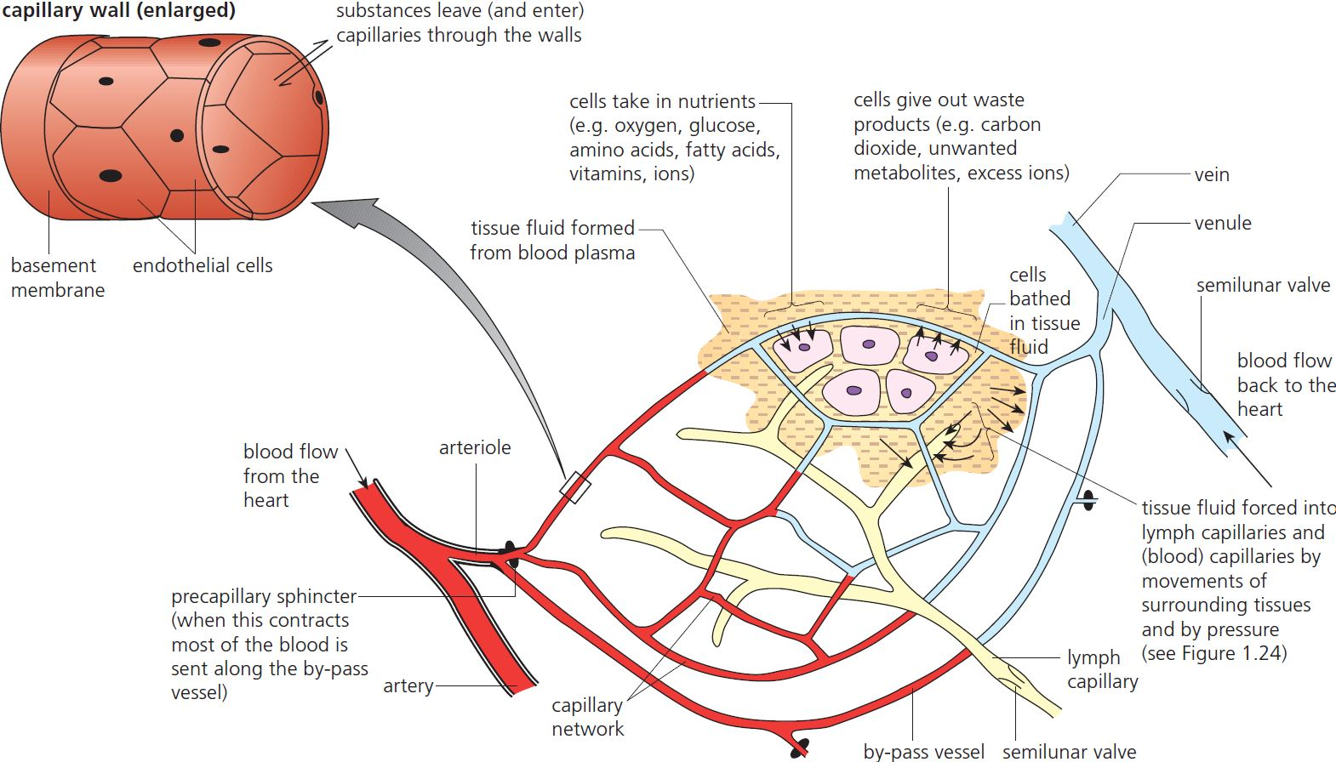
9 Mass transport in animals Summary
Tissue fluid
High hydrostatic pressure combined with ‘leaky’ capillaries generates fluid around the cells that form tissues. This tissue fluid bathes the tissues and excess drains away as lymph.
© Hodder & Stoughton 2015

Slide 7
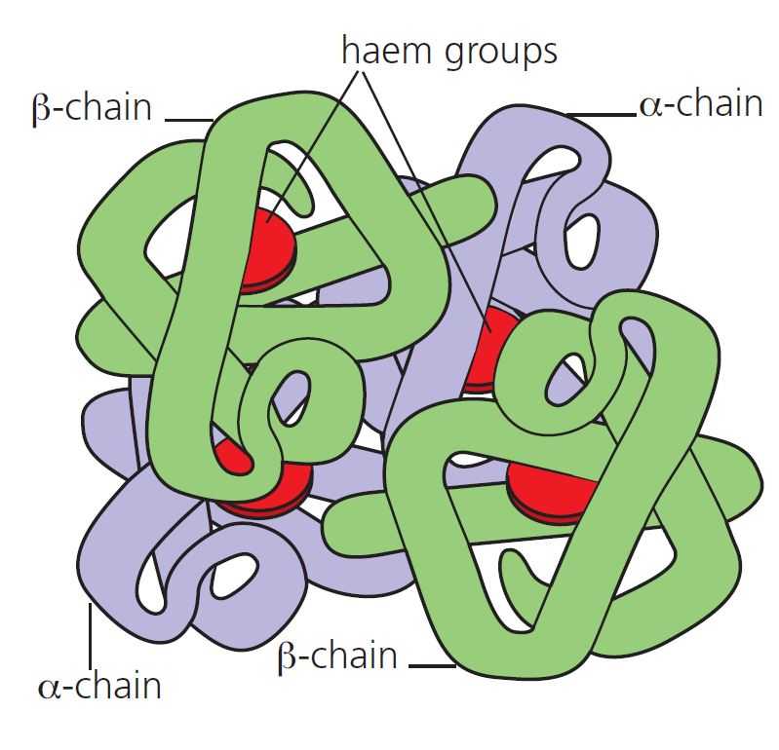
9 Mass transport in animals Summary
Haemoglobin
Haemoglobin is the protein that carries oxygen in the blood.
© Hodder & Stoughton 2015

Slide 8
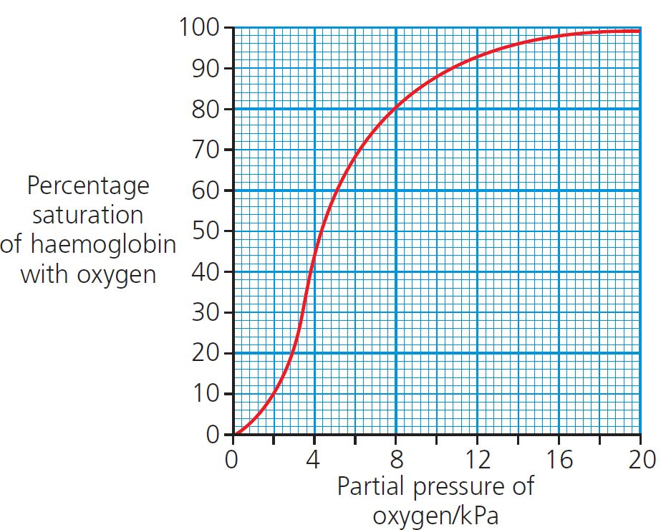
9 Mass transport in animals Summary
Oxygen dissociation curves
At high partial pressure of oxygen (lungs) haemoglobin has a high affinity for oxygen.
At low partial pressure of oxygen (tissues) haemoglobin has a low affinity for oxygen.
© Hodder & Stoughton 2015

Slide 9
9 Mass transport in animals Summary
Questions
Explain why mammals have a double circulatory system but fish have a single circulatory system.
Describe an advantage of having a closed circulatory system.
Draw a graph showing the dissociation curves for:
adult haemoglobin
foetal haemoglobin
myoglobin.
How is the structure of the capillary well suited for its function?
Why is the left side of the heart wall thicker than the right?
Starting at the left atrium, describe the movement of blood around the body.
What is the role of:
the atrioventricular valves
the aortic (semilunar) valves.
© Hodder & Stoughton 2015

