Slide 1
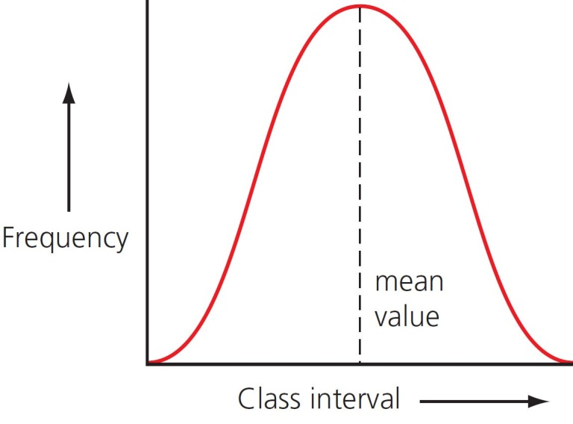
11 Genetic diversity Summary
Natural selection
Gene mutations
Mutation: genetic variation in a population
Changes in the code that forms DNA will cause a change in the proteins produced.
Change in environmental conditions
Variation
Some individuals at an advantage and survive
Those that survive produce more offspring
Favourable variation passed onto next generation
© Hodder & Stoughton 2015

Slide 2
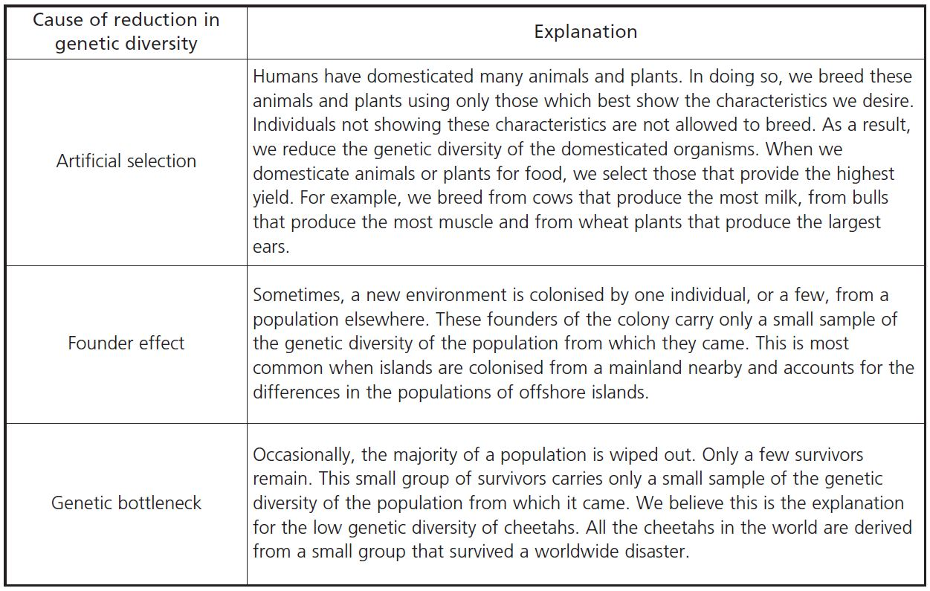
11 Genetic diversity Summary
Loss of genetic diversity
© Hodder & Stoughton 2015

Slide 3
11 Genetic diversity Summary
Artificial selection
© Hodder & Stoughton 2015

Slide 4
11 Genetic diversity Summary
Founder effect
© Hodder & Stoughton 2015

Slide 5
11 Genetic diversity Summary
Genetic bottleneck
© Hodder & Stoughton 2015

Slide 6
11 Genetic diversity Summary
Questions
Describe how a change in a single DNA base could bring about an altered protein.
Explain why some mutations have little or no effect.
Describe how selection could bring about antibiotic resistance in bacteria.
Describe an example of an environmental change that could cause selection to take place.
Give an example of the founder effect.
© Hodder & Stoughton 2015

