Slide 1
Pan’s Labyrinth Scene analysis
Ofelia and the Toad

Slide 2
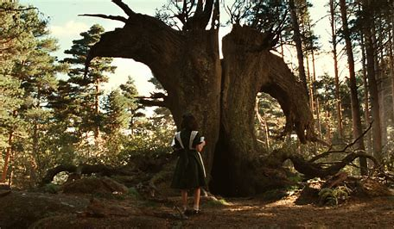
Overview
The scene begins with Ofelia reading about the colossal fig tree which the giant toad lives in, preventing it from growing. Her mission here is to put 3 magic stones in the toad’s mouth and retrieve a golden key from its belly.
Before entering the tree Ofelia removes her new green dress her mother got for her, although this shows she cares, it is also a symbol of her disobedience.
Once inside, she crawls down a narrow tunnel, covered in mud and insects.
We then get a cut to Vidal and his men searching in the woods. He finds out that the (rebels) left their camp in a hurry, he also estimates how many of them there, and finds their medicine. Finally, he warns them by shouting to come back for their things in a threating tone.
We then cut back to Ofelia who has found the giant toad, she has a one-way conversation with it about how it should be ashamed of itself for destroying the tree before it licks her, and then does a massive burp at her.
Cleverly, she covers the gems in mud and tricks the toad into eating them by putting a insect in front of them so it can’t see them.
After this, the toad throws its stomach up and deflates. Ofelia finds the key submerged in its stomach and swiftly leaves.

Slide 3
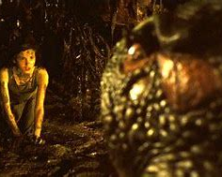
Cinematography
Most of the shots in this scene are very close up because the setting is quite small and confined, however we do get a few important wide shots which establish the setting and characters very well. However, before we get into the tree, we have a panning shot from Ofelia to her dress which hangs on a branch of the tree and loses a ribbon in the wind. This is important because this shot is what segways us into the fantasy world.
Once inside of the tree, we get a close up shot of Ofelia's reaction to inside, and then we get a wide shot of the tunnel itself which allows us to see it ourselves, this shot slowly zooms back towards Ofelia before cutting to a low angle shot which moves up from her hands on the floor to her face. We then get a side on shot of Ofelia before the camera falls behind a wall in the cave which transitions to behind a tree where Vidal and his men are galloping on their horses through the same woods. In this short scene, we get various close up shots of Vidal’s face as he discovers various things about the (rebels). We also get a shot of the (rebels) themselves for the first time.
We cut back to Ofelia who has found the toad. When the toad licks Ofelia, we get a very important close up shot of her hand dropping the gems into the mud in shock. After this we get a close up shot f her hand with the stones alongside the insect, and then another mid shot of Ofelia realising she can use this to trick the toad into eating the stones.
We then get various shots of Ofelia and the toad as it decides to go for her hand, the camera pans with its tongue as it sores across our screen towards Ofelia. We then get a shot of Ofelia struggling with the toads tongue before it shoots back into its mouth.
After the toad has thrown its stomach up, we get an important close up of Ofelia reaching for the key before cutting back to outside where we see her re emerge to the real life world.

Slide 4
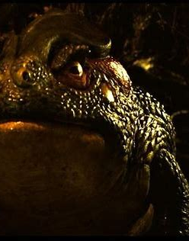
Mise en scene
The main elements of Mise en scene in this scene include:
Ofelia’s dress – Ofelia’s dress is of great importance in this scene because it represents Carmen and also the real world in a way. It shows how she’s abandoned left her mother and the mill and it could also be seen as her leaving the real world behind before entering the fantasy world. This emphasises are disobedience highly.
The giant fig tree – The tree is also important in this scene because it is like a passage to the fantasy world. Like the great spiral staircase, it goes downwards, which further backs the idea of the fantasy world being underneath the real world.
The gem stones – The gems which Ofelia hold are important mainly because they are what Ofelia needs to complete her quest. However they are also important because they similarly to the tree represent the fantasy world. In the real world they carry no significance, however in the fantasy world they are hugely important.
The toad – The toad is important in this scene because like the gem stones, Ofelia needs it to complete her quest, but also because the toad has multiple fascist qualities. It’s very greedy, and doesn’t have and respect or regard for the insects which it eats, like how Vidal had no regard for the hunters which he killed for no good reason earlier in the film.
The antibiotics – The antibiotics are important for multiple reasons as well. Firstly, they are important because they influence Vidal’s impression of the (rebels), he thinks they are ill and weak hiding in the forest. They are also important however because they are what give away the doctors betrayal to Vidal later on in the film.

Slide 5
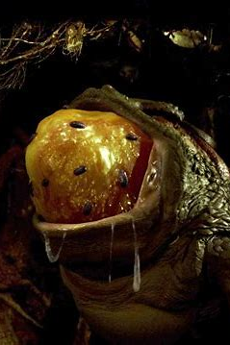
Sound
We get a lot of diegetic sound in this scene inside of the tree when Ofelia crawls through it. However we get some soundtrack before which is important.
We have some calm quiet piano playing subtly in the background alongside violins, but when Ofelia enters the tree we get a short sinister brass piece. This tells us that she is entering a dangerous environment and could be facing something bad or evil. However when the camera pans back to her dress wailing in the wind we hear the calm piano again. This represents the difference between the real world and the fantasy.
Inside the tree it is eerily quiet. There isn’t any soundtrack but there is a couple sound effects. We can hear the sludge of the mud as Ofelia crawls though it and we can hear insects walk and squeak. Although she doesn’t actually speak for a while here we can hear Ofelia’s fast shaken breathes as she crawls though the tunnel as well.
We then cut to a lot of noise with Vidal and his men on their horses. We can hear the horses hooves hit the ground, the jingling and jangling of the foot pegs, and also the sound of the horses legs brushing up against the ferns on the ground as well. We also get a lot of dialogue here from Vidal as he investigates the fire. He speaks with the same low volume he often speaks with, however he raises his voice a lot when he shouts at the (rebels) which we don’t hear often. This creates a lot of contrast in noise which continues throughout the scene.
When we go back to Ofelia we can hear the same sound effects as before, however when we meet the toad we are met with new sound effects. These are the sounds of the toad beathing and blinking so they are quite subtle, however we then get a sudden rise in volume when we get the aggressive sound of the toad launching its tongue towards Ofelia. We also get the very loud sound of the toad burping afterwards as well.
Once the toad has thrown up we see Ofelia grab the key from its stomach, and when she does we hear this sparkly sound effect which highlights its magical ness.

Slide 6
Editing
Editing wise there’s not much to talk about, however there are a couple stand out moments. The first of which is the insects.
Although Ofelia holds on of them at one point, for the most part in this scene the insects are CGI. They weren’t there when they filmed the scene but have been added in in post. You can tell this by the texture of them and also their shadows
There is also a lot of camera cuts in this scene, however the important one is when the camera goes behind a wall in the tunnel and then re emerges behind a tree in the woods. This is an effective way of transitioning through scenes and makes it feel seamless.

Slide 7
Performance
The main performance to focus of in this scene is Ofelia’s since she is pretty much the only character in this scene, and gets a lot of screen time throughout.
At the beginning of the scene she seems more confident. Although she speaks with the same, delicate voice which she usually does when telling stories, compared with later on she seems content. This dialogue is done over a voice over so it is not technically her performance.
When she enters the tree, it is very apparent to us that Ofelia is frightened at this point. She uses a scared facial expression paired with fast paced heavy breathing, and when she speaks with the toad, although she is mustering up her courage to talk to it, we can see that she is still frightened from the lack of eye contact she has with it and her fast paced speech. This is also paired with body shakes throughout which furthermore enhance her fear in this scene.
Another character to look at is Vidal, although he only has a minute or two on screen. He uses the same low volume, sinister voice in this scene which he uses often. However, in this scene we can see him let out his rage when he screams at the (rebels) in the mountains. This si the first time we see him truly let go, we also see his extremely angry facial expression in this scene which highlights his anger towards them.

