Slide 1
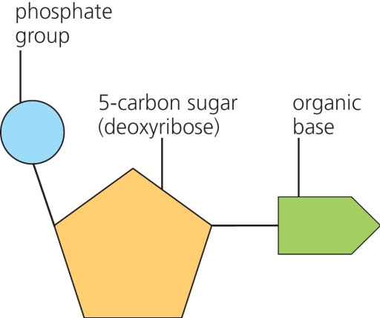
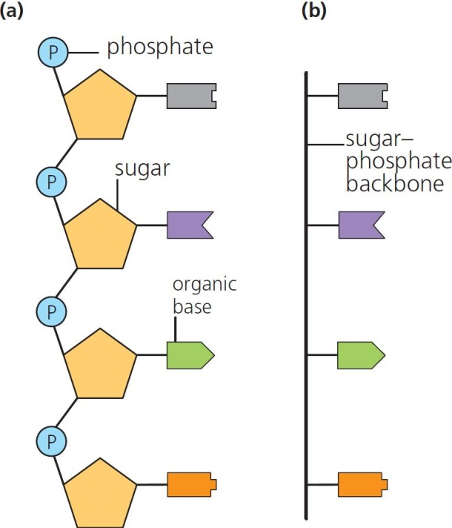
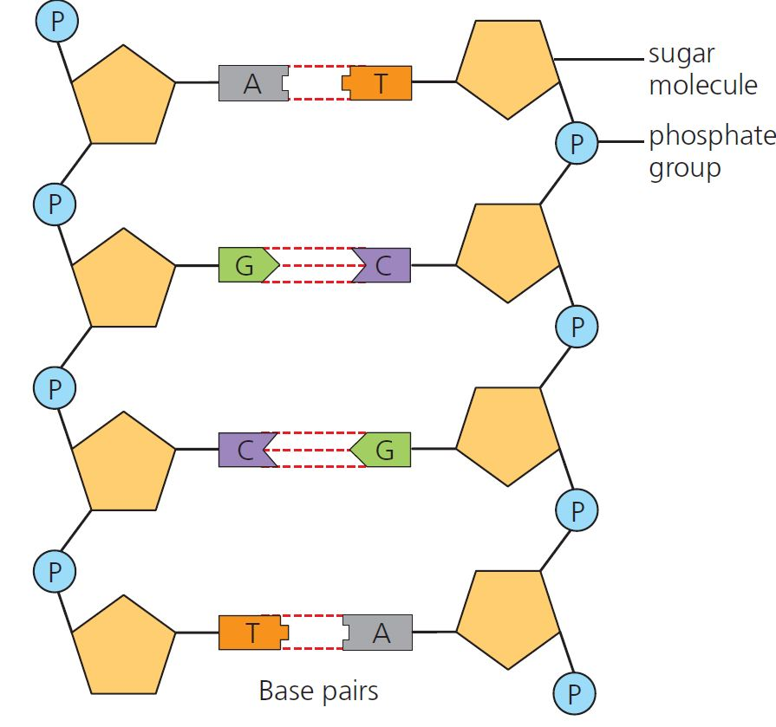
4 DNA and protein synthesis Summary
Nucleotides
Polynucleotides
Base pairing
Purines (A&G)
Pyrimidines (C&T)
Formed by condensation reactions
© Hodder & Stoughton 2015

Slide 2
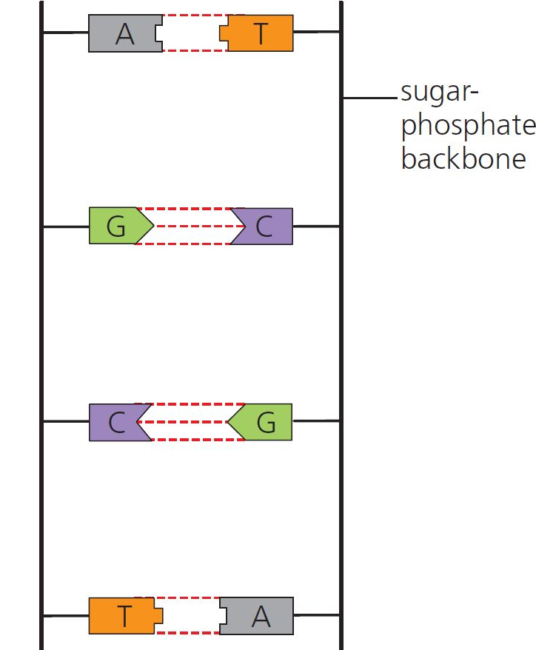
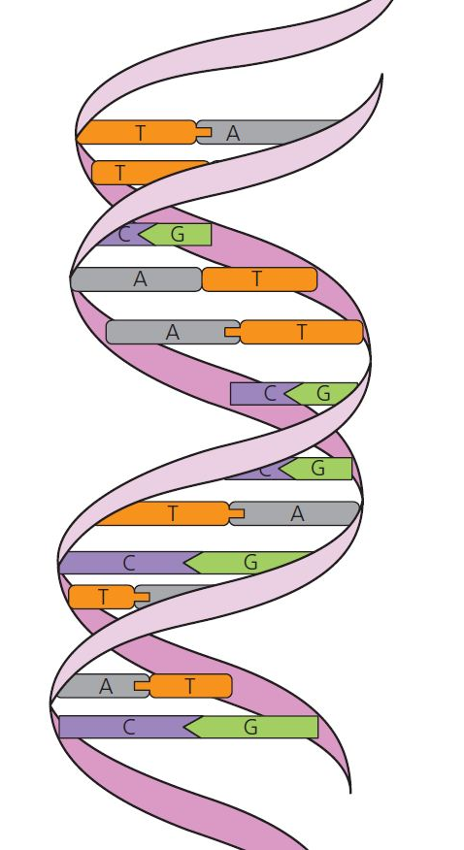
4 DNA and protein synthesis Summary
DNA
DNA twists to form an antiparallel double helix.
© Hodder & Stoughton 2015

Slide 3
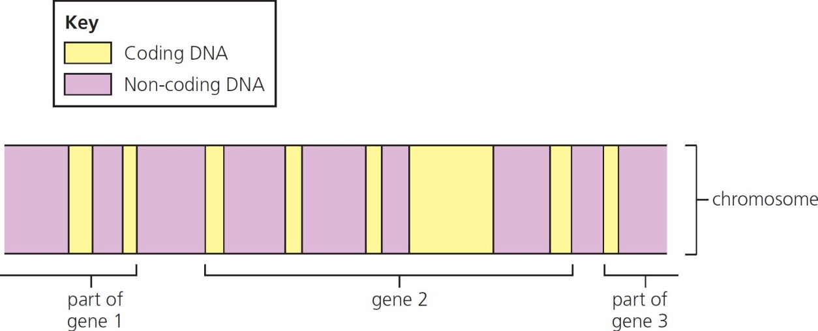
4 DNA and protein synthesis Summary
Chromosomes, genes and alleles
DNA strands condense to form chromosomes in the nucleus of eukaryotic cells.
The part of the DNA molecule that codes for a particular protein is called a gene – made up of coding and non-coding regions.
Different forms of one gene are known as alleles, e.g. Aa Bb.
© Hodder & Stoughton 2015

Slide 4
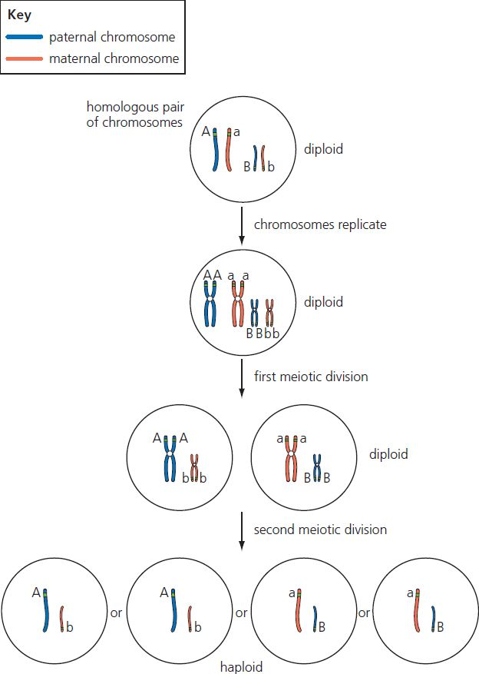
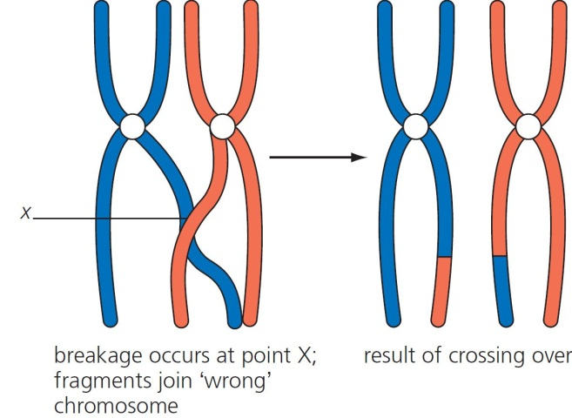
4 DNA and protein synthesis Summary
Meiosis
Meiosis splits homologous chromosomes to form haploid cells.
Alleles can swap homologous chromosomes when crossing over occurs
© Hodder & Stoughton 2015

Slide 5
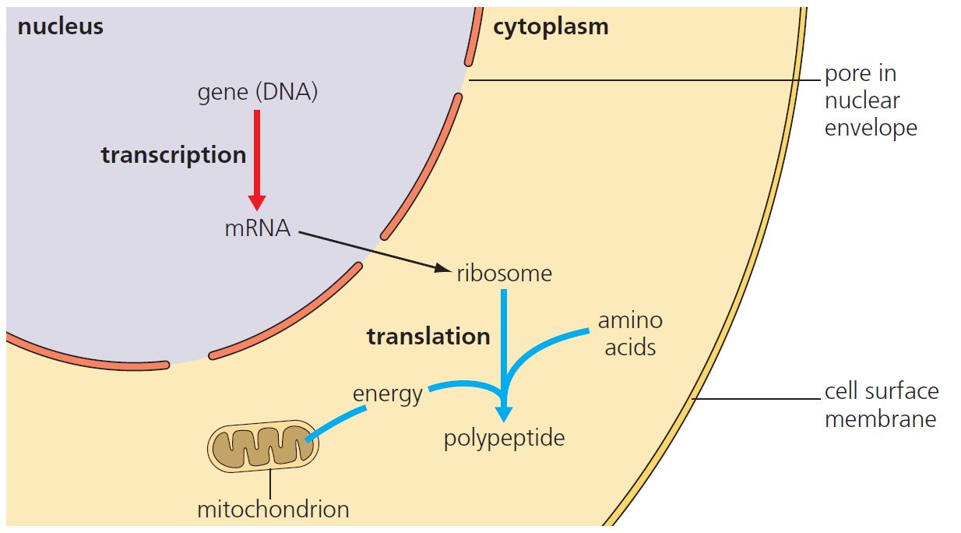
4 DNA and protein synthesis Summary
Protein synthesis
DNA codes for proteins.
Transcription in nucleus: DNA → mRNA
Translation in cytoplasm: mRNA → protein
© Hodder & Stoughton 2015

Slide 6
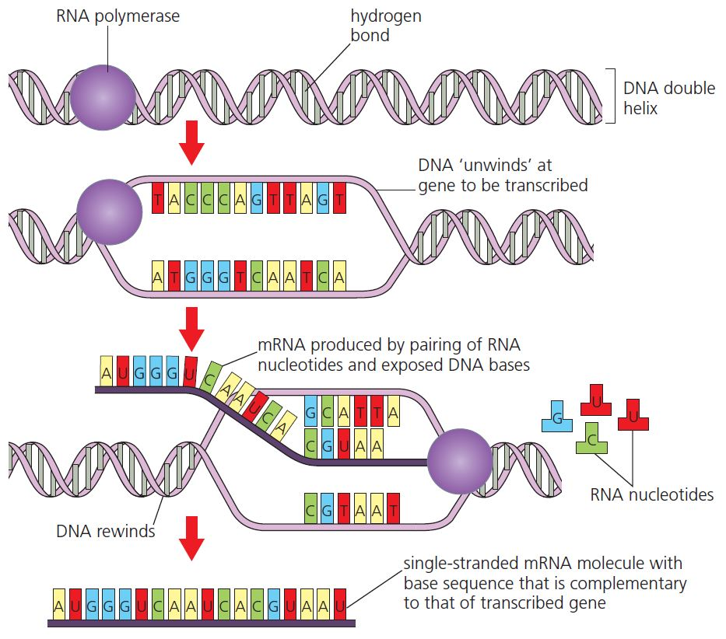
4 DNA and protein synthesis Summary
Transcription
DNA unwinds to allow mRNA formation.
© Hodder & Stoughton 2015

Slide 7
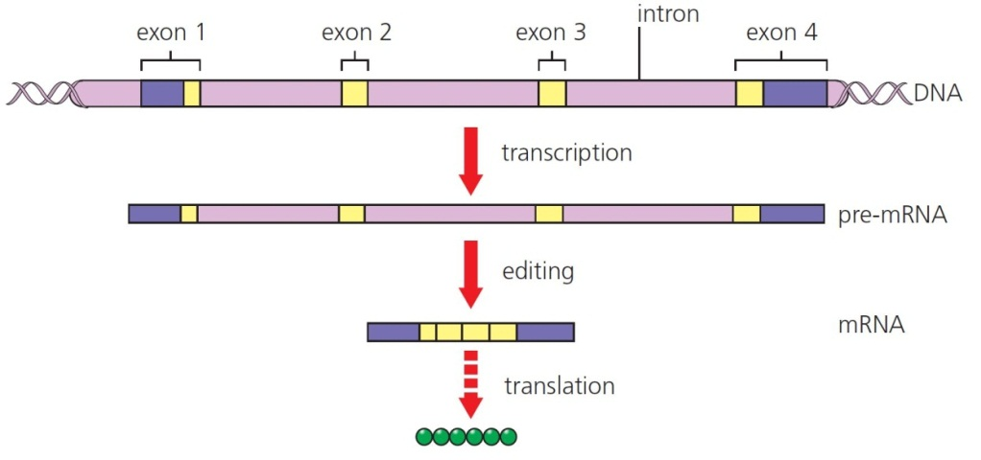
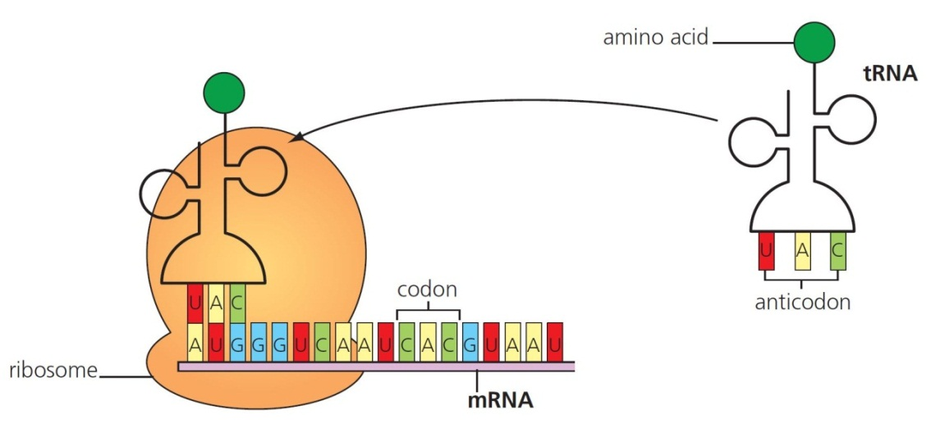
4 DNA and protein synthesis Summary
mRNA is processed:
introns removed and exons spliced together.
Translation
Amino acids brought to the mRNA codons using tRNA.
© Hodder & Stoughton 2015

Slide 8
4 DNA and protein synthesis Summary
Questions
Draw and label a dinucleotide.
Explain how DNA is well suited to its function.
Write down the complimentary mRNA sequence for the following DNA coding sequence:
AGGGCTGTCAGTCA
Define the following:
codon
anticodon.
Explain why translation requires a supply of ATP.
© Hodder & Stoughton 2015

