Slide 1
Carbohydrate structure and bonding
1 Biological molecules Key concepts
Next
© Hodder & Stoughton 2015

Slide 2
1 Biological molecules Key concepts
Carbohydrates are molecules containing carbon, hydrogen and oxygen. They include sugars, starch, glycogen and cellulose.
Single carbohydrate units or monosaccharides are small, soluble sugars like. glucose. Monosaccharides can be joined together to form larger, insoluble molecules like starch and cellulose.
The three main groups of carbohydrate are:
Monosaccharides
like glucose and fructose.
Disaccharides
like sucrose, lactose and maltose.
Polysaccharides
like starch, glycogen and cellulose.
Next
© Hodder & Stoughton 2015

Slide 3
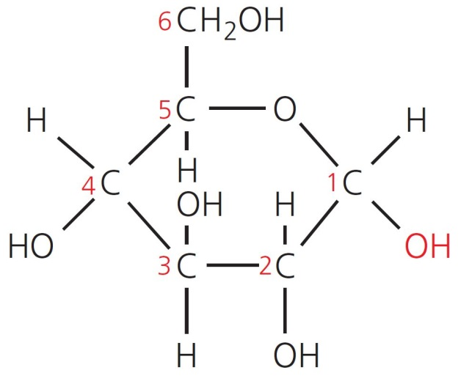
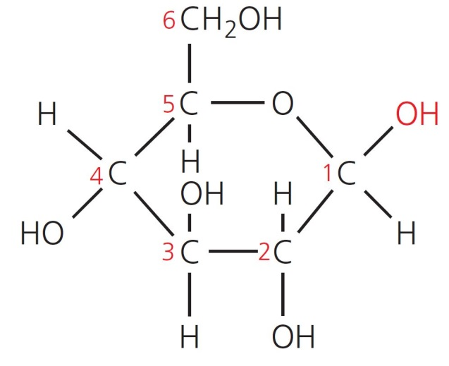
1 Biological molecules Key concepts
Monosaccharides
There are two forms of glucose.
Alpha glucose which is the monomer for disaccharides, starch and glycogen.
Beta glucose which can be built up into cellulose.
α-glucose
β-glucose
Back
Next
© Hodder & Stoughton 2015

Slide 4
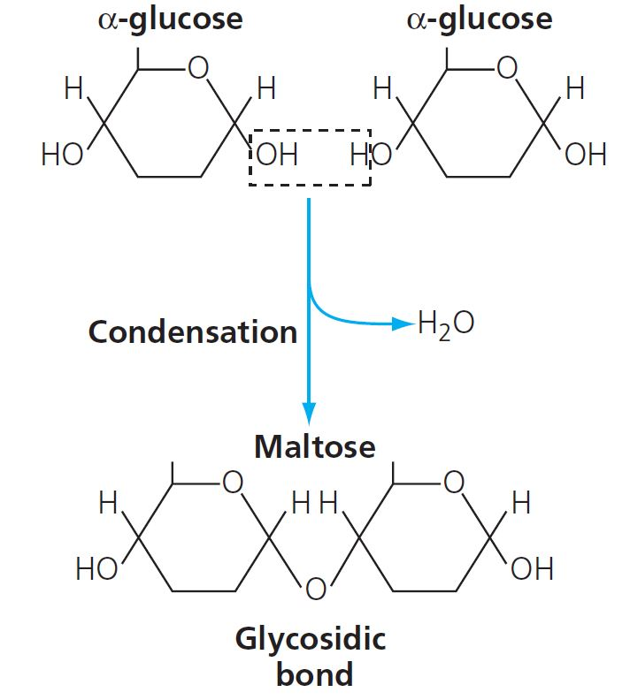
1 Biological molecules Key concepts
Disaccharides
When two monosaccharides join they form a disaccharide. A glycosidic bond forms between carbon atoms 1 and 4 on adjacent glucose molecules. This is a condensation reaction because water is released. Maltose is formed from two alpha glucose molecules.
Sucrose is a disaccharide of glucose and fructose. Lactose is a disaccharide of glucose and galactose.
Back
Next
© Hodder & Stoughton 2015

Slide 5
1 Biological molecules Key concepts
Polysaccharides
Polysaccharides are polymers of monosaccharides. Their properties and functions vary according to whether they are composed of alpha glucose or beta glucose molecules.
Starch and glycogen are examples.
α-glucose
β-glucose
Back
Next
© Hodder & Stoughton 2015

Slide 6
1 Biological molecules Key concepts
Questions
What do the numbers on the glucose molecules represent?
The carbon atoms in a ring are numbered so they can be identified and the position of the bonds more easily described.
What is the structural difference between an alpha and a beta glucose molecule?
The position of the H and OH groups on carbon atom 1 are reversed.
What is the name given to two compounds that have the same chemical formula but differ in the arrangement of their atoms?
Isomers.
Answers
Next
© Hodder & Stoughton 2015

Slide 7
1 Biological molecules Key concepts
Starch
Starch is mixture of two polysaccharides both of which are polymers of alpha glucose.
These are:
Amylose
Amylopectin
Next
© Hodder & Stoughton 2015

Slide 8
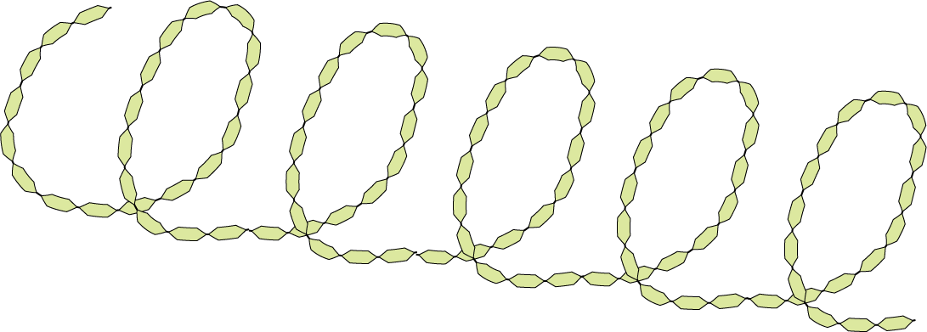
1 Biological molecules Key concepts
Amylose
Amylose is a long chain coiled into an alpha helix.
1,4 glycosidic bond
alpha glucose monomers
Amylose is a chain of 1,4 linked alpha glucose molecules twisted into a helix. The structure is held in position by hydrogen bonds.
Back
Next
© Hodder & Stoughton 2015

Slide 9
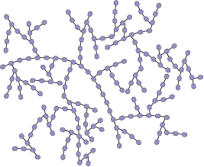
1 Biological molecules Key concepts
Amylopectin
Amylopectin a highly branched structure.
Glycogen has a more highly branched structure than amylopectin. It is a storage polysaccharide found in animal cells and fungi.
alpha glucose molecules joined by 1⁻,4 bonds
side chain forms a 1,6 glycosidic bond
glycosidic bond between adjacent alpha glucose molecules
Back
Next
© Hodder & Stoughton 2015

Slide 10
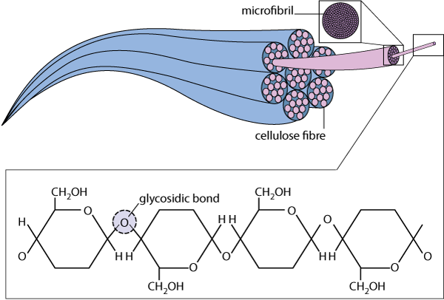
1 Biological molecules Key concepts
Cellulose
Cellulose is composed of chains of beta glucose units arranged in parallel rows to form microfibrils.
Next
© Hodder & Stoughton 2015

Slide 11
1 Biological molecules Key concepts
Questions
If a condensation reaction releases water when a bond is formed, what is a hydrolysis reaction?
The breaking of a bond in the presence of water (and an enzyme).
What are the names of the enzymes that hydrolyse:
lactose
maltose?
Why is starch a good storage polysaccharide?
It is a compact molecule which is insoluble.
Why is cellulose so difficult to digest?
Mammals do not have the enzyme cellulase. Digestion is usually carried out by micro-organisms that live in a herbivore’s gut. In humans, cellulose forms roughage in the diet.
lactase
maltase
Answers
End
© Hodder & Stoughton 2015

