Slide 1
Morse & Semaphore

Slide 2
Aims
By the end of this lesson, you will be able to:
Send and receive Morse signals
Send and receive semaphore signals
So that you can use different ways of communicating in cadets to send messages

Slide 3
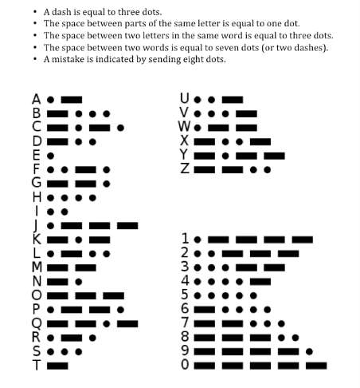
Morse
Made by turning a signal on and off
What could you use to send Morse?
Dots are called ‘dits’
Dashes are called ‘dah’s’
They are called ‘dits’ and ‘dah’s’ because that’s how they sound
A ‘dah’ should take the same time as three ‘dits’
Leave long gaps between letters and words
Morse can be more effective than voice on a radio with poor signal

Slide 4
Morse practical
Break-off into teams and send each other messages using Morse code

Slide 5
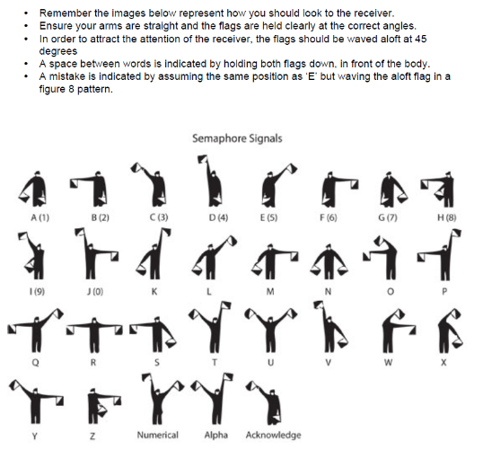
Semaphore
Using flags to communicate
Between each letter, return the flags to the front
Some signals are shared for numbers and letters
Use a ‘change character’
‘Numerical’ for numbers
‘Alpha’ for letters
The images show how each letter looks to the receiver

Slide 6
Semaphore practical
Break off into teams to send each other messages

Slide 7
Any Questions?
?

Slide 8
Summary
You should now be able to:
Send and receive Morse signals
Send and receive semaphore signals

Slide 9
Final Confirmation
Split into teams of three:
Person 1 sends message to person 2 using Morse
Person 2 sends the message on to person 3 using semaphore
Person 3 compares the received message with the message person 1 sent
Make sure you know who is on your team so you receive the correct message!
Who will get their message sent through correctly first?

