Slide 1
Enzymes
2 Enzymes Key concepts
Next
© Hodder & Stoughton 2015

Slide 2
2 Enzymes Key concepts
Introduction
Enzymes are biological catalysts. They speed up chemical reactions in living organisms. For example, an enzyme may break a bond within a substrate. The substrate is split into products. The enzyme will also bond the products together. Enzymes catalyse reversible reactions. Enzymes work best under a set of optimum conditions.
Next
© Hodder & Stoughton 2015

Slide 3
2 Enzymes Key concepts
Decide whether each of these statements is TRUE or FALSE.
All enzymes work at pH 7.
FALSE. Some enzymes work at pH 7 but they all have their own optimum pH.
Increasing the temperature above 45°C makes an enzyme controlled reaction speed up.
FALSE. At temperatures above 45°C the enzyme denatures and the reaction stops.
Enzymes work on one substrate only.
TRUE. Enzymes are specific.
Enzymes are proteins which denature when it is cold.
FALSE. Enzyme action slows down when it is cold. They do not denature.
Enzymes have a tertiary structure.
TRUE. Enzymes are proteins folded into a tertiary structure.
Enzymes increase the rate of chemical reactions.
TRUE. Enzymes are biological catalysts and speed up reaction rates.
Answers
Next
© Hodder & Stoughton 2015

Slide 4
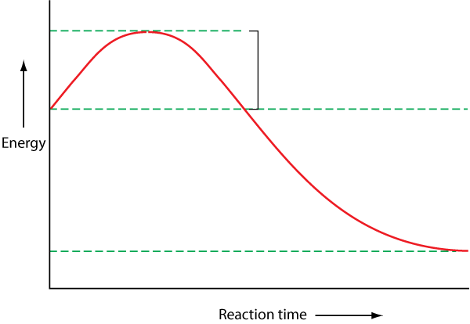
2 Enzymes Key concepts
Activation Energy
Activation energy is the minimum amount of energy required to make a reaction take place. For example, if sucrose is boiled with hydrochloric acid, it breaks down into glucose and fructose. A lot of activation energy in the form of heat is required. The enzyme sucrase will break sucrose down rapidly at room temperature.
Activation energy required to break down sucrose without an enzyme
Activation energy in form of heat required
Energy level of sucrose
Energy level of the products, glucose and fructose
Next
© Hodder & Stoughton 2015

Slide 5
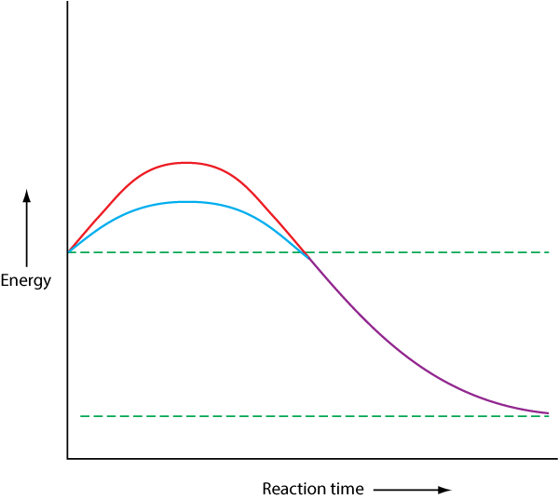
2 Enzymes Key concepts
Activation Energy
Click to reveal the three hotspots.
Activation energy required when enzyme is present
Higher activation energy required for the reaction without the enzyme.
With an enzyme, the activation energy required is lower. The reaction will take place at body temperature.
Energy level of the products is the same with, or without the enzyme.
Reveal
Next
© Hodder & Stoughton 2015

Slide 6
2 Enzymes Key concepts
Questions
Give two ways in which the disaccharide maltose can be broken down into glucose monomers.
1. The maltose would be boiled in acid.
2. The maltose can be broken down by the enzyme maltase.
Which method requires more activation energy?
A large amount of activation energy is required in the form of heat when maltose is boiled.
Answers
Next
© Hodder & Stoughton 2015

Slide 7
2 Enzymes Key concepts
How an enzyme works
The shape of an enzyme is critical to its function. The enzyme has a depression on its surface called the active site. The active site is shaped so that only one complementary substrate fits into it. When an enzyme and its substrate join, the bonds within the substrate molecule are put under stress. The bonds break. The products formed leave the active site. The enzyme is unchanged and can be re-used.
Next
© Hodder & Stoughton 2015

Slide 8
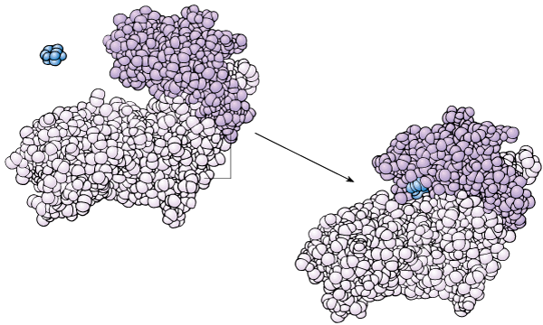
2 Enzymes Key concepts
How an enzyme works
Substrate
Enzyme substrate complex
Active site
Enzyme has changed shape to mould itself around the substrate
Enzyme
Reveal
Next
© Hodder & Stoughton 2015

Slide 9
2 Enzymes Key concepts
Questions
What are the substrates in this reaction?
Glucose and ATP.
What are the products of this reaction?
Glucose phosphate and ADP.
What is the name of the enzyme?
Hexokinase.
Why is the enzyme substrate complex a slightly different shape?
When the substrate binds to the active site, the complex is a slightly different shape.
How has the enzyme rearranged the substrate molecules?
A phosphate group has been removed from ATP and added to the glucose.
Answers
Next
© Hodder & Stoughton 2015

Slide 10
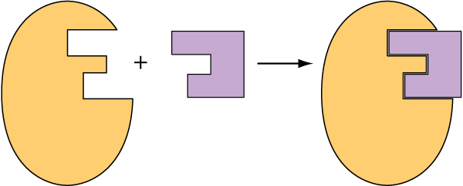
2 Enzymes Key concepts
Lock and Key Mechanism Model
This theory explains enzyme action by suggesting that an enzyme and its substrate fit together like a key fitting into a lock.
The active site is an exact complement of the substrate
Substrate molecule fits snugly into the active site
Substrate – the key
Enzyme-Substrate Complex – the key fits into the lock
Enzyme – the lock
Reveal
Next
© Hodder & Stoughton 2015

Slide 11
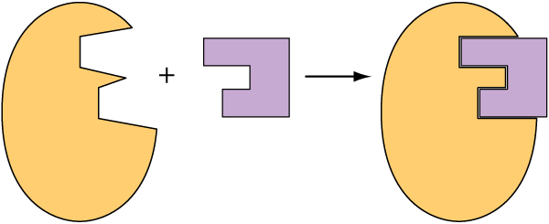
2 Enzymes Key concepts
Induced Fit Model
The substrate enters the active site and the enzyme moulds around it creating a closer more secure fit.
Active site is not an exact complement of the substrate
Enzyme moulds itself around substrate for a closer fit
Substrate
Enzyme-Substrate Complex
Enzyme
Reveal
Next
© Hodder & Stoughton 2015

Slide 12
2 Enzymes Key concepts
Questions
Enzymes are proteins which work best under optimum conditions. What happens to an enzyme controlled reaction if the temperature is raised above 45°C?
The reaction stops.
Explain your answer in terms of the active site.
The active site changes shape. It will no longer be complementary to the substrate. The substrate does not fit.
Explain your answer in terms of the bonding within the enzyme.
Heat increases the kinetic energy of molecules. The increased kinetic energy makes the molecule vibrate and breaks the bonds. The tertiary structure is lost.
What happens to an enzyme controlled reaction if the temperature is very low? Explain your answer.
The enzyme is not changed but the reaction is much slower.
Answers
End
© Hodder & Stoughton 2015

