Slide 1
Immunology
6 The immune system Key concepts
Next
© Hodder & Stoughton 2015

Slide 2
6 The immune system Key concepts
Introduction: Antigens and antibodies
The immune system is dependent on the interaction between the antibodies produced by the bodies white blood cells and the antigens on the surface of every cell.
Next
© Hodder & Stoughton 2015

Slide 3
6 The immune system Key concepts
Click on the six hotspots to learn more.
Antibody. Antibodies are special proteins known as immunoglobulins, made up of four polypeptide chains. They are highly specific to a particular antigen.
Antigen. Antigens are glycoproteins (a combination of protein and carbohydrate) found on the surface of every cell. The glycoproteins are genetically determined and become embedded in the cell surface membrane, uniquely identifying the cell type. Antigens from an organisms own body are referred to as ‘self’ – those from another organisms are known as ‘foreign’.
Antigen binding site. Specific sequences of amino acids creates a specific region for the binding of antigens. This region varies between different antibodies.
Light chain polypeptides.
Heavy chain polypeptides, bound together by disulphide bridges.
Bacterium
Next
© Hodder & Stoughton 2015
Antigen-antibody complex.

Slide 4
6 The immune system Key concepts
Non-specific barriers
The body prevents invasion from microorganisms using a range of non-specific methods. These prevent entry of pathogens into the body and subsequent destruction of any microorganisms that do gain entry. Click on each method to learn more.
Skin
The skin acts as a physical barrier to the entry of microorganisms such as bacteria and viruses.
The lining of the gut, respiratory system and reproductive system consists of epithelial layers protected by a layer of mucus.
The stomach secretes hydrochloric acid which destroy any pathogens that enter the body on the food that we eat.
Enzymes secreted in the stomach, tears, saliva and urine help destroy microbes before they can gain entry into the body.
Phagocytes are white blood cells that engulf and digest any foreign particles, including microorganisms, that have entered the body.
Dilation of blood vessels at the site of infection brings phagocytes. Proteins such as histamine aid this process.
Mucus membranes
Stomach acids
Enzymes
Phagocytes
Inflammation
What are the advantages of having a non-specific immune response?
Next
© Hodder & Stoughton 2015

Slide 5
6 The immune system Key concepts
Specific immunity
Once a pathogen has invaded the body, a sequence of defences are set up which identify the microorganism and then target specific defences to destroy it. This is known as the specific immune response and involves two types of cells – B lymphocytes and T lymphocytes.
Next
© Hodder & Stoughton 2015

Slide 6
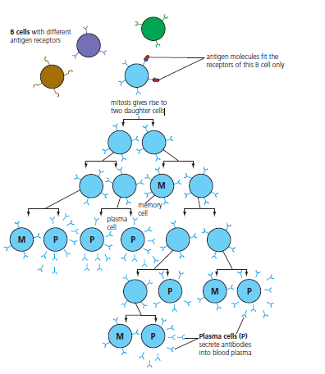
6 The immune system Key concepts
The pathogens antigens are recognised by a specific B cell which then clones itself to produce two types of cell – memory cells and plasma cells. The plasma cells secrete antibodies that bind to the specific antigen and results in the destruction of the pathogen. The memory cells remain in the body and protect from subsequent infection.
Next
© Hodder & Stoughton 2015

Slide 7
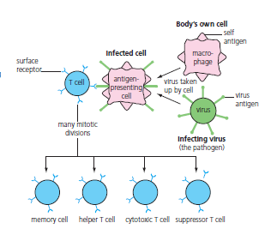
6 The immune system Key concepts
One of the invading microbes is engulfed by a special phagocyte called a macrophage. The microbes antigens are taken to the T cells by the macrophage and the T cell then clones itself to produce four types of cell: memory cells, helper T cells, killer T cells and suppressor T cells.
Next
© Hodder & Stoughton 2015

Slide 8
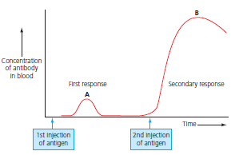
6 The immune system Key concepts
Vaccination and immunity
Vaccination is the process of exposing the body to antigens in a controlled and safe manner. This stimulates the immune system to produce memory cells that then protect us.
The primary response results in the short term production of antibodies, but also results in formation of memory cells.
The secondary response occurs as a result of stimulation of the memory B cells and produces a large, long term secretion of antibodies.
A mother’s blood and mothers milk carries antibodies that are transferred to the baby, imparting immunity.
Use of vaccines that protect the body (with antibodies) but do not stimulate the immune system to produce memory cells.
The production of memory cells as a result of a natural infection.
Primary response
The production of memory cells as a result of a vaccination that mimics the antigens found on a pathogenic microbe.
Secondary response
Natural passive immunity
Artificial passive immunity
Natural active immunity
Artificial active immunity
Next
© Hodder & Stoughton 2015

Slide 9
6 The immune system Key concepts
Define these terms.
antigen
Foreign or non-self substance that induces an immune response.
antibody
A blood protein produced by B lymphocytes against specific antigens.
passive immunity
Short term immunity derived from introduced antibodies.
active immunity
Immunity brought about by antibody production.
natural immunity
Immunity brought about by naturally occurring material.
artificial immunity
Immunity brought about by injection with antibodies or antigenic material.
Answers
End
© Hodder & Stoughton 2015

