Slide 1
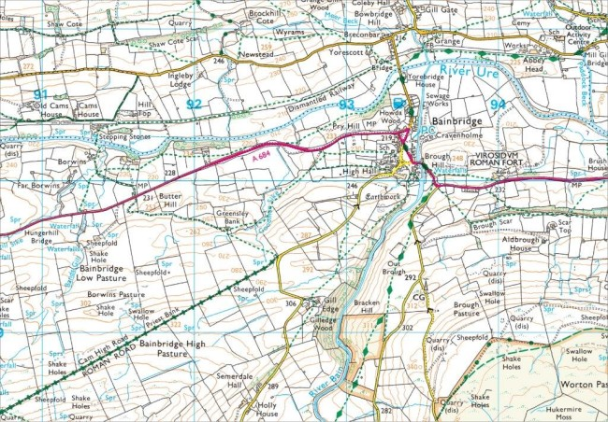
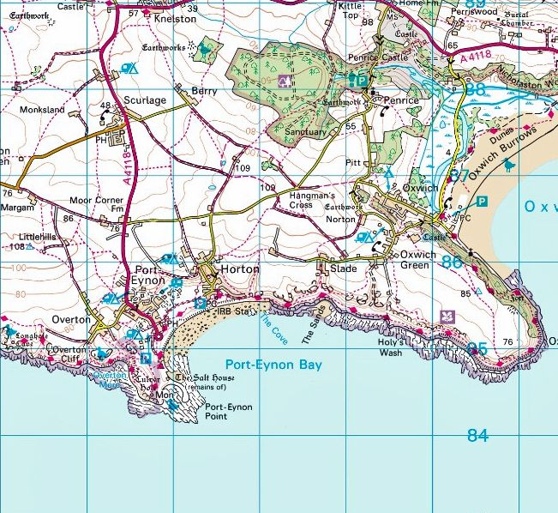
Map bearings and distances

Slide 2
How to take a bearing on a map.
Place an edge of the compass over the original location.
Orientate the compass correctly, edge which is over the original point, needs to be over, or in line with the destination.
Orientate the compass housing so the North symbol is pointed North on the map.
Once this done ensure the edge of the compass is still aligned with both the original position and the destination.
Read of the number on the compass housing that is in line with the direction of travel arrow. This will give the correct bearing.

Slide 4
How to measure distances on a map.
Use a strip of paper or string to mark the distance between 2 points

Slide 5
Cont.
Line this strip up with the maps scale, from this you can determine the distance between 2 points as the crow flies.
You can use the grid squares on most OS maps as a quick estimate, as each grid square represents a square kilometre.

Slide 6
Following a route.
Mark your strip of paper at each turn and then continue to the next curve, repeat until the destination is reached.

