Slide 1
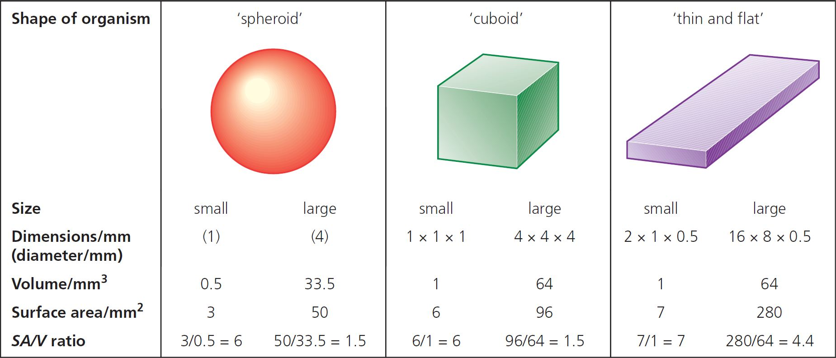
7 Gas exchange Summary
Surface area to volume ratio
Small organisms tend to have a large surface area to volume ratio, so making gas exchange more efficient.
© Hodder & Stoughton 2015

Slide 2
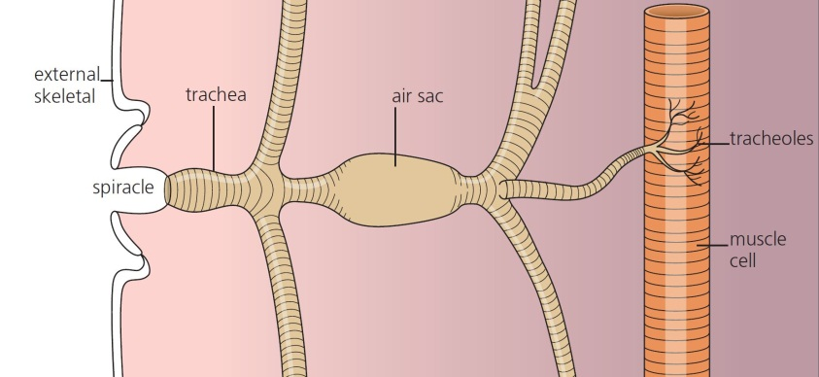
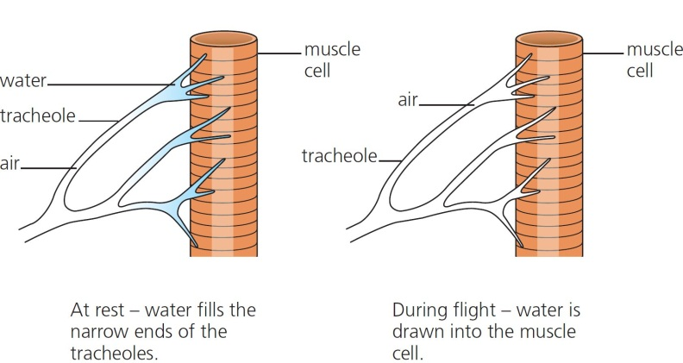
7 Gas exchange Summary
Insects
Insects take air into the body through a series of holes called spiracles. These lead to branched fluid-filled tubes called trachea.
© Hodder & Stoughton 2015

Slide 3
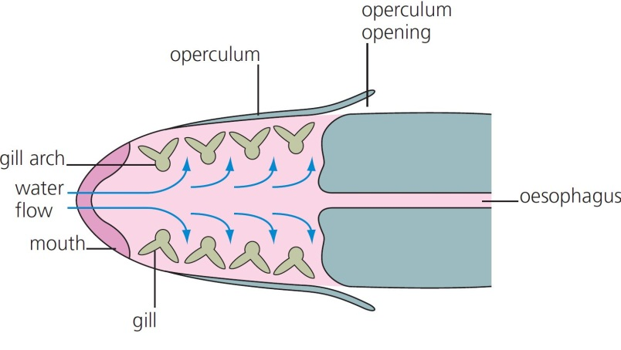
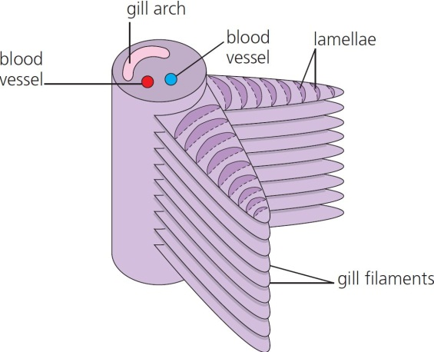
7 Gas exchange Summary
Fish
Fish use gills as a gas exchange surface with filaments and lamellae to increase surface area and a counter-current system to increase efficiency.
© Hodder & Stoughton 2015

Slide 4
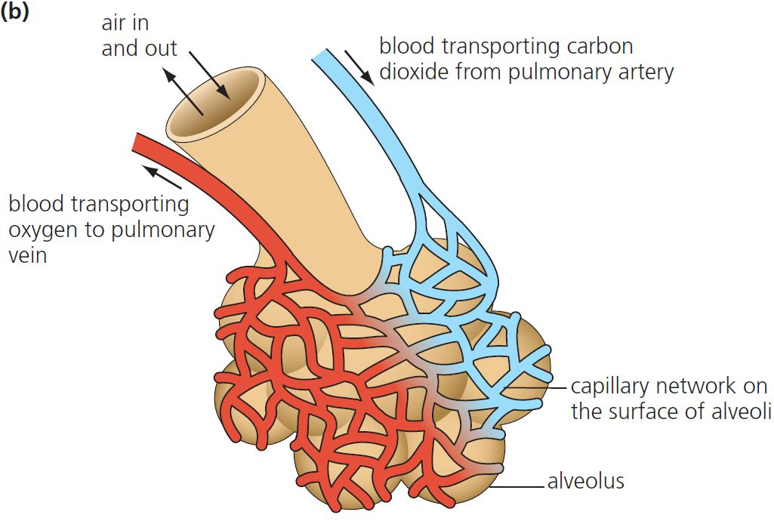
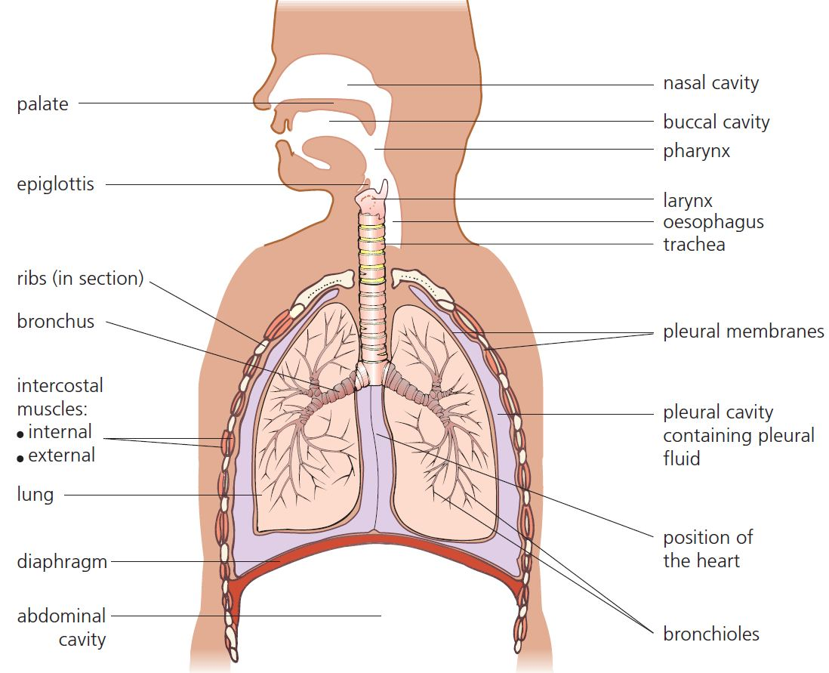
7 Gas exchange Summary
Mammals
In mammals the gas exchange surface is the lungs.
© Hodder & Stoughton 2015

Slide 5
7 Gas exchange Summary
Ventilation
Ventilation involves the movement of air into and out of the lungs to maintain a concentration gradient.
 | Inspiration | Expiration
Diaphragm | Contract (flattens) | Relax
Internal intercostal muscles | Relax | Contract
External intercostal muscles | Contract | Relax
Rib cage | Rises | Falls
Chest volume | Increases | Decreases
Pressure | Decreases | Increases
Airflow | In | Out
Spirometry
The volume of air in the lungs can be recorded suing a spirometer.
© Hodder & Stoughton 2015

Slide 6
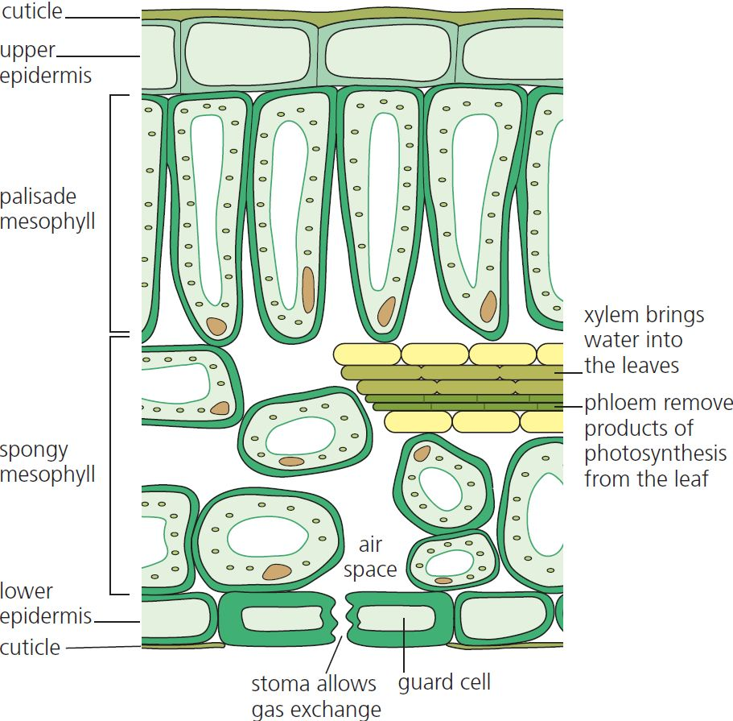
7 Gas exchange Summary
Plants
Plants exchange gases within the mesophyll tissue of the leaf. Gas enters through stomata.
© Hodder & Stoughton 2015

Slide 7
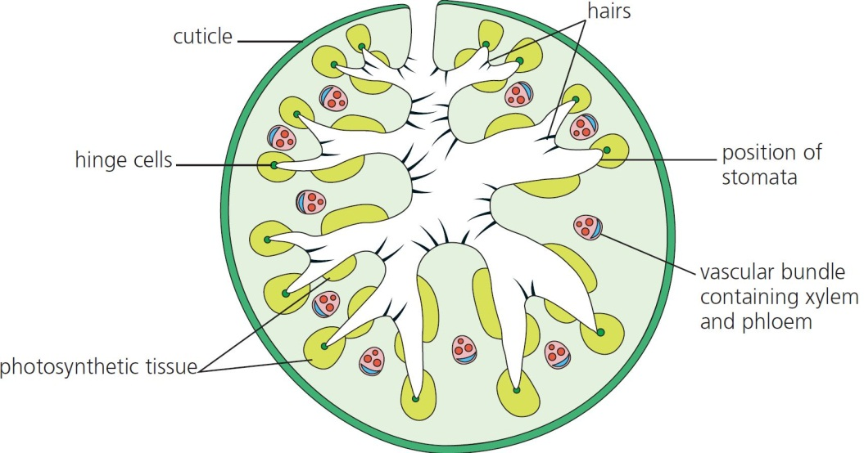
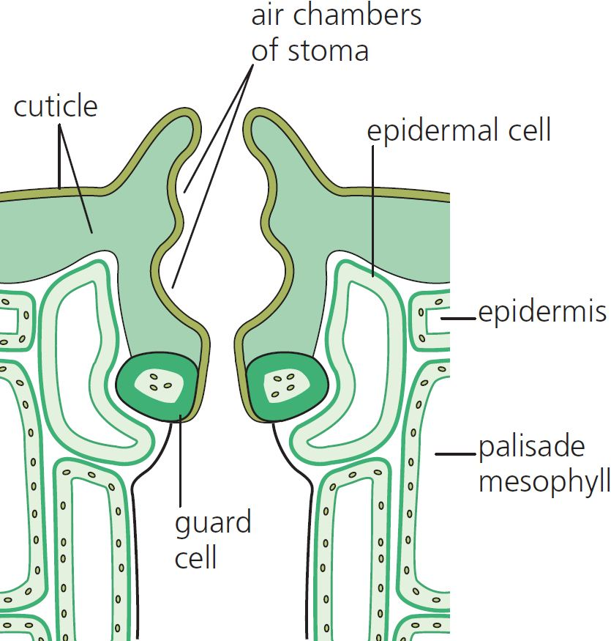
7 Gas exchange Summary
Adaptations to reduce water loss
Thick cuticle
Small or needle-shaped leaves
Few stomata
Stomata sunk into pits in the epidermis
Hairs around the stomata and over the leaf surfaces.
© Hodder & Stoughton 2015

Slide 8
7 Gas exchange Summary
Questions
Name the features of a gas exchange surface.
Explain how a spirometer can be used to measure the rate of cellular respiration.
What is meant by a counter-current mechanism?
Why would fluid move from trachea into the muscles during exercise in insects?
Why do the stomata sometimes close to reduce gas exchange in the leaf?
© Hodder & Stoughton 2015

