Slide 1
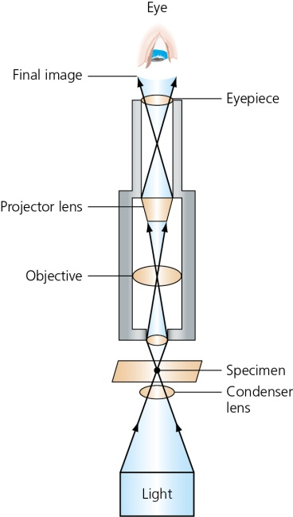
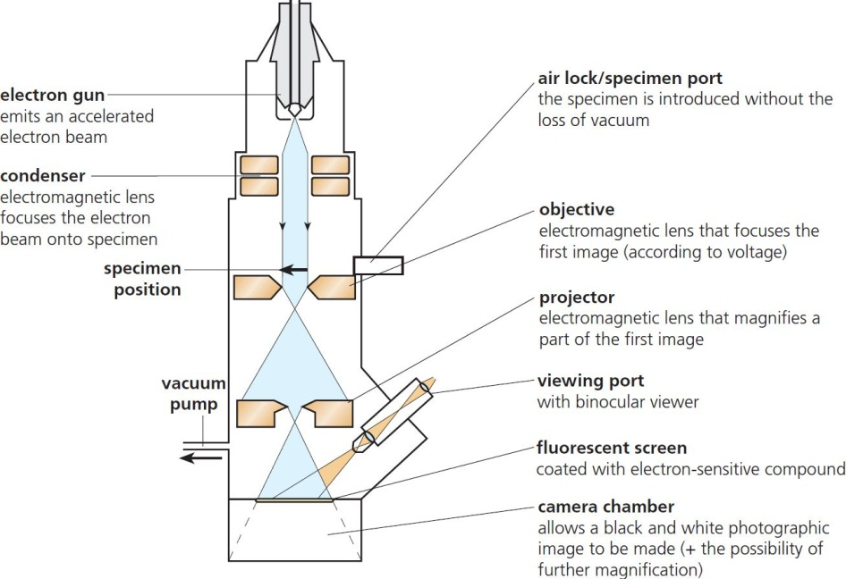
3 Cells Summary
The light microscope
The electron microscope
Resolution 1 μm
Magnification x 1500
Resolution 1 nm
Magnification x 1 000 000
© Hodder & Stoughton 2015

Slide 2
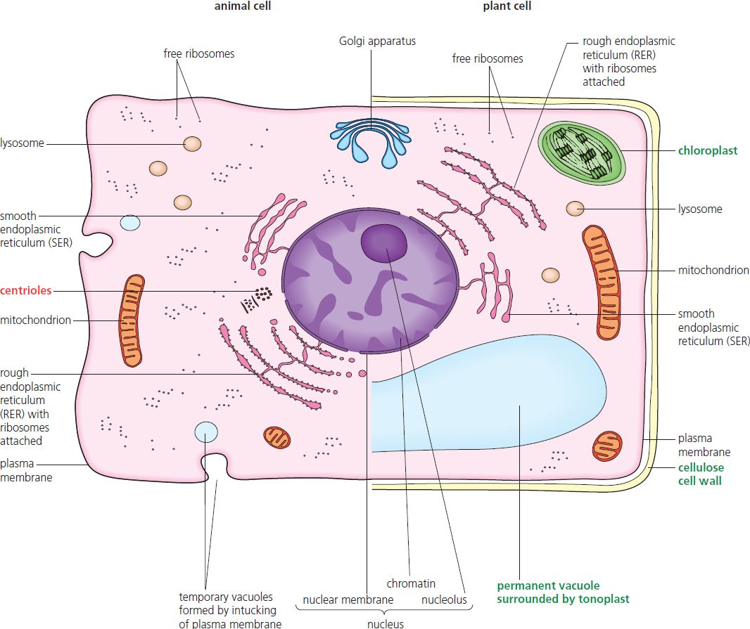
3 Cells Summary
Cell ultrastructure
© Hodder & Stoughton 2015

Slide 3
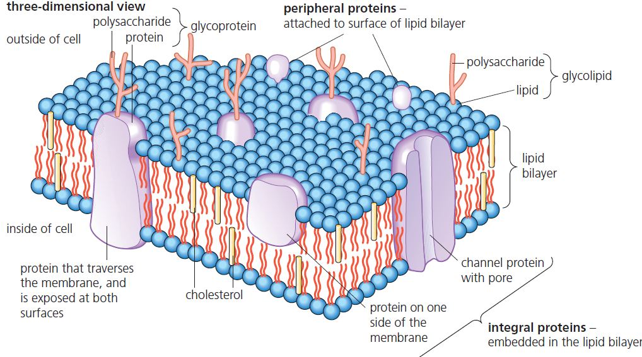
3 Cells Summary
Cell membranes – the fluid mosaic model
© Hodder & Stoughton 2015

Slide 4
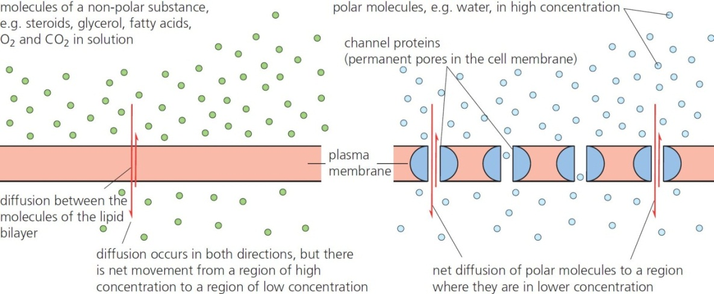
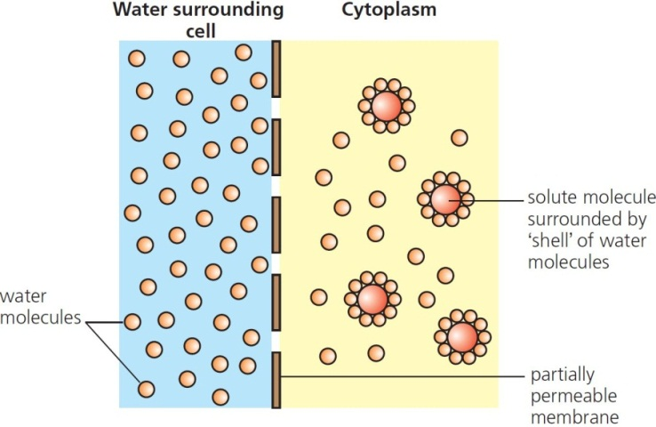
3 Cells Summary
Cell transport
Osmosis
© Hodder & Stoughton 2015

Slide 5
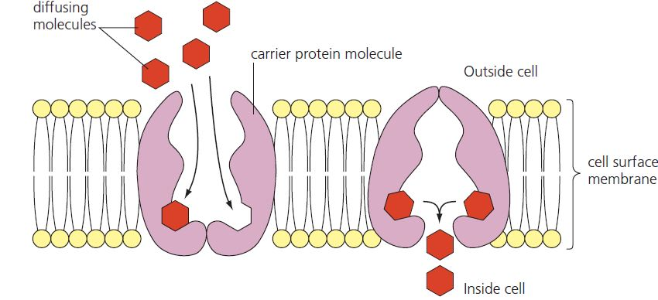
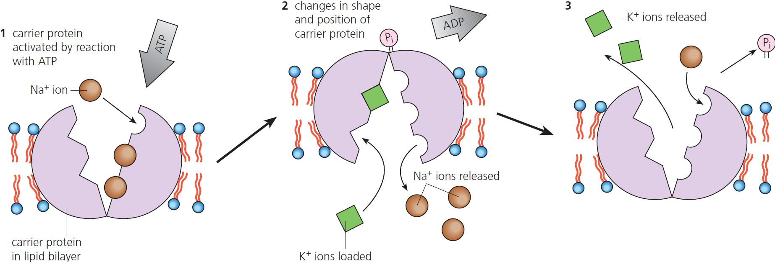
3 Cells Summary
Facilitated diffusion
Active transport
© Hodder & Stoughton 2015

Slide 6
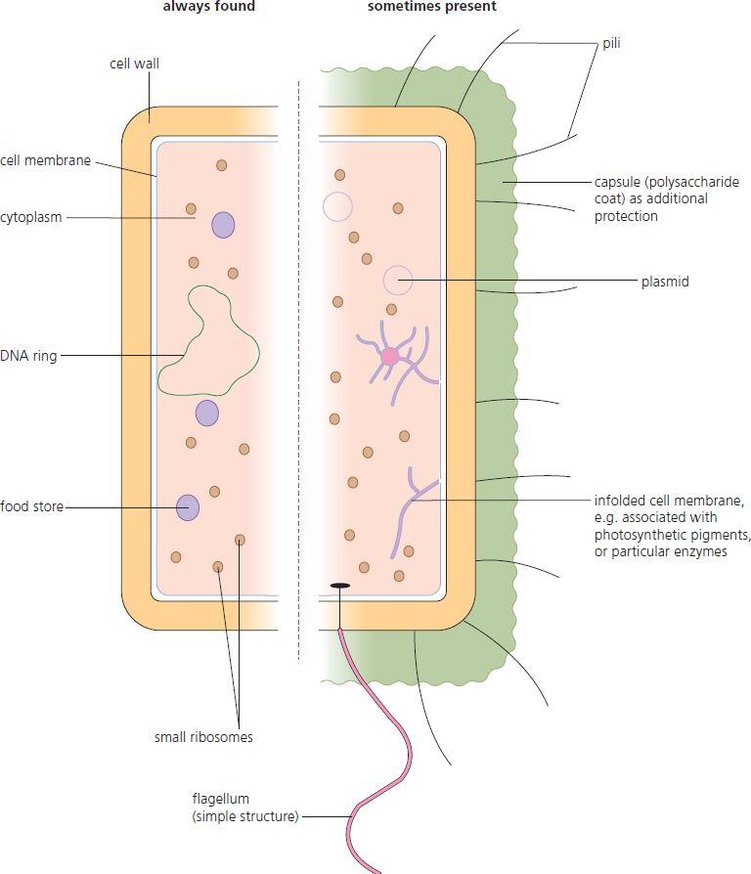
3 Cells Summary
Prokaryotic cells
The bacteria:
Small single cells with no internal membrane-bound organelles
© Hodder & Stoughton 2015

Slide 7
3 Cells Summary
Questions
Compare a plant cell with an animal cell.
List the components of a cell surface membrane.
Define the following:
diffusion
osmosis
facilitated diffusion
active transport.
Describe how a prokaryotic cell differs from a eukaryotic cell.
© Hodder & Stoughton 2015

