Slide 1
Structure of the British Army
1 Star Military Knowledge

Slide 2
The Role of the British Army
Purpose of the British Army (4mins)

Slide 3
Key Components of the British Army
Command Structure | British Army (3 mins)
The British army’s units are identified by unique insignia. For example their cap badge:

Slide 4
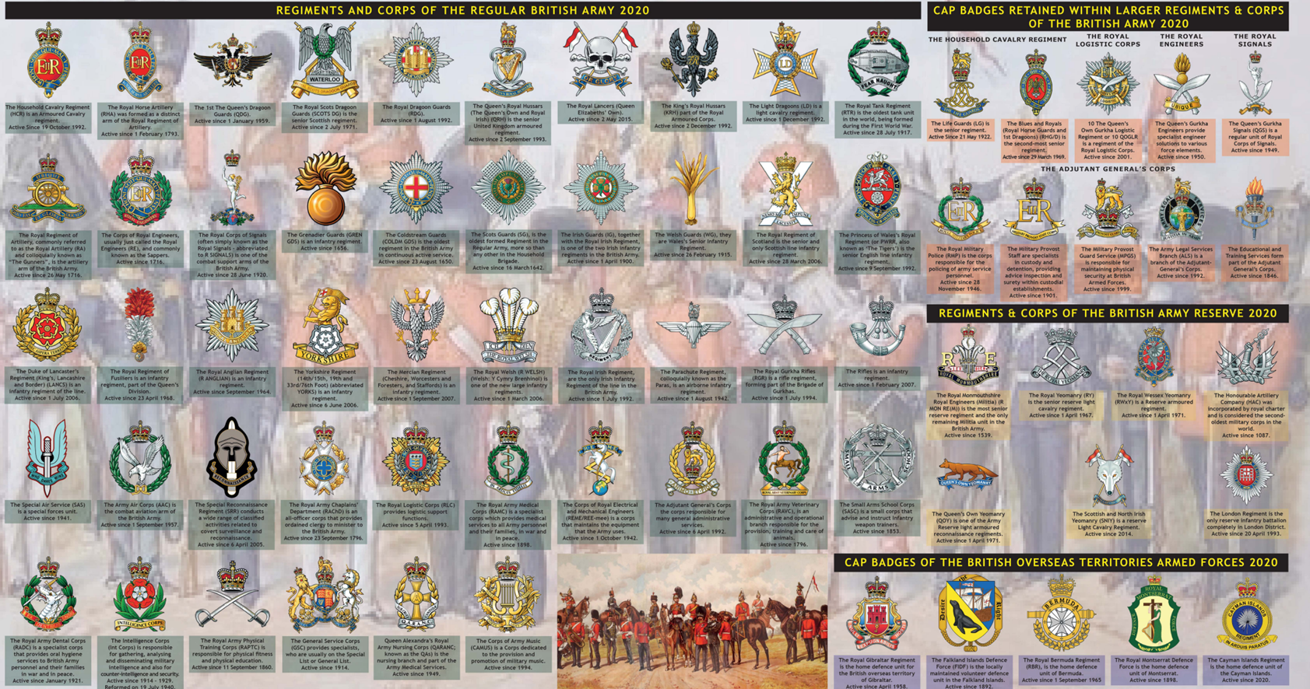
Key Components of the British Army

Slide 5
Examples of Army Formations: Infantry Regiments
The Princess of Wales’ Royal Regiment (PWRR)
This is the infantry regiment to which Elizabeth College CCF army section is affiliated. It was formed from the Royal Hampshire Regiment which had a long association with Guernsey.

Slide 6
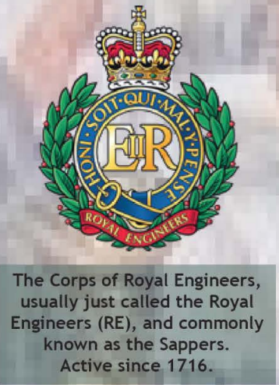
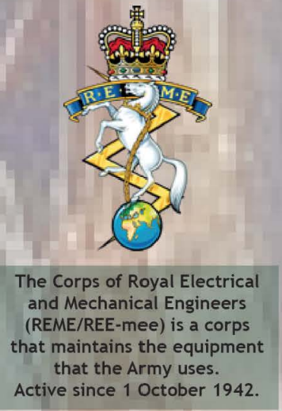
Examples of Army Formations: Engineering Corps

Slide 7
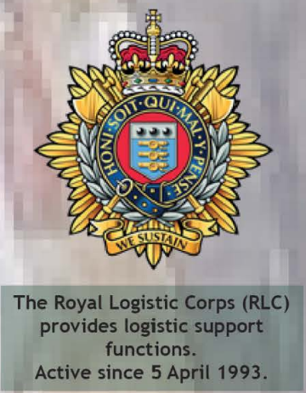
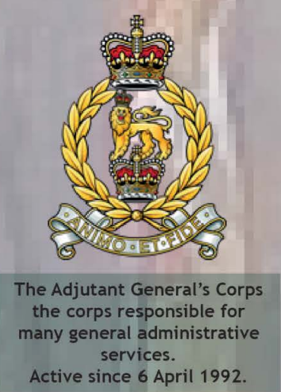
Examples of Army Formations: Logistical/Administrative

Slide 8
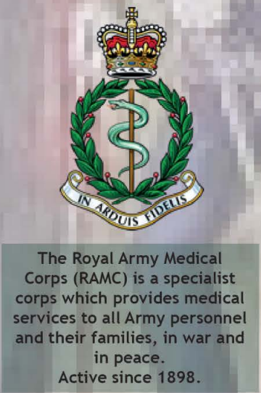
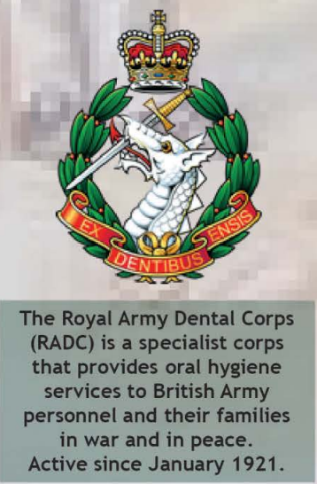
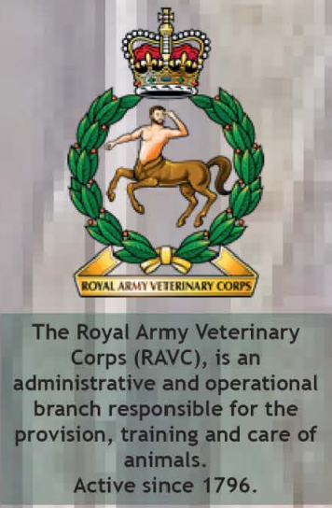
Examples of Army Formations: Medical/Vetinary Corps

Slide 9
Final Confirmation
Can you name an infantry regiment?
The Princess of Wales’s Royal Regiment (PWRR)
Can you name an engineering Corps?
The Royal Engineers The Royal Electrical and Mechanical Engineers (REME)
Can you name a logistical/administration corps?
The Royal Logistic Corps The Adjutant General Corps
Can you name a medical/veterinary corps?
The Royal Army Medical Corps The Royal Army Dental Corps The Royal Veterinary Corps

