Slide 1
Protein Structure and Bonding
1 Biological molecules Key concepts
Next
© Hodder & Stoughton 2015

Slide 2
1 Biological molecules Key concepts
Proteins are built up from just 20 amino acids. Amino acids are held together by peptide bonds forming long chains or polypeptides. The order of amino acids in a polypeptide is coded for by the sequence of bases on DNA.
Amino acids within a polypeptide interact with each other to form a specific three dimensional shape.
There are four levels of protein structure:
Primary structure
Tertiary structure
Secondary structure
Quaternary structure
Next
© Hodder & Stoughton 2015

Slide 3
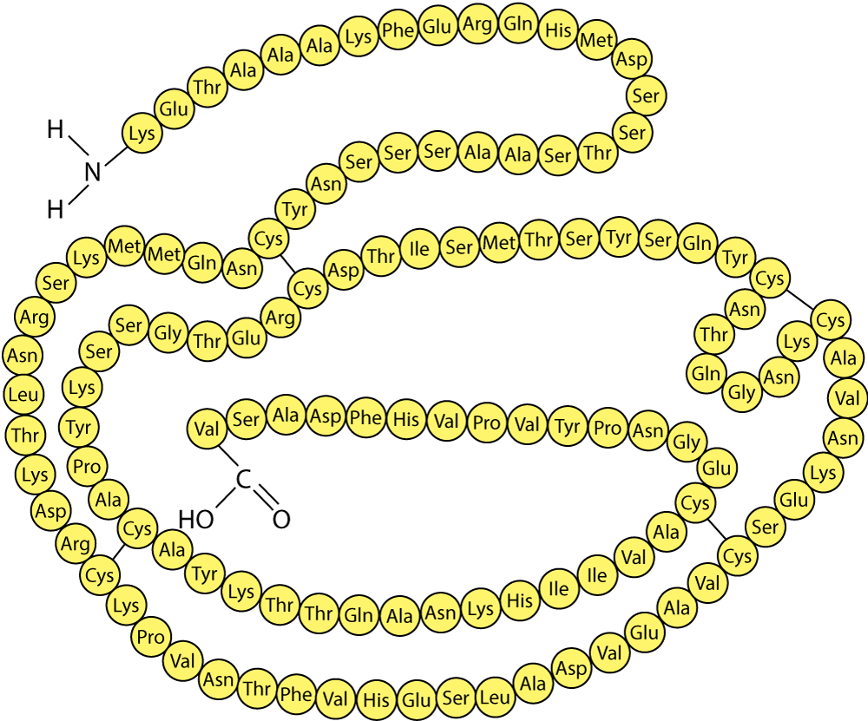
1 Biological molecules Key concepts
Primary structure
The primary structure is the order of amino acids in a polypeptide. The amino acids are held together by peptide bonds.
Back
Next
© Hodder & Stoughton 2015

Slide 4
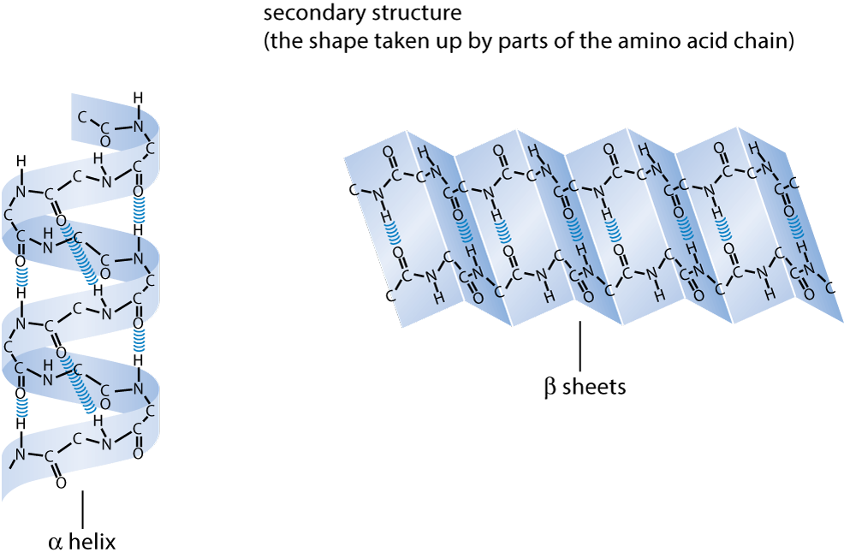
1 Biological molecules Key concepts
Secondary structure
The secondary structure is the folding of the primary structure into pleated sheets or helical structures.
Back
Next
© Hodder & Stoughton 2015

Slide 5
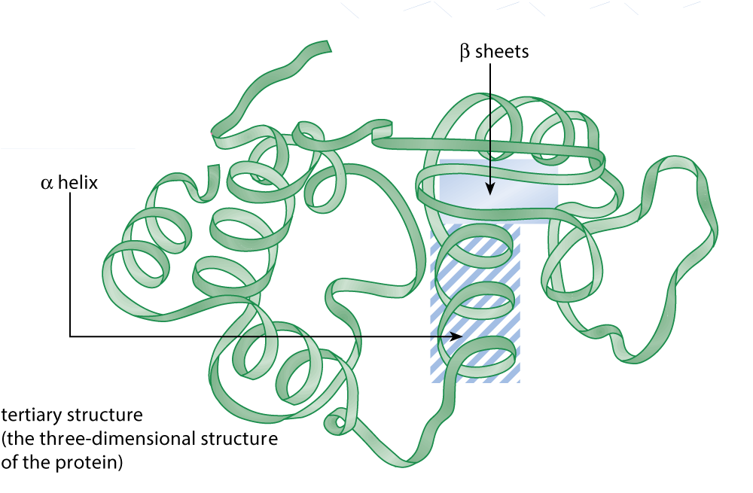
1 Biological molecules Key concepts
Tertiary structure
The tertiary structure forms when the secondary structures is folded. This produces a 3D shape. It can be a mixture of alpha helices and beta pleated sheets.
Back
Next
© Hodder & Stoughton 2015

Slide 6
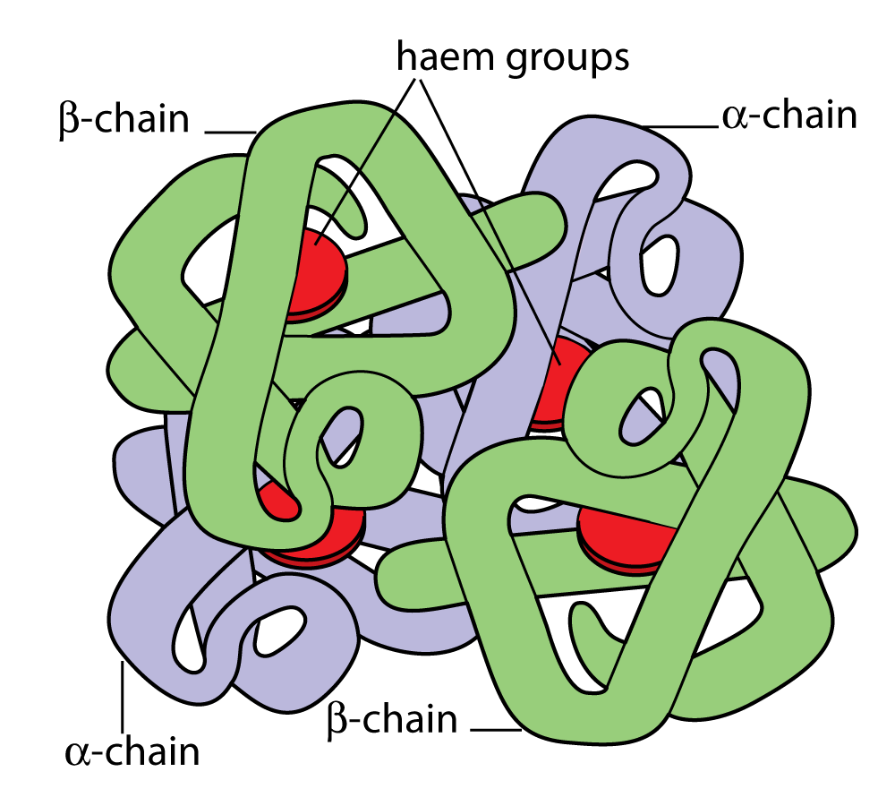
1 Biological molecules Key concepts
Quaternary structure
The quaternary structure is formed when two or more polypeptide chains bond. E.g. haemoglobin has four polypeptides.
Back
Next
© Hodder & Stoughton 2015

Slide 7
1 Biological molecules Key concepts
Polypeptides are held together with different types of bond.
Peptide bonds
Hydrogen bonds
Ionic bonds
Disulphide bonds
Hydrophobic/hydrophilic interactions
Next
© Hodder & Stoughton 2015

Slide 8
1 Biological molecules Key concepts
Peptide bonds
Peptide bonds form between the amino group of one amino acid and the carboxyl group of another. Peptide bond formation is a condensation reaction because water is lost.
Back
Next
© Hodder & Stoughton 2015

Slide 9
1 Biological molecules Key concepts
Hydrogen bonds
Hydrogen bonds are weak attractive forces between oppositely charged molecules. They form between the R groups of amino acids. Hydrogen bonds hold the secondary structure together.
Back
Next
© Hodder & Stoughton 2015

Slide 10
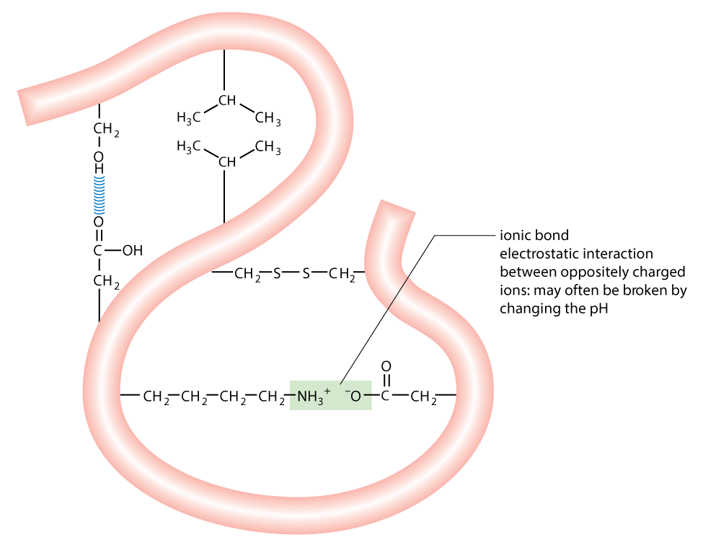
1 Biological molecules Key concepts
Ionic bonds
Ionic bonds are interactions between oppositely charged ions. They are strong bonds which may be disrupted by pH changes.
Back
Next
© Hodder & Stoughton 2015

Slide 11
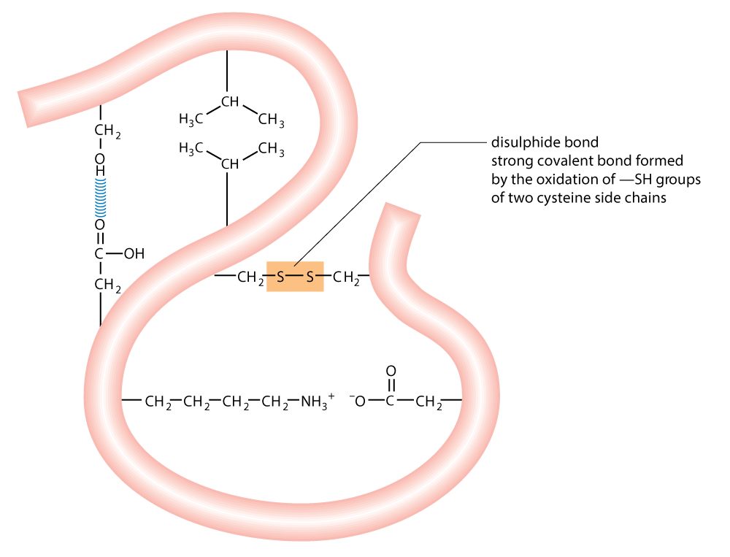
1 Biological molecules Key concepts
Disulphide bonds
Disulphide bonds are strong covalent bonds. They form between amino acids (e.g. cysteine) that contain sulphur in their R groups.
Back
Next
© Hodder & Stoughton 2015

Slide 12
1 Biological molecules Key concepts
Hydrophobic/hydrophilic interactions
Some amino acids have hydrophobic (water repelling) R groups. Others have hydrophilic (water loving) R groups. Interactions between these opposing forces twists the polypeptide into different shapes.
Back
Next
© Hodder & Stoughton 2015

Slide 13
1 Biological molecules Key concepts
Questions
What is a condensation reaction?
The release of a water molecule when two amino acids bond together during the formation of a peptide bond.
Describe the primary structure of a protein.
The sequence of amino acids along a polypeptide chain.
Name two bonds that hold the tertiary structure of a protein in position.
Any two from ionic, covalent, disulphide, hydrophobic interactions, hydrogen.
What two shapes make up the secondary structure of a protein?
Alpha helix, beta pleated sheet.
What is meant by the hydrophobic region of a protein?
Amino acids which repel water.
Answers
End
© Hodder & Stoughton 2015

