Slide 1
Polymers

Slide 2
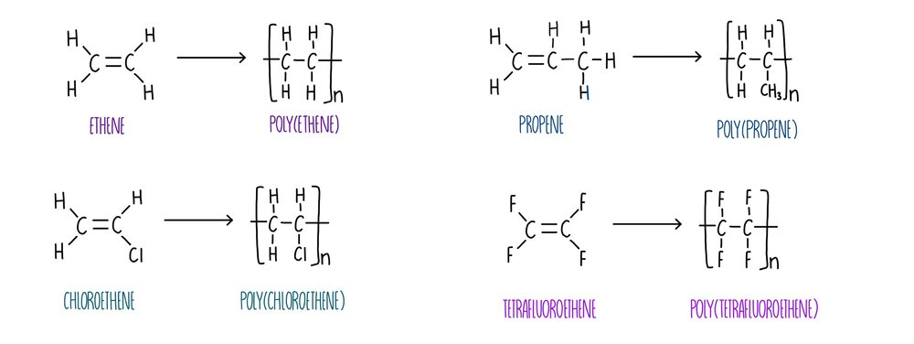
Two kinds
Addition Polymers
Formed when alkenes react (the monomer)
To form long chains with single carbon-carbon bonds
And any atoms out to the side depending on what the monomer was:

Slide 3
Two kinds
Condensation Polymers
Formed from reactions similar to esterification reactions
This time you will need two different monomers
Each monomer needs to have two reactive ends
E.g.

Slide 4
Condensation Polymers
Polyesters
They form from the same reactions that form esters
You need a carboxylic acid – but at both ends
You need an alcohol – but at both ends
Where they react, an ester linkage forms
A water molecule is also produced

Slide 5
Condensation Polymers

Slide 6
Condensation Polymers
Nylon
Formed from a diol:
And an amine:
React to form an amide linkage at both ends:

