Slide 1
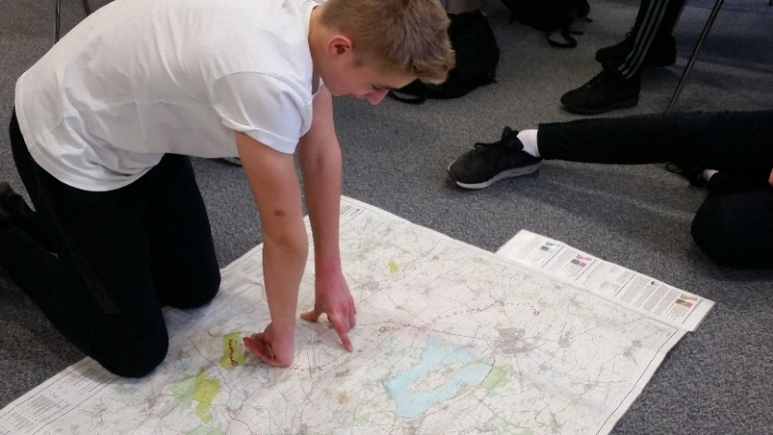
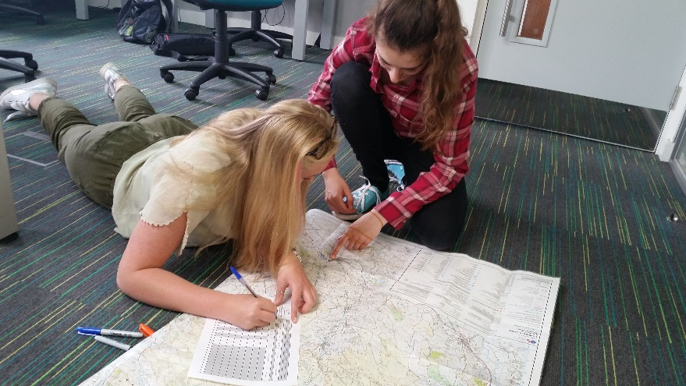
Route Planning
For your DofE Expedition
You have two things to complete....
Plan and mark up your expedition on a map
Enter your expedition onto eDofE mapping
All map images are crown copyright and reproduced via the Duke of Edinburgh's Award E-DofE license training provision.

Slide 2
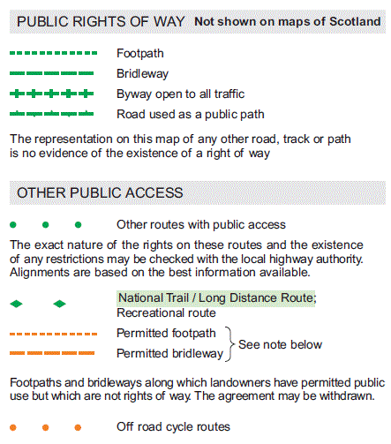
Step 1 – planning your route
With the help of your instructor:
Find the start/finish points.
2. Work out a route using GREEN public rights of way. GET IT CHECKED! Mark it up carefully.
3. Put in 5-6 legs/sections.
4. Mark up both maps with complete expedition and front cover

Slide 4
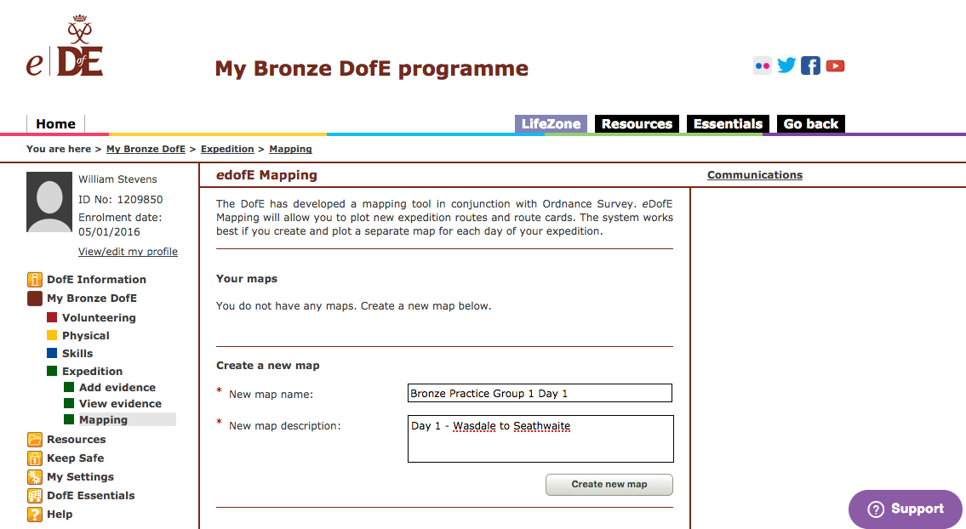
Step 2 – eDofE mapping
With the help of your instructor:
1. Log into eDofE
2. Map your route on the mapping software
3. Complete the route card with checkpoints & description
4. SAVE, SEND and PRINT

Slide 5
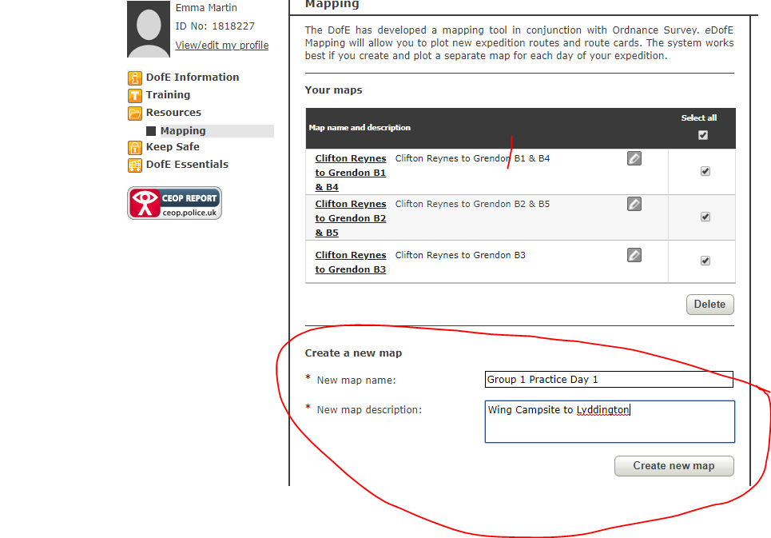
A. Create a map name & description

Slide 6
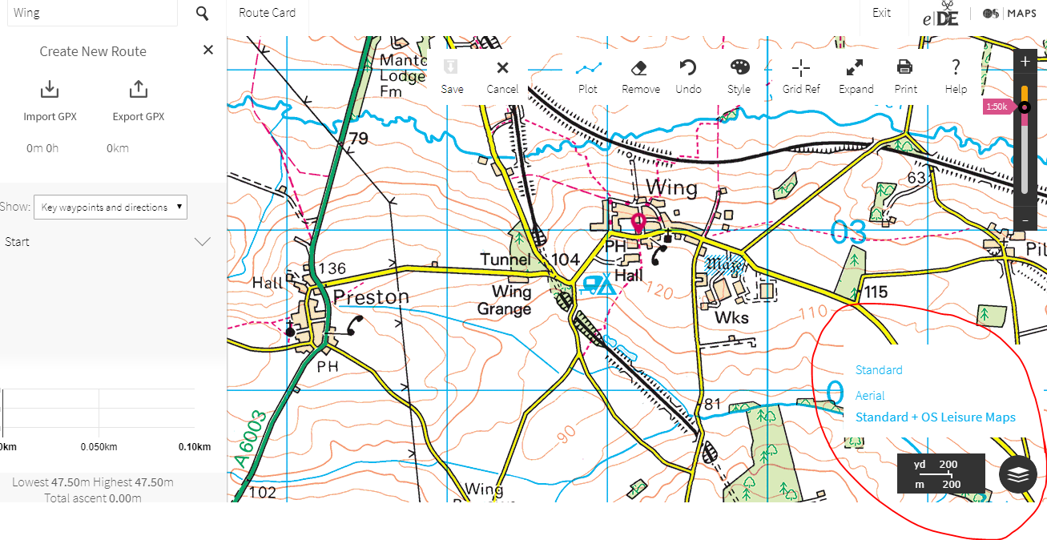
B. Find OS Leisure Map

Slide 7
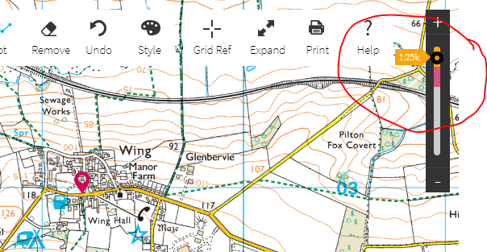
C. Find OS Map 1:25k

Slide 8
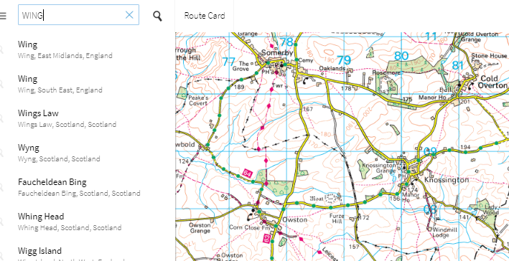
D. Find your LOCATION

Slide 9
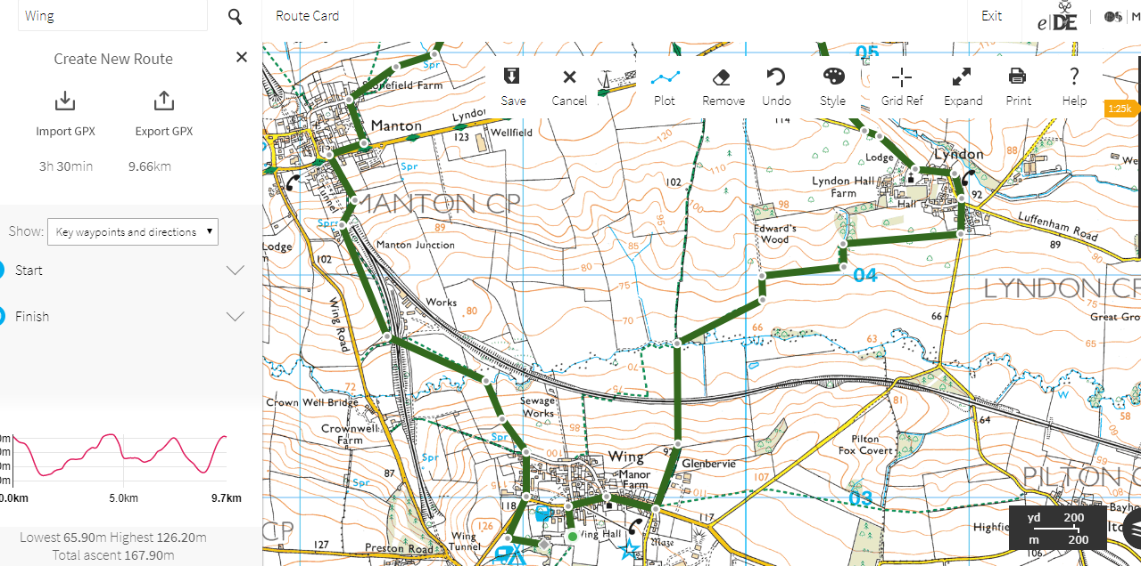
E. Use ‘PLOT’ to mark up your route

Slide 10
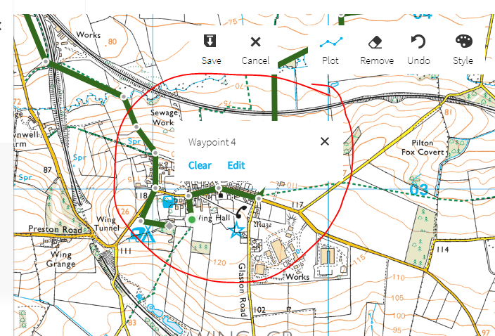
F. Create checkpoints/waypoints

Slide 11
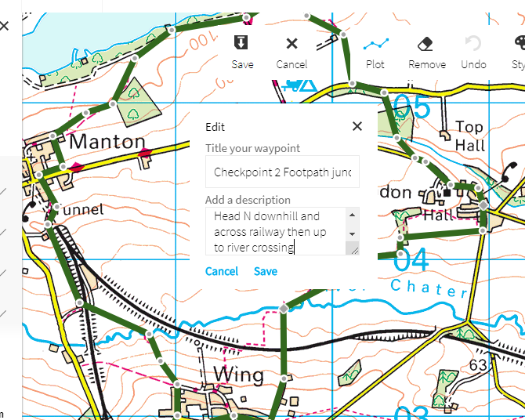
G. Give each checkpoint a title & a description for how to get to that point

Slide 12
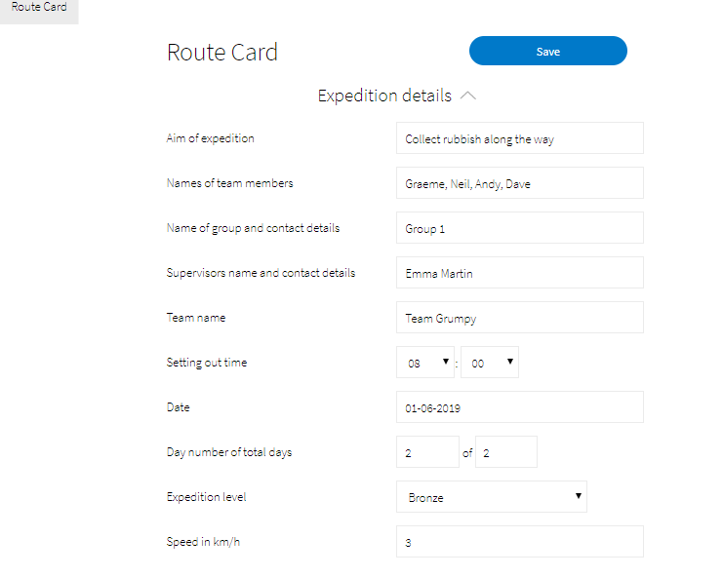
H. Fill in the routecard

Slide 13
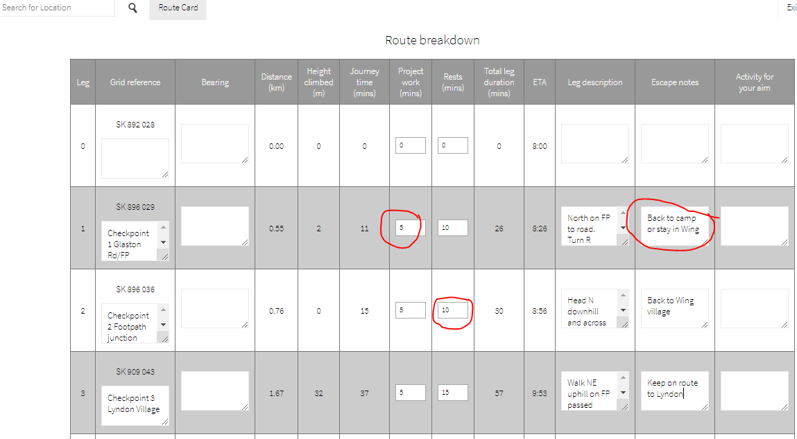
I. Complete timings and escape notes. Check totals.

Slide 14
SUMMARY
Create map name & description
Find correct map (1:25k) & location
Plot route
Create & label checkpoints/waypoints
SAVE
Complete route card details
Complete timings & escape notes
SAVE, SEND to DofE Manager/Group Members & PRINT

