Slide 1
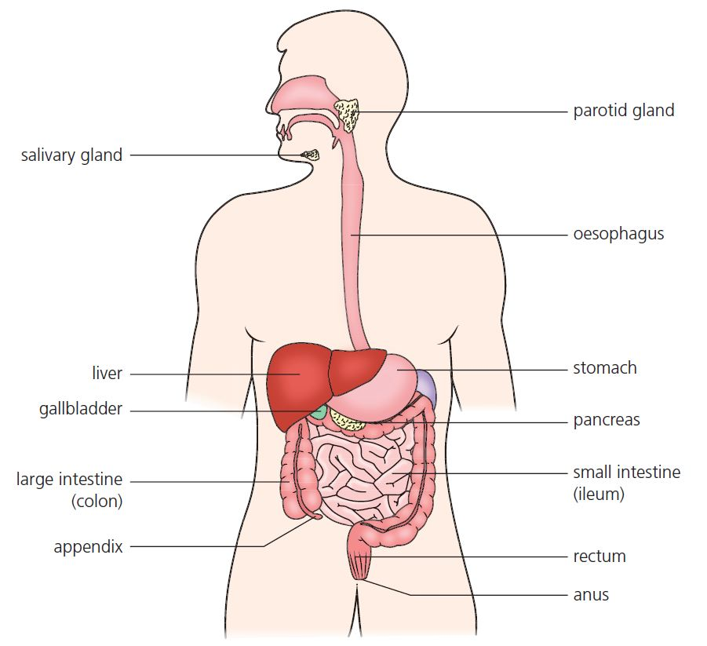
8 Digestion and absorption Summary
Digestive system
Ingestion
Intake of food into the digestive system
Digestion
The breakdown of food using enzymes
Absorption
The movement of soluble food into the blood
Assimilation
The incorporation of digested food into the body
Egestion
The expulsion of indigestible food from the body
© Hodder & Stoughton 2015

Slide 2
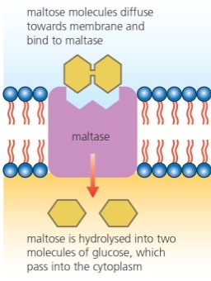
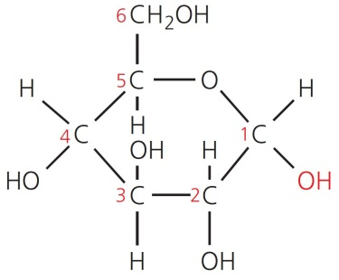
8 Digestion and absorption Summary
Enzymes
Substrate | Enzyme | Product
Starch | Carbohydrase: amylase | Maltose
Maltose | Disaccharidases: Maltase (membrane- bound) | Glucose
Large fat globule | Bile salts | Small fat droplets made from triglycerides
© Hodder & Stoughton 2015

Slide 3
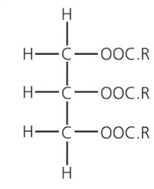
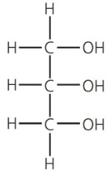
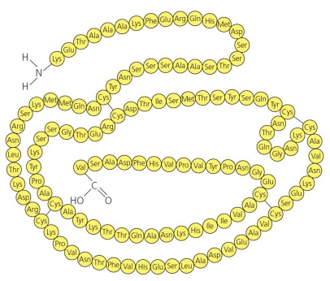
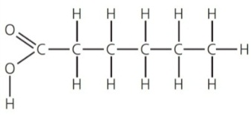
8 Digestion and absorption Summary
Enzymes
Substrate | Enzyme | Product
Triglyceride | Lipase | Glycerol and fatty acids
Proteins | Protease: endopeptidase | Polypeptides
Polypeptides | Exopeptidase | Dipeptides
© Hodder & Stoughton 2015

Slide 4
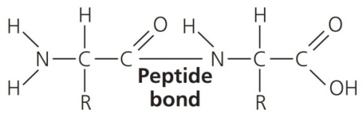
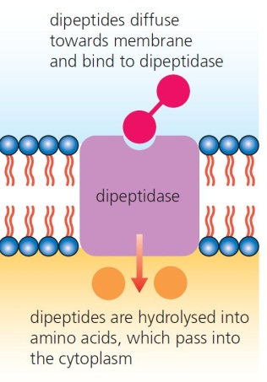
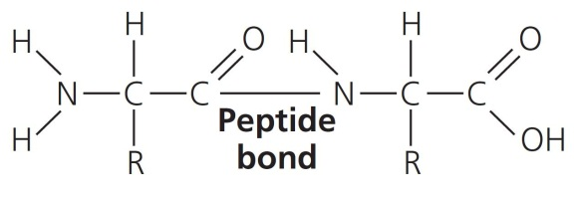
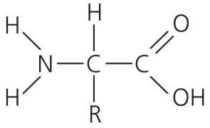
8 Digestion and absorption Summary
Enzymes
Substrate | Enzyme | Product
Polypeptides | Exopeptidase | Dipeptides
Dipeptides | Dipeptidases (membrane- bound) | Amino acids
© Hodder & Stoughton 2015

Slide 5
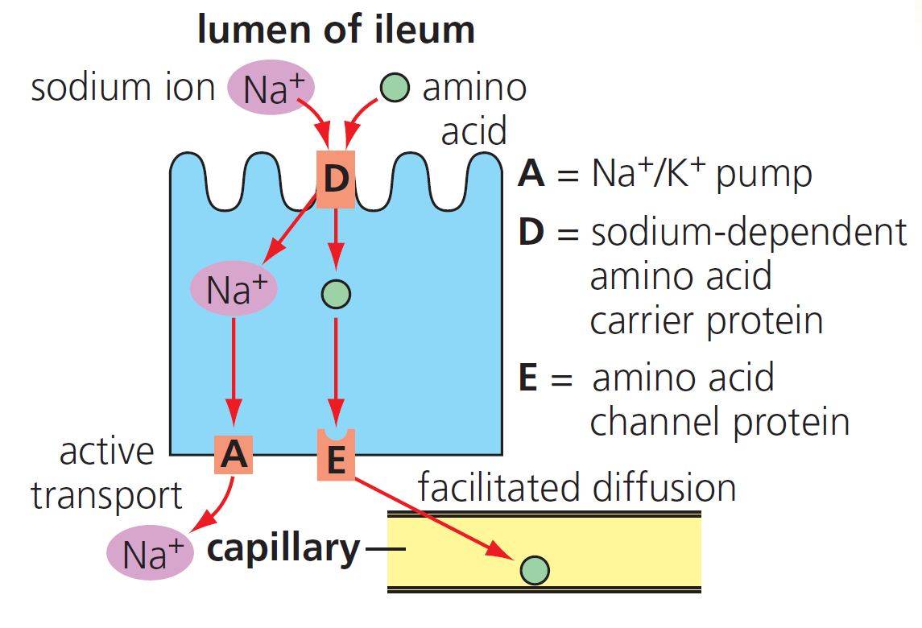
8 Digestion and absorption Summary
Absorption
Amino acids are absorbed through a co-transport system involving active transport, facilitated diffusion and passive diffusion.
© Hodder & Stoughton 2015

Slide 6
8 Digestion and absorption Summary
Questions
Explain how the digestive system is adapted for efficient:
digestion
absorption.
Explain what is meant by hydrolysis.
Describe the role of active transport in the absorption of amino acids.
Explain how bile salts aid the digestion of fats.
© Hodder & Stoughton 2015

