Slide 1
English
Revision
Activities

Slide 2
Re-read ‘Between a Rock and a Hard Place’.
Highlight 5 key sentences.
Choose a character from Of Mice and Men. How many key quotes for this character can you list in 10 minutes?
Re-read ‘The Explorer’s Daughter.’
Highlight 5 key sentences.
Re-read ‘Chinese Cinderella.’
Highlight 5 key sentences.
Re-read ‘A Game of Polo with a Headless Goat.’
Highlight 5 key sentences.
Test yourself and name as many different language and structural devices as possible. (check your answers against the mindmap in your book afterwards).
Re-read ‘Young and Dyslexic?’
Highlight 5 key sentences.
10 minute revision tasks
Re-read ‘Explorers or Boys Messing?’
Highlight 5 key sentences.
Re-read ‘H is for Hawk.’
Highlight 5 key sentences.
Re-read ‘A Passage to Africa.’
Highlight 5 key sentences.
Read an article online on a subject of your choice. What is the purpose and who is the audience? How do you know?
Re-read ‘The Danger of a Single Story.’
Highlight 5 key sentences.
Choose a key theme from Of Mice and Men. How many key quotes for this theme can you list in 10 minutes?
Re-read ‘Beyond the Sky and Earth.’
Highlight 5 key sentences.

Slide 3
Choose a character from Of Mice and Men. Research and make notes on the historical context from the 1930s that would have impacted them.
Create a mindmap to plan an answer to the question: How does Levine create excitement and suspense in ‘A Game of Polo…?’
Include key quotes, techniques used and the effect on the reader.
Create a mindmap to plan an answer to the question: How does Alagiah create a sense of pity in ‘A Passage to Africa’?
Include key quotes, techniques used and the effect on the reader.
Create a mindmap to plan an answer to the question: How does Herbert use language and structure to present her feelings on the narwhal hunt in ‘The Explorer’s Daughter…’?
Include key quotes, techniques used and the effect on the reader.
Read the poem, ‘My Box’.
Highlight and label how the poet uses language and structure to present the box and its contents.
Create a mindmap to plan an answer to the question: How does Ralston create tension In ‘Between a Rock and a Hard Place…?’
Include key quotes, techniques used and the effect on the reader.
Create a mindmap with 3 key points you could argue for the question: Explore the theme of dreams in Of Mice and Men.
Include key quotes and context.
25 minute revision tasks
Create a mindmap with 3 key points you could argue for the question: Examine the significance of locations in Of Mice and Men.
Include key quotes and context.
Create a mindmap to plan an answer to the question: How Zephaniah present the challenges and triumphs of having dyslexia in ‘Young and Dyslexic’?
Include key quotes, techniques used and the effect on the reader.
Create a mindmap to plan an answer to the question: How does the writer use language and structure to convey her impressions of Bhutan in ‘Beyond the Sky and the Earth?’
Include key quotes, techniques used and the effect on the reader.
Create a mindmap to plan an answer to the question: How does Yen Mah use language and structure to present family relationships in ‘Chinese Cinderella?’
Include key quotes, techniques used and the effect on the reader.
Create a mindmap to plan an answer to the question: How does Adichie use language and structure to convey her feelings on the danger of a single story?
Include key quotes, techniques used and the effect on the reader.
Create a mindmap to plan an answer to the question: How does Morris use language and structure to present the two men in Explorers or boys…?’
Include key quotes, techniques used and the effect on the reader.
Create a mindmap to plan an answer to the question: How does Macdonald use language and structure to describe her experience with the hawk in ‘H is for Hawk’?
Include key quotes, techniques used and the effect on the reader.

Slide 4
Read and label the article, ‘East Africa Hit by Returning Drought and Famine.’
Make notes on how you could compare it to ‘Passage to Africa.’
Your local newspaper has published an article with the headline ‘Young people today lack any desire for adventure’.
Write a letter to the editor of the newspaper expressing your views on this topic.
Write an exam style answer for the question:
In what ways is George and Lennie’s dream important in the novel?
Include key quotes and context.
A magazine is inviting readers to send in articles with the title, ‘My hopes and ambitions for the future.’
Write the article that you would submit.
Read and label the article, ‘The Toughest Climb.’
Make notes on how you could compare it to ‘Between a Rock and a Hard Place.’
Compare the example PETAL paragraphs to the markscheme and give each one a WWW and an EBI.
Create a glossary of key poetic devices, their meaning and the impact they have on a reader.
45 minute revision tasks
A magazine is publishing articles with the title ‘Friendship is one of the greatest gifts in life.’
Write your article on this topic.
Read the poem, ‘A Cottage in the Lane’.
Write 3 PETAL paragraphs exploring how the writer presents the cottage and its inhabitants in this poem.
Read and label the article, ‘Should we leave tribes alone?’
Make notes on how you could compare it to ‘Explorers or Boys Messing...?’
‘Nowadays there should be no differences in the way that boys and girls are raised and educated.’
Write a speech to parents/ carers and teachers in which you express your views on this statement.
Write an exam style answer for the question:
How does Steinbeck present the character of Curley?
Include key quotes and context.
‘The key to success in anything is being prepared.’
Write a section for a guide giving advice on the importance of preparation.
Write an exam style answer for the question:
How does Steinbeck suggest that the idea of the American Dream is flawed?
Include key quotes and context.

Slide 5
English Literature
Example of ‘Unseen Poems’:

Slide 6
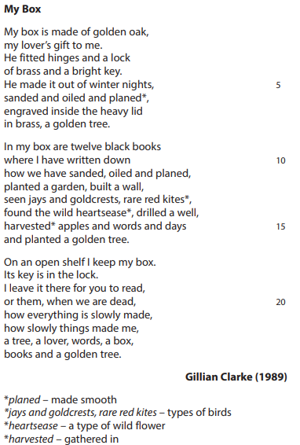

Slide 7
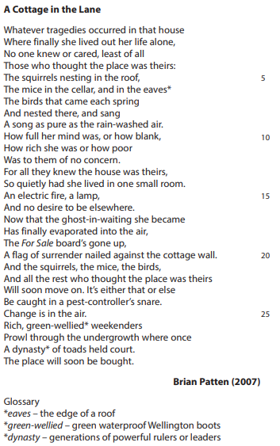

Slide 8
English Language
Examples of articles for comparison against the Anthology texts:

Slide 9
The Toughest Climb?
After 19 gruelling days of hard work and shredded fingertips, two climbers have made it to the top of El Capitan — a towering slab of granite rock. But just how great an achievement is it?
It was a climb that many people said could not be done. Higher than the world’s tallest building, El Capitan in California’s Yosemite National Park stands at a staggering 3,000ft. A towering, sheer face of almost totally smooth granite, it is arguably the world’s toughest rock to free-climb — that is, without aids other than ropes. For years, it had been dismissed by experts as ‘impossible’ and in the ‘realm of the absurd’.
But this week, after 19 days on El Capitan’s fearsome Dawn Wall, US climbers Tommy Caldwell and Kevin Jorgeson inched their way into the history books. Upon clambering over the final edge, they paused, embraced each other, and raised their arms in triumph. El Capitan had been conquered.
It is an astonishing achievement, made all the more so by the fact that the two men did it without any climbing tools; just safety ropes and harnesses to prevent them falling to their deaths. Using their fingers and feet; relying on such cracks and lumps, and rough, razor sharp edges, as the rock face grudgingly provided; they hoisted themselves up.
They slept in tents precariously suspended from the mountain face and were forced to take days of rest to allow the torn skin on their fingers to heal. They often climbed at night when it was cooler, and the duo set alarms every four hours to wake themselves up in order to apply beeswax cream to their shredded fingers.
There were times when the climbers almost lost faith in their ability to finish the task. The bruising falls became almost too much to bear.
One of the climbers battled for seven days and fell eleven times trying to scale just one section. But once he conquered it, he was jubilant, declaring to his fans on Facebook: ‘It took everything in my power to stay positive.’
Some critics are unimpressed, dismissing the adventure as futile and foolish. Life goals and great accomplishments come in many different shapes and sizes, but surely the greatest ones of all are those that touch other people's lives. Nursing in an old people's home, bringing up a child, or even the dignity and honour that come from a hard day's work - these are far worthier accomplishments. Even Caldwell conceded that ‘climbing, just like being filthy rich, tends to spoil people. Many of us become self-absorbed.’
Others vehemently disagree. To set your mind to something that takes years of physical training and mental resolve is a tremendous feat not to be sniffed at - it requires levels of patience and perseverance that many of us simply do not possess. Nor is it necessarily a selfish adventure. As Barack Obama remarked in his congratulatory tweet to the climbers: ‘you remind us anything is possible.’

Slide 10
East Africa Hit By Returning Drought and Famine
The United Nations believes 10 million people are at risk from lack of food and water in the Horn of Africa. Lack of rain has left crops failing and livestock dead.
A large area of East Africa is being affected by drought after the rains failed to come twice in the last year. As a result, the local people are threatened by widespread malnutrition and famine.
This week the United Nations has stepped up its appeal for help, and the UK has pledged £38million in food aid to feed 1.3m people in Ethiopia and treat 329,000 malnourished children and mothers. Major charities like Save the Children are starting a fundraising push.
But the crisis needs a properly co-ordinated international effort, according to Baroness Amos, the UN head of emergency relief, if it is to stop the worst drought in 60 years becoming a humanitarian catastrophe.
Across Ethiopia, Somalia, Kenya, Uganda and Djibouti, food prices have risen dramatically because crop failures have led to shortages – in affected areas of Kenya, grain costs 30-80% more than elsewhere. And most of the cattle and sheep are dying.
Refugees from across the region arrive in a steady stream at aid centres inside the Kenyan border: at Dadaab, a camp built to contain 90,000 is now coping with nearly 368,000.
And aid agencies say tens of thousands are migrating to land that is no better than that which they have left: wells have dried up and families are picking their way across barren plots littered with animal carcasses.
Save the Children’s Kenya programme director, Catherine Fitzgibbon, told The Independent: ‘Children have made long journeys in terrifying conditions, often losing their families along the way and arriving at the camps in desperate need of security, healthcare and a normal life.’ Meanwhile, the continuous fighting in Somalia is thwarting UN efforts both to secure international aid and distribute what help is available.
Governments, particularly the USA, don’t want aid or aid money falling into the hands of anyone associated with guerrilla militias fighting in Somalia, so they are refusing to contribute funds.
It’s a combination of factors causing the latest crisis in the Horn of Africa, a region that is all too familiar with hunger. The drought has caused food shortages, the price of food is soaring to unaffordable levels anyway, and the fighting in Somalia is hampering both aid efforts and the campaign to raise aid funds from governments.
Behind it is the changing global weather pattern reducing the rains on which local people rely: a new report suggests global warming may reduce rainfall for some years. So the international community will need to come up with a way to cope sooner or later.

Slide 11
Should we leave remote tribes alone?
A search is on for a British explorer who has not returned home from an expedition in Papua New Guinea. Some believe he should never have gone at all.
Humans have plumbed the depths of the oceans and scaled the highest mountains. No island remains undiscovered. But there are still pockets of wilderness in the world — and yes, explorers do still exist.
The vast, jungly interior of Papua New Guinea (PNG) is one of these remaining areas, and Benedict Allen, a 57-year-old from south-west London is one of the world’s great modern explorers.
And he is missing. His sister Katie says she was expecting to hear from him by Monday — and he has not taken his planned flights home. It is “out of character”, she says. “It’s ghastly.” Now a frantic search is on to find Allen, who travels without a satellite phone or GPS, “because this is how I do my journeys of exploration”.
He was attempting to find the reclusive Yaifo tribe, whom he first met 30 years ago. There are over 300 tribes in PNG, many of whom have had little contact with the outside world. A small handful have had absolutely none. Some of these tribes are infamous for cannibalism.
These uncontacted tribes have been called “the last free people on Earth”. There are roughly 100, and they are found in equatorial rainforests, especially in South America and New Guinea.
We can assume that they have no idea of the existence of cars, televisions or modern medicine. Surely, then, it is our duty to introduce them to our world?
But this is a difficult moral issue. The charity Survival International aims to protect tribes from outsiders who subject them to “genocidal violence, slavery and racism so they can steal their lands, resources and labour in the name of ‘progress’ and ‘civilisation.’”
Outsiders can also spread diseases to people with no immunisation, potentially wiping out entire peoples.
The Indian government has made it illegal to contact the people of North Sentinel Island in the Indian Ocean. No boat may go within three miles of the island, whose inhabitants have been known to throw rocks and fire poisoned arrows at any outsiders. The government of PNG has no such laws.
Update (09:10): Benedict Allen has been spotted “alive and well” in PNG and requested rescue.
“Leave them alone”, say many activists. They are the most vulnerable peoples on the planet. If we care about human rights at all, we should surely care about the most endangered. Their languages, knowledge of their environment and view of life are unique. They know things we do not, and they add enormously to the diversity of human life.
“Let’s not romanticise these tribes”, reply others. The lives of uncontacted people are short, narrow and dangerous. The rest of the world has produced so many wonderful things, and it is selfish to refuse to share them with others. These people are not zoo animals; they are human beings who deserve the same chances as everyone else.

Slide 12
English Language
Example PETALs for some of the Anthology texts:

Slide 13
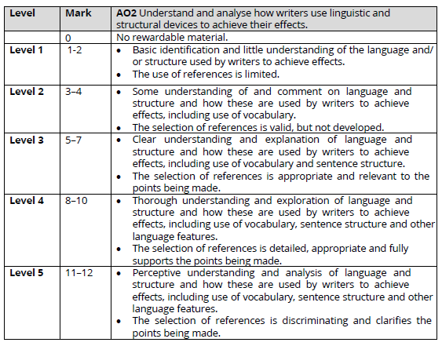
Anthology Markscheme

Slide 14
How does Emma Levine use language and structure to build atmosphere?
Emma Levine travels to Karachi, Pakistan, and uses language and structure to present the local atmosphere as immensely different to a conventional western one. Firstly there’s the title, ‘a Game of Polo with a Headless Goat’, which uses to juxtaposition of ‘Polo’ and ‘Headless Goat’ to emphasise the difference in cultures. The former connotes, class, wealth, and sophistication, whereas the latter suggests barbarous, uncivilised people. Put together, these words clash to make the reader feel this is an unfamiliar environment, where two different things are meeting. The writer wants to strongly emphasise that this is a different place and culture to the one most of the readers have experienced. To back this image up, she tells the men she’s with ‘open the boot’ and get her to ‘climb inside, and point your camera at the race!’ The verb ‘climb’ presents an unconventional approach to things, far from strict rules and regulations, and the fact she’s ‘climbing’ into the ‘boot’ furthers that idea, and also hints this is more than slightly dangerous, as the boot is obviously not a usual place to be seated in a car. The reader gets the idea that the laws of life people follow going about their daily lives are different here, that lines here are perhaps always more blurry. To help the reader understand the extent of the difference in cultures, Emma Levine offers a comparison, calling the activities ‘Wacky Races’. In comparing the donkey races to a kids tv show featuring a dog that attaches rockets to his car, the writer suggests that events only fit for a seriously fictitious cartoon in the Western World can be and are arbitrary where she is. While understanding this comparison, the reader also comprehends Karachi culture truly is very distinct from cultures more familiar to readers, a place where things that could never happen where they are happen every day.

Slide 15
How does the writer use language and structure to convey her impressions of Bhutan?
Zeppa first shares her awe of the magnificent landscape in Bhutan. The piece starts by describing ‘mountains all around’, which is repeated in the second sentence ‘all and only mountains’, this use of repetition emphasizes how this is all Zeppa can see. This suggests a feeling of awe about the gigantic size of the landscape. The metaphor, ‘giant child’ sculpting the landscape similarly helps us imagine what it looks like; random and messy yet beautiful and impressive at the same time. Zeppa is deeply mesmorised by the mountainous landscape. The precise (and often alliterative) verbs ‘gathering’, ‘piling’, ‘pinching’, ‘poking’ and ‘knuckling’ evoke images of playful and artistic creation, again showing how the landscape is almost magical in Zeppa’s eyes. The adjectives ‘giant’ and ‘great’ are juxtaposed with ‘little’ to further emphasise the stunning height and power of the mountains. Finally, the word ‘mountains’ is repeated six times in the second paragraph, reinforcing Zeppa’s initial captivated impression of Bhutan.

Slide 16
How does Yen Mah use language and structure to present family relationships in ‘Chinese Cinderella’?
In Chinese Cinderella, it is clear that Adeline and her father have a negative relationship. He has more power than her and she is scared of him. This is demonstrated when she writes, “I was overwhelmed by the thought that I had been summoned by Father to enter the ‘Holy of Holies.’” This metaphor shows that she is frightened of her father and views him as almost God-like. ‘Holy of Holies’ suggests that she feels like she is going to a place of worship and he is the all-powerful leader of the family – ruling over them and controlling their lives. This shows the reader that their relationship isn’t strong because she is scared and nervous about meeting him, even though she has just come home from school and normally a child would be happy to see their parent. The word ‘summoned’ tells the reader that he is powerful and shows that she is far less important in the household than he is. This is reinforced by the fact that he chooses her future for her and she accepts without argument. She says “thank you very very much.” The writer repeats ‘very’ which shows how grateful she is even though he has chosen a path she would not choose for herself. It also shows how desperate she is to get away from home, emphasizing how poor the relationship with her father is.

Slide 17
How does Morris use language and structure to present the two men in ‘Explorers or Boys Messing…?’
Throughout the article, the writer makes disparaging remarks in an attempt to trivialise the rescue mission. Morris refers to it as ending in ‘farce’ - here, the noun choice suggests that the explorer’s actions are absurd, despite the fact that they are actually incredibly experienced and brave individuals who took a calculated risk. Structurally, the writer manages to focus the reader’s attention on the failed mission at both the beginning and end of the extract, so that their message (that the men’s incompetency led to an embarrassing failure) is clearly communicated to the reader. The section where the past achievements of Brooks and Smith are mentioned (lines 36-45) is short and mainly factual. The writer makes disparaging remarks such as ‘Mr Smith [...] claims to have been flying since the age of five’ - here the verb ‘claims’ implies that Mr Smith is not to be trusted and reinforces the negative representation of the explorers. In this section the reader is briefly allowed to acknowledge their experience and success, before the writer shifts our focus once more to the failed mission.

Slide 18
How does the writer use language to describe her experience with the hawk in H is for Hawk?
The writer describes her experience with the hawk as something incredible and almost other-worldly. She uses the phrase ‘the air turned syrupy, slow, flecked with dust’. The metaphor here suggests that time is being altered, slowing down to emphasise this moment. ‘Syrupy’ has connotations of sugar and sweetness, so the reader understands that this is a pleasant feeling, which is strengthened through the use of sibilance to imply a smooth, almost silky effect. This is a fantastical description, adding to the impression that the experience with the hawk is like something out of a myth or a dream. This is reinforced through the metaphors used to describe the hawk itself. The writer describes the hawk as ‘a conjuring trick. A reptile. A fallen angel. A griffon from the pages of an illuminated bestiary’, further building the idea that this hawk is an extraordinary creature. The use of simple sentences alone portrays the overpowering wonder the writer feels; it is as though she can barely breathe. She uses juxtaposing ideas, ‘trick […] reptile […] angel’ to suggest that the hawk is no one thing alone, it is awe-inspiring, ever changing and it is though the writer can hardly believe it is real. ‘Angel’ has connotations of heaven, again portraying the idea that this is a creature from another world or dimension. The reader knows that the writer has just lost her father, and perhaps the reference is an allusion to this loss. The later simile ‘like gold falling through water’ also seems to hold this importance, the noun ‘gold’ having clear connotations of something that is precious and valuable, yet the verb ‘falling’ contains a sense of loss. Overall, the reader is left with the impression that although this is an incredible experience, the writer cannot escape her grief and even this beautiful moment is filled with echoes of her dead father.

