Slide 1
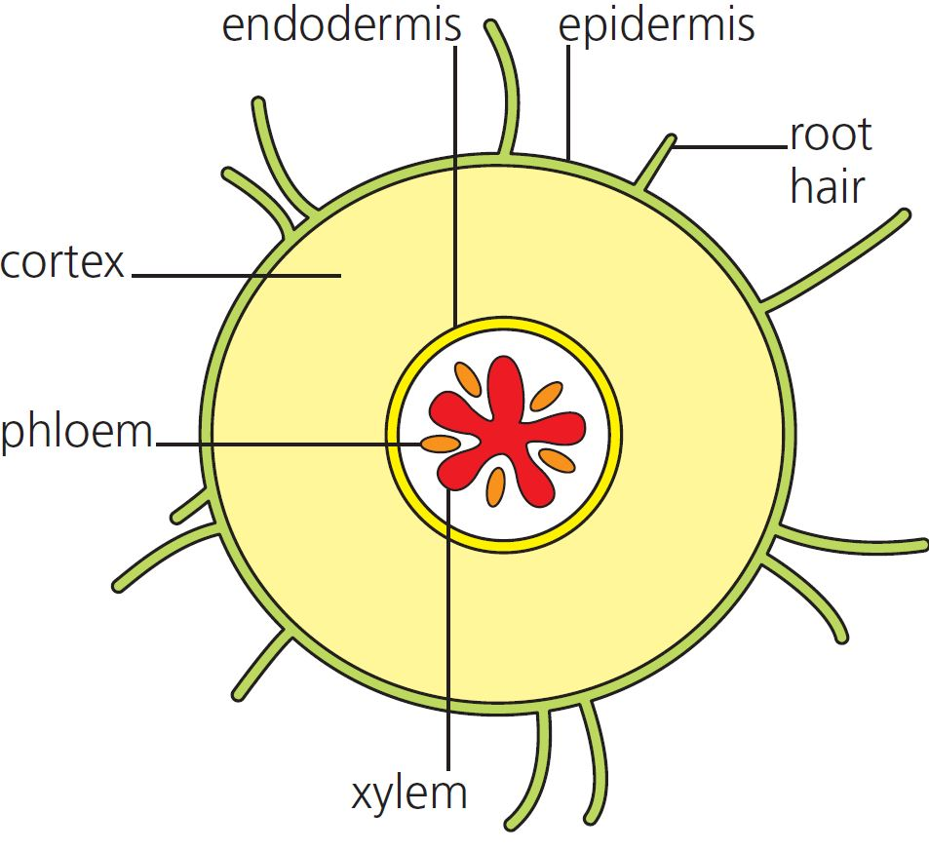
10 Mass transport in plants Summary
Transpiration
Water and minerals are transported in the xylem vessels of plants.
© Hodder & Stoughton 2015

Slide 2
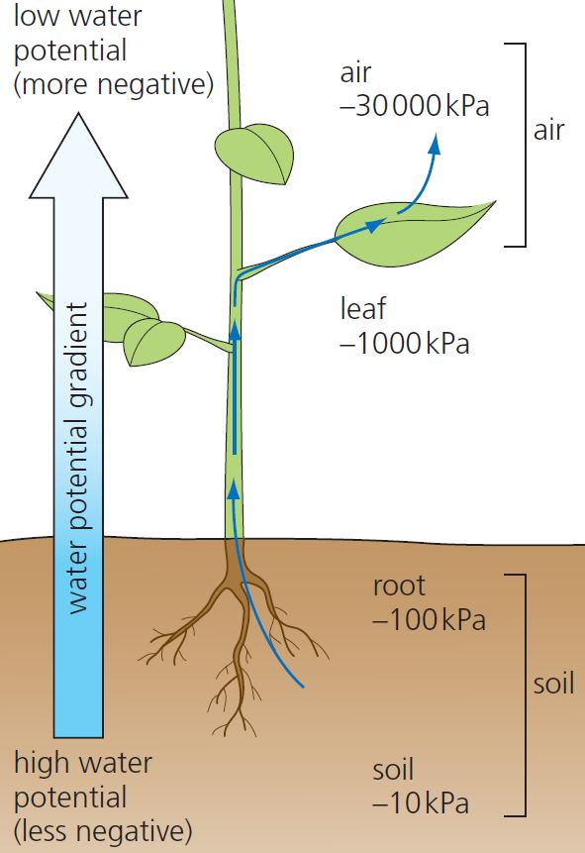
10 Mass transport in plants Summary
Transpiration is affected by:
Humidity
Temperature
Light intensity
Wind speed
Leaf surface area
Number of stomata
Evaporation of water from the leaves through stomata generates a negative pressure, pulling water up the xylem by cohesion-tension.
© Hodder & Stoughton 2015

Slide 3
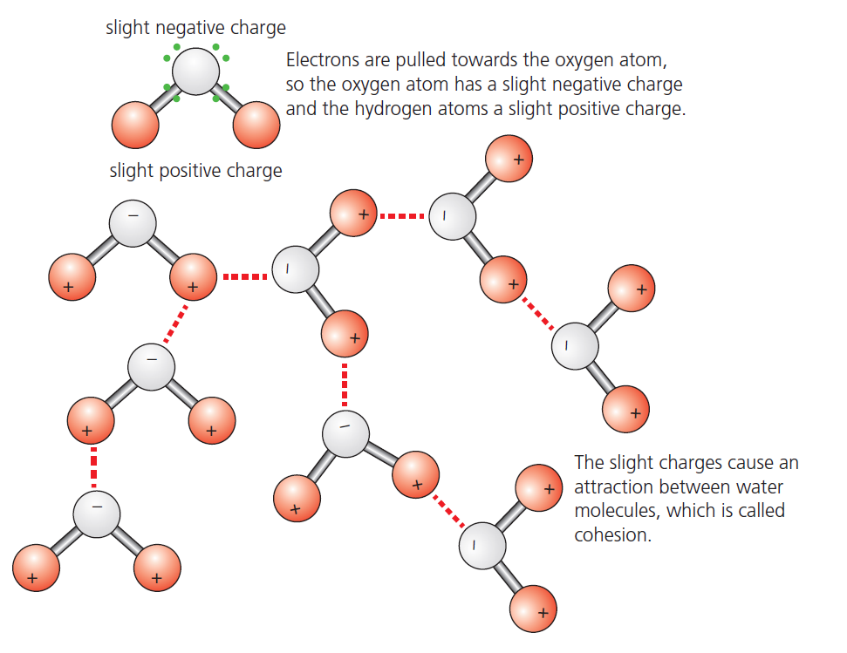
10 Mass transport in plants Summary
Water
The slightly negative and positive charges on water molecules results in hydrogen bonding, making the molecules ‘sticky’.
© Hodder & Stoughton 2015

Slide 4
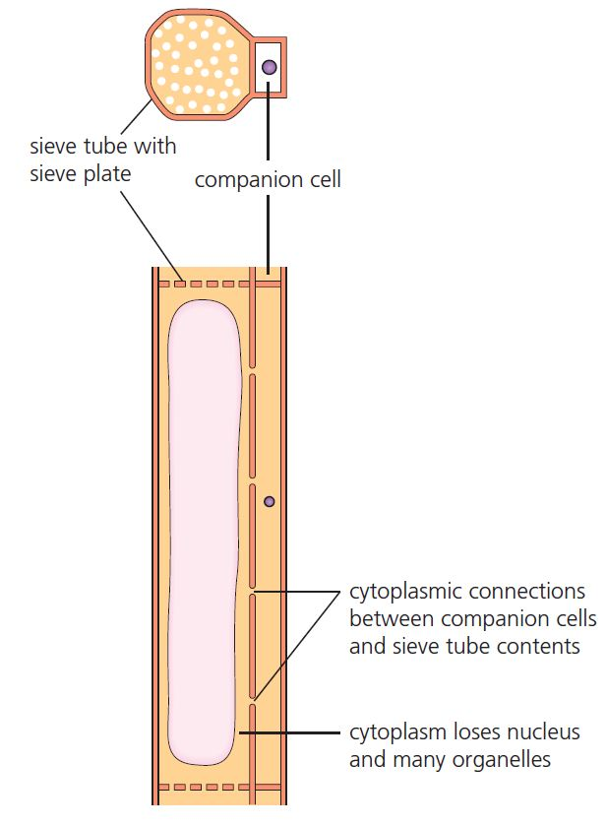
10 Mass transport in plants Summary
Translocation
Water and sucrose are transported around the plant through the phloem.
© Hodder & Stoughton 2015

Slide 5
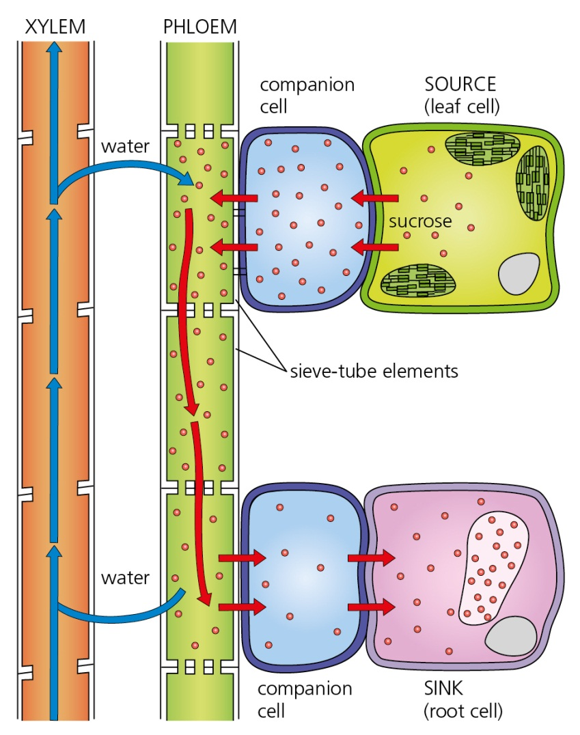
10 Mass transport in plants Summary
Mass flow
Sucrose is actively loaded into the phloem from the leaves (the source).
This reduces the water potential in the phloem, bringing in water from surrounding tissues.
This increases hydrostatic pressure.
© Hodder & Stoughton 2015

Slide 6
10 Mass transport in plants Summary
Questions
List the factors affecting transpiration.
Explain the role of active transport in translocation.
© Hodder & Stoughton 2015

