Slide 1
Mitosis and the Cell Cycle
5 The cell cycle Key concepts
Next
© Hodder & Stoughton 2015

Slide 2
5 The cell cycle Key concepts
Introduction
A cell which is going to divide goes through a series of stages in preparation for division. This is called the cell cycle.
New cells differentiate and become specialised. Some cells never reproduce once they have been formed. Other cells are destined to continue dividing. Mitosis is the division of the nucleus to form two genetically identical copies. It is a crucial stage of the cell cycle.
Next
© Hodder & Stoughton 2015

Slide 3
5 The cell cycle Key concepts
The Cell Cycle
The cell cycle consists of three phases:
Interphase or preparation for division
Mitosis or division of the nucleus
Cytokinesis which is the division of the cytoplasm
Next
© Hodder & Stoughton 2015

Slide 4
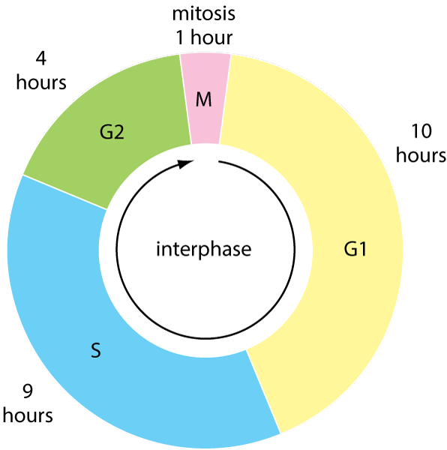
5 The cell cycle Key concepts
The Cell Cycle
Interphase is divided into three stages, G1, S and G2. Click on each phase to reveal more information about it.
G2 phase is a growth phase.
G1 phase is the stage of the cell cycle when the cell synthesises proteins and new organelles.
S phase is the replication of the DNA to form two sets of chromosomes.
Next
© Hodder & Stoughton 2015

Slide 5
5 The cell cycle Key concepts
Questions
Name three organelles that the cell would synthesise during G1.
Any three of: mitochondria, endoplasmic reticulum, ribosomes, lysosomes, Golgi apparatus.
If a cell is stuck in G1, what is likely to be its fate?
The cell is destined not to divide again. It will remain in the G1 stage until it dies.
Explain the advantage to this cell of remaining in the G1 stage.
The cell does not waste energy and resources going through the S (synthesis) stage or G2 (growth) if it is not going to divide.
Answers
Next
© Hodder & Stoughton 2015

Slide 6
5 The cell cycle Key concepts
Replication of the DNA
During the S phase each chromosome replicates itself. The newly replicated chromosomes are called chromatids. They are held together by a region called the centromere.
centromere
‘sister’ chromatids
chromosome before replication is one strand of DNA
chromosome after replication is two strands of DNA
Next
© Hodder & Stoughton 2015

Slide 7
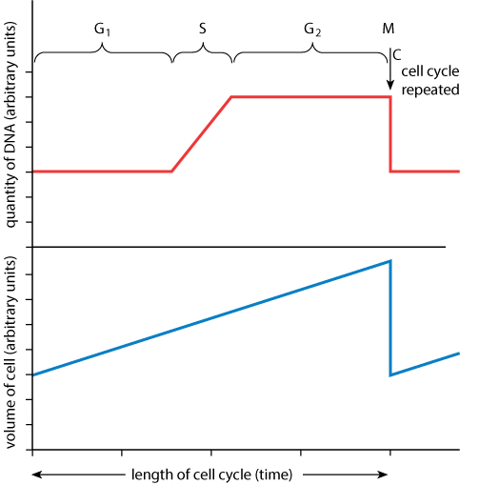
5 The cell cycle Key concepts
Replication of the DNA
The diagram shows the amount of DNA during the cell cycle.
Next
© Hodder & Stoughton 2015

Slide 8
5 The cell cycle Key concepts
Questions
Explain the pattern shown by the quantity of DNA during the different phases of the cell cycle. Use the units on the graph in your answer.
There are 3 arbitrary units of DNA during the G phase. During the course of the S phase, the DNA doubles from 3 – 6 arbitrary units. Each chromosome has replicated itself exactly. The level of DNA does not change during the G2 phase. Mitosis is the distribution of the chromosomes between two new cells. Each new cell receives 3 arbitrary units of DNA.
Explain the pattern shown by the graph in terms of the number of chromosomes in a human cell.
In the G1 phase of mitosis there are 46 chromosomes. During the S phase, each chromosomes replicates. There are now 92 chromatids. At mitosis, the 92 chromatids are split between the two new cells. Each new cell receives 46 chromosomes.
Answers
Next
© Hodder & Stoughton 2015

Slide 9
5 The cell cycle Key concepts
Mitosis
Mitosis is a continuous process but can be divided into stages for ease of study.
Prophase
Metaphase
Anaphase
Telophase
Cytokinesis
Next
© Hodder & Stoughton 2015

Slide 10
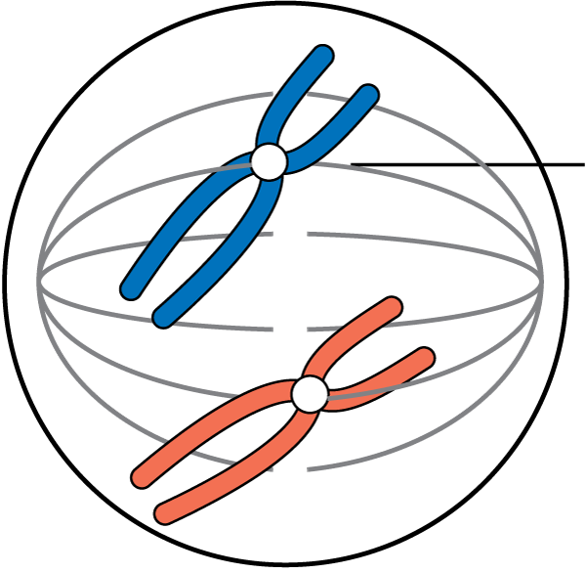
5 The cell cycle Key concepts
Prophase
The replicated chromosomes shorten and thicken by supercoiling. They can now be stained and observed with a light microscope.
fibre of spindle
Back
Next
© Hodder & Stoughton 2015

Slide 11
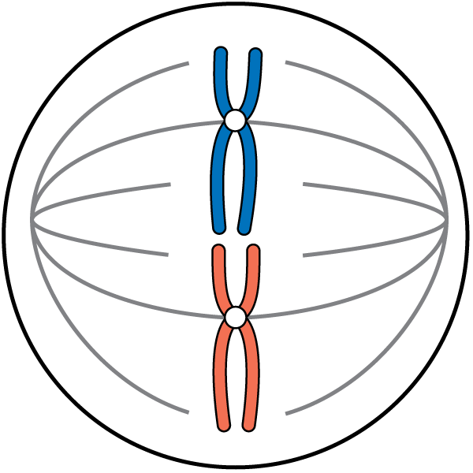
5 The cell cycle Key concepts
Metaphase
The chromosomes, each composed of two chromatids, line up on the spindle equator.
Back
Next
© Hodder & Stoughton 2015

Slide 12
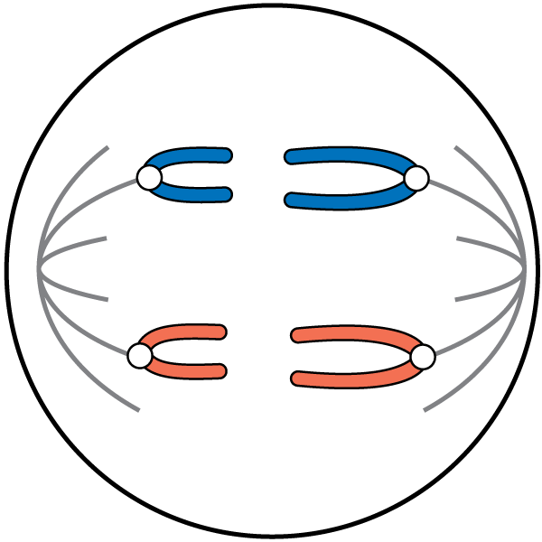
5 The cell cycle Key concepts
Anaphase
The centromere divides and the spindle fibres pull chromosomes to opposite poles.
Back
Next
© Hodder & Stoughton 2015

Slide 13
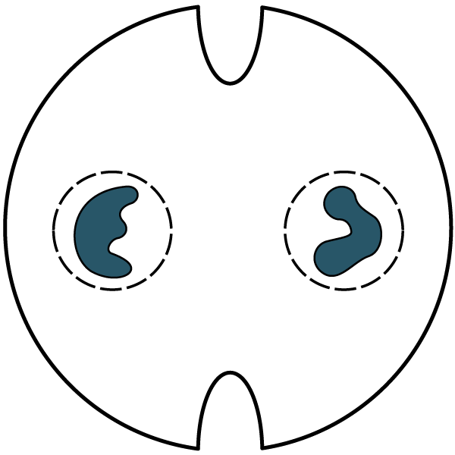
5 The cell cycle Key concepts
Telophase
The chromosomes start to uncoil and a new envelope encloses the new nuclei.
Back
Next
© Hodder & Stoughton 2015

Slide 14
5 The cell cycle Key concepts
Cytokinesis
The cell membrane tucks in along the equator of the cell. The plasma membrane on one side meets the membrane on the other and the two new cells are pinched off. In plant cells, a new cell wall forms along the equator.
Back
Next
© Hodder & Stoughton 2015

Slide 15
5 The cell cycle Key concepts
Questions
Name the stages of mitosis when each of the following take place.
Centromeres split and chromosomes separate.
Late metaphase, early anaphase.
Chromosomes first become visible.
Prophase.
Nuclear envelope reappears.
Telophase.
Chromosomes line up on the equator of the cell.
Metaphase.
Chromosomes move towards the poles of the cell.
Anaphase.
Answers
Next
© Hodder & Stoughton 2015

Slide 16
5 The cell cycle Key concepts
Mitosis in Plants and Animals
In plant cells mitosis takes place in meristems. A meristem is a growing point found at the root tip and the shoot tip. There is no cytokinesis in plants. When the cells divide, a cell plate forms along the spindle equator. The cell wall is laid down along the cell plate. Plant cells do not have a centriole.
Next
© Hodder & Stoughton 2015

Slide 17
5 The cell cycle Key concepts
Questions
An onion cell has 12 chromosomes.
What is the diploid chromosome number for an onion?
What is the haploid chromosome number?
Where would haploid chromosomes be found in an onion?
In the pollen grain or the ovum.
In which stages of mitosis would there be 24 chromosomes in an onion cell?
Interphase, prophase, metaphase and anaphase.
Make a table showing the difference between the cell cycle in a plant and an animal cell.
12
6
Animal Cell | Plant Cell
Mitosis occurs in all cells | Mitosis only occurs in meristems
Centrioles organise the spindle | No centrioles found
Cytokinesis or in-tucking of cytoplasm to separate two new cells | Cell plate and new cell wall forms between the new nuclei
Answers
End
© Hodder & Stoughton 2015

