Slide 1
GCSE & A Level Exams - Student Briefing
Exam Series 2024

Slide 2
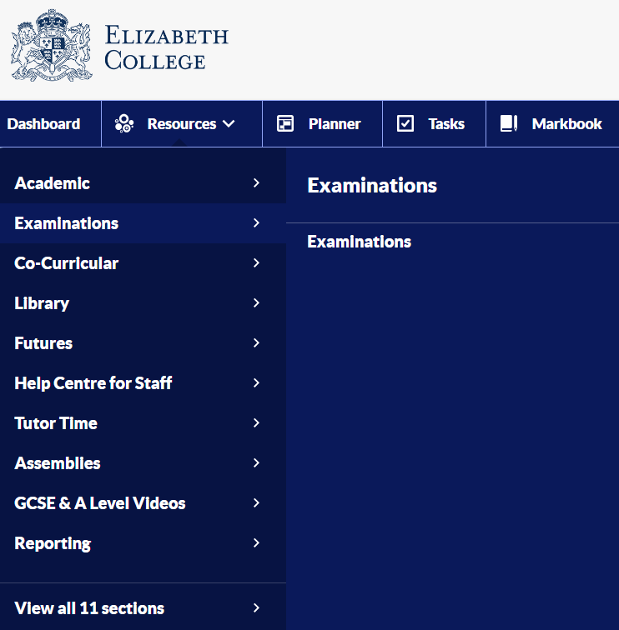
Exam Information
https://elizabethcollege.fireflycloud.net/examinations

Slide 3
Exam Office student video

Slide 4
Exam Preparation
Make copies of your timetable and put them up at home. KNOW YOUR DATES AND TIMES!
Plan for traffic, plan for road closures, plan for parking!
Don’t be late! Exam arrival times are 8:20am and 1:20pm If you arrive late, please report to Reception, do not enter the exam room.
MEETING POINT: Always in Perrot Court Quad (or Sixth Form Centre if raining).
Y11 Bags can left be next to the wall - Drama toilets, Y13 bags in Sixth Form Centre.
No toilet breaks in the first hour or last 15 minutes, unless it’s an emergency. You don’t get this time back. Close your booklet!
It’ll be summertime! Leave blazers/jackets with your bags.
Exam conditions start from the moment you walk in the room – COMPLETE SILENCE
If you need to get the invigilators attention for anything…..RAISE YOUR HAND and they will come over to you.

Slide 5
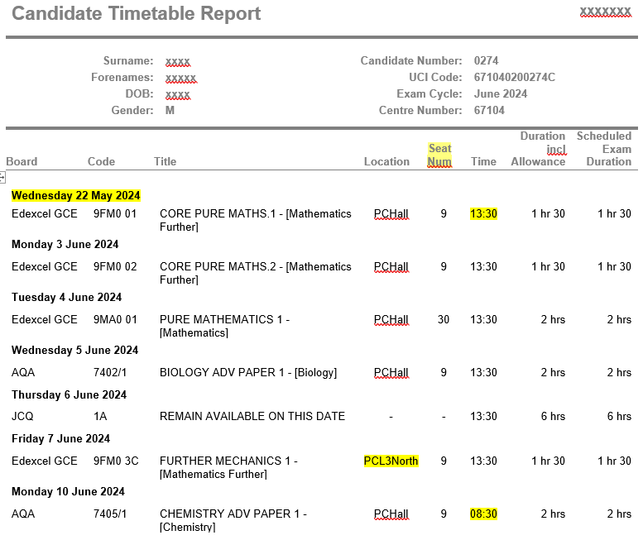
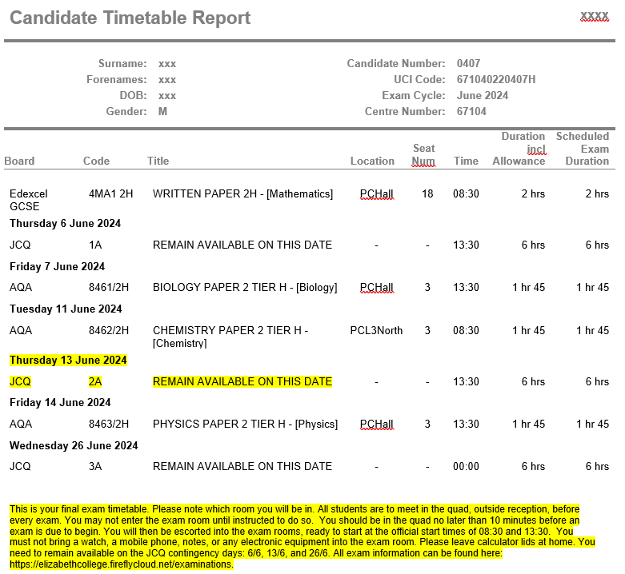
Please collect your final timetable before you leave
A Level
GCSE

Slide 6
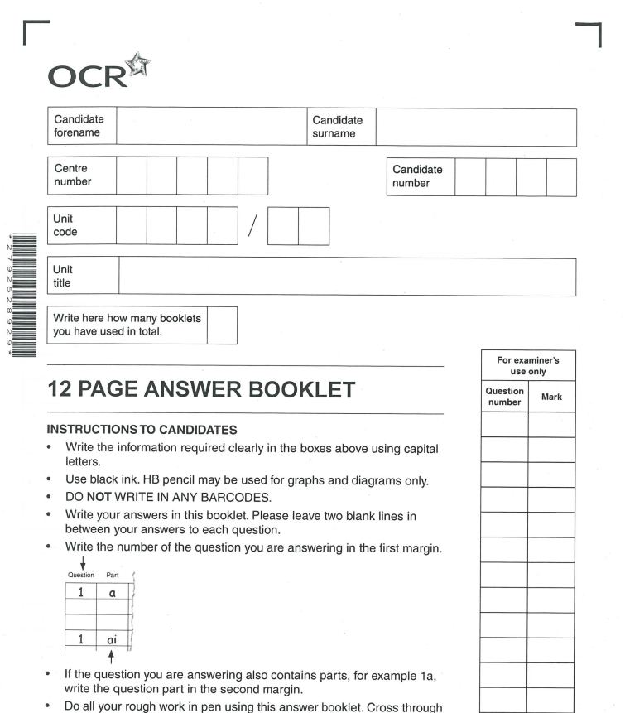
Example
Example
No lined paper allowed, only these booklets even for rough work. In 2023, 1.26 million students took exams with 16 million scripts marked.

Slide 7
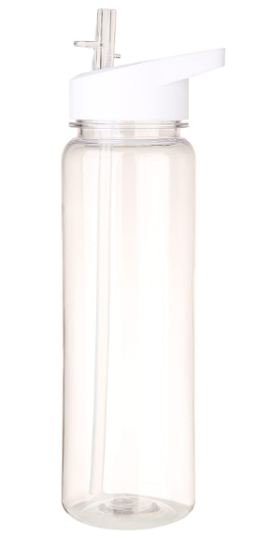
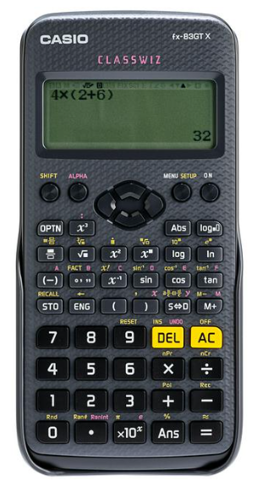
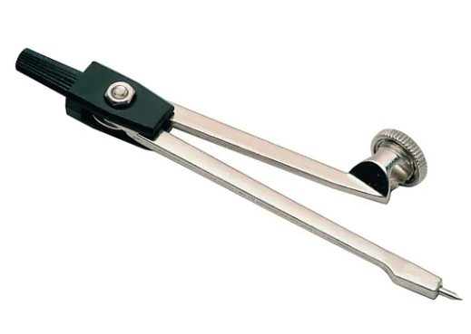
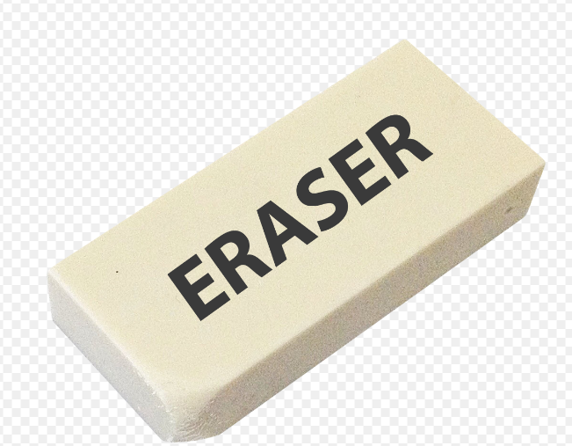
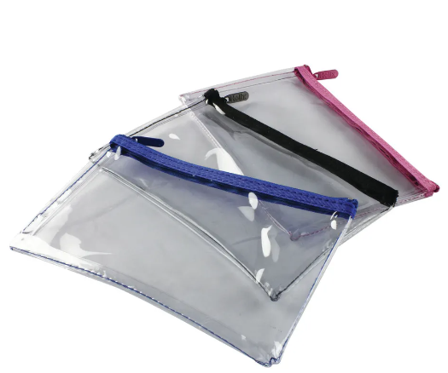
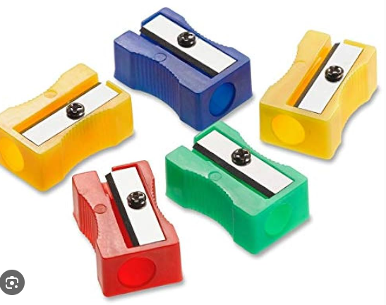
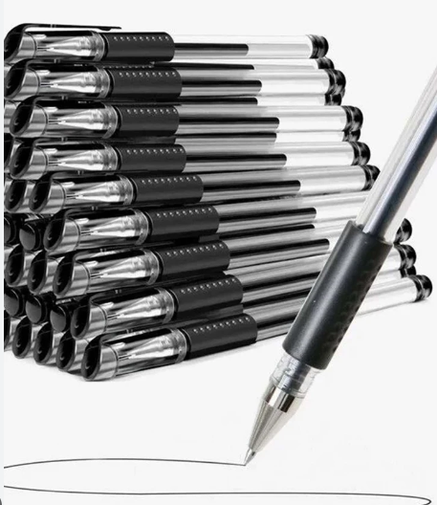
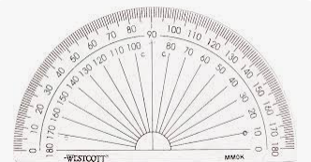
Bring with you to every exam
Fat lids – you will be asked to open the bottle
During an examination a calculator must not be able to offer any of these facilities:
language translators;
symbolic algebra manipulation;
symbolic differentiation or integration;
communication with other machines or the internet.
During an examination a calculator must not give access to pre-stored information. This includes:
databanks;
dictionaries;
mathematical formulae;
Invigilator will check calculators on your desk – make available

Slide 8
During & after the exam
Wait for the invigilator’s instructions before picking up your pen or opening the Q paper.
Laptop users log in as soon as you sit down then wait to fill in your booklet
Invigilators will walk around - seating plan and register.
We will get visited by an Inspector- he’s inspecting the exam set-up not you, ignore!
No scrap paper- rough work in your answer booklets then cross it out
Come to the end of your answer booklet….we have more! All additional booklets must have all your details rewritten on the front
Fire alarm & meeting points – Await the invigilator’s instructions.
You keep an eye on the time (no 5 min warning)
When the time is up, STOP WRITING (“I just want to finish my sentence … “ Exam Board will discount your last few sentences)
Leave in silence- there may still be students writing. The Quad is loud!

Slide 9
Malpractice
Malpractice in exams
Failure to follow the rules of the exam or assessment which includes things like breach of invigilator instructions, unauthorised material in the exam hall, trying to communicate with others, copying, cheating in any way, disruptive behaviour etc.
Exam Information

Slide 10
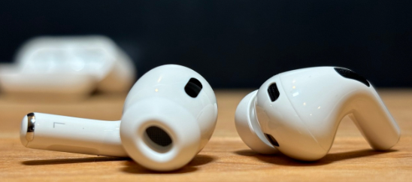
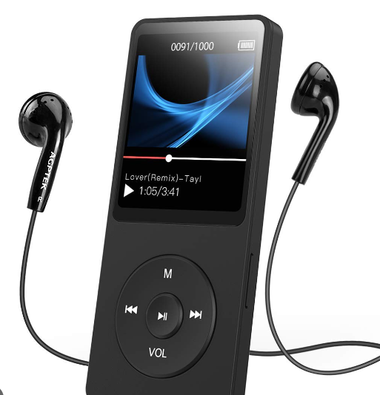
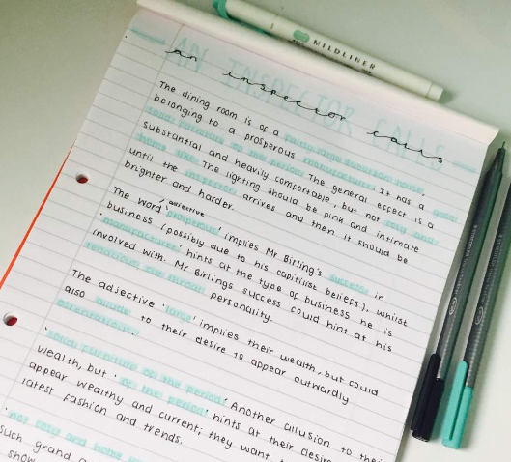
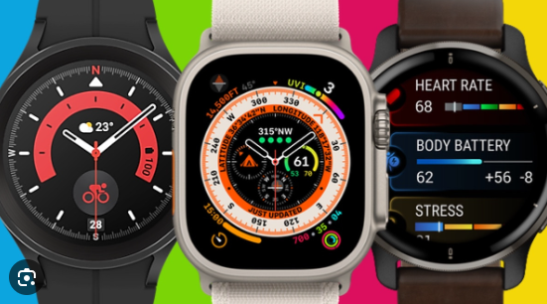
Prohibited items

Slide 11
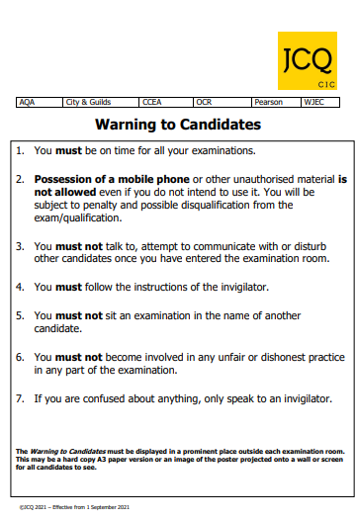
Exam Posters

Slide 12
Final reminders
Take out only what you took in
Illness – We MUST have a Doctor’s note
No social media after exams. It is monitored 24/7
Beware hoax papers online- you will be disqualified if you attempt to buy one!
Textbooks- drop books on table in Reception any time until Friday 28th June
Exam contingency days- 6th, 13th, 26th June 2024
Any questions you have, come and ask me!
And finally….take it one exam at a time and give it your very best! Good luck

