Slide 1
6 The immune system Summary
The body protects itself from pathogens
Chemical and physical barriers:
Skin
Mucus
Enzymes in:
- Tears
- Saliva
- Urine
Non-specific immunity
Phagocytes in the blood identify and engulf pathogens with the help of histamine.
© Hodder & Stoughton 2015

Slide 2
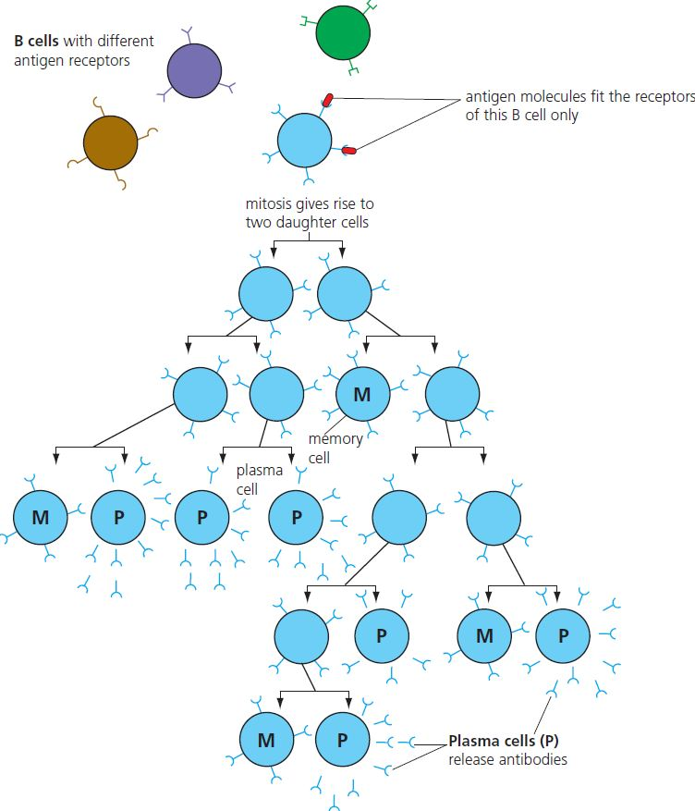
6 The immune system Summary
Specific immunity
B cells
Stimulation of specific B cells by antigens causes mitosis and clonal selection.
Plasma cells and memory cells are produced.
© Hodder & Stoughton 2015

Slide 3
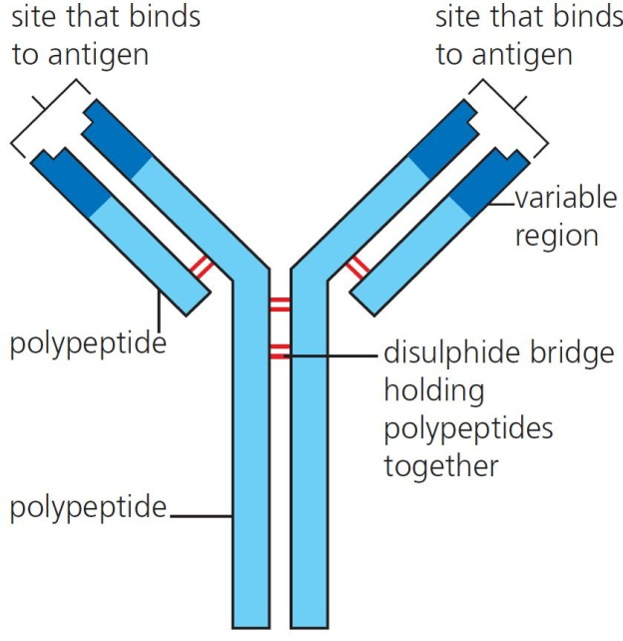
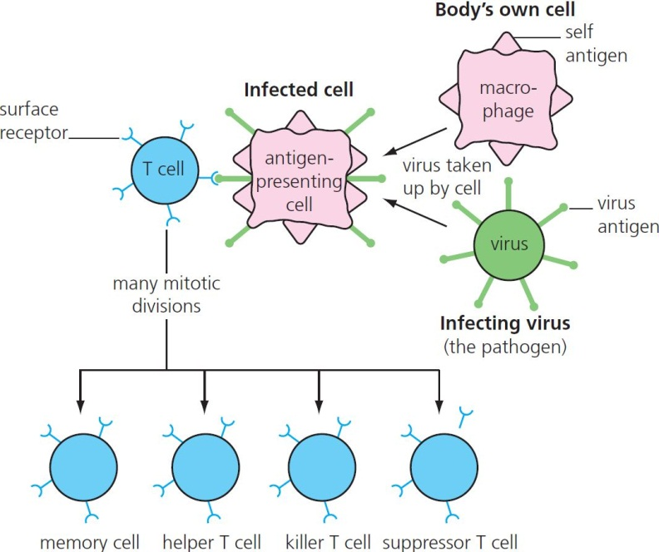
6 The immune system Summary
Antibodies
T cells
Specific T cells divide when antigens are presented by a macrophage cell.
Helper T cells assist other white blood cells.
Killer T cells help destroy the pathogen.
Memory T cells remain in the body ready for a second invasion.
Plasma cells produce antibodies specific for the identified antigen.
© Hodder & Stoughton 2015

Slide 4
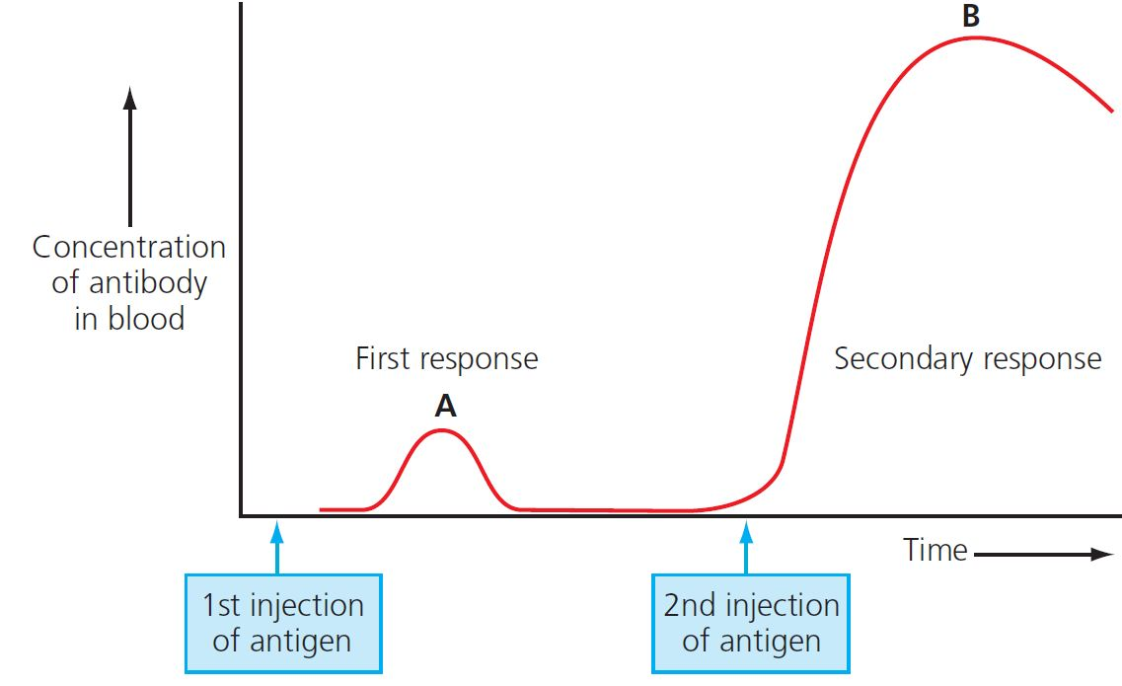
6 The immune system Summary
Vaccination
Passive:
No immune response – a person is given antibodies that help destroy the pathogen.
Active immunity:
Immune response – a person is given antigens that stimulate the immune system.
Secondary response:
A second exposure to the antigen causes a much longer and stronger response due to the presence of memory B and T cells.
© Hodder & Stoughton 2015

Slide 5
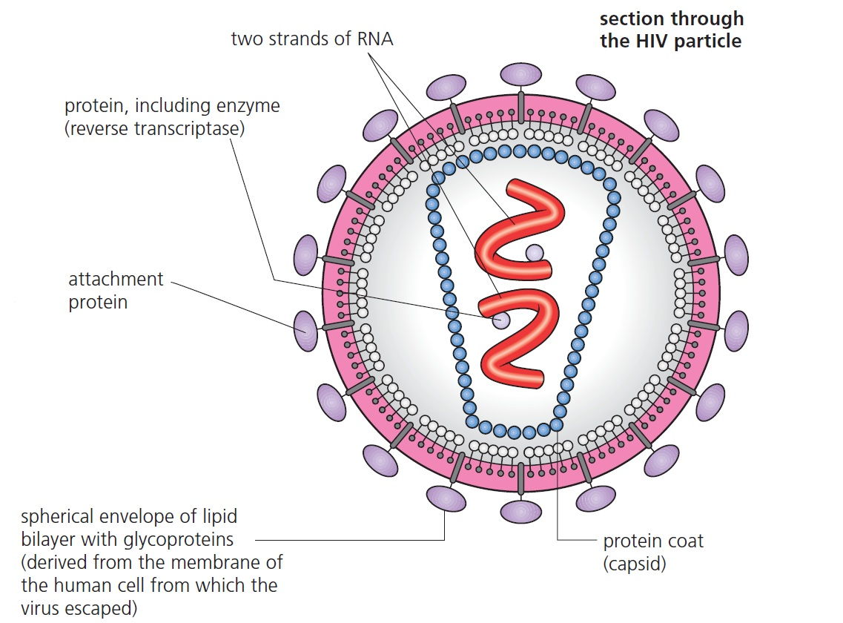
6 The immune system Summary
Viruses
A protein coat (capsid) surrounds a core of genetic material.
© Hodder & Stoughton 2015

Slide 6
6 The immune system Summary
Questions
What is meant by the term pathogen?
Describe the chemical and physical barriers that prevent infection by pathogens.
Describe the non-specific immune response.
Explain the difference between passive and active immunity.
How can a person suffer from a cold just after recovering from one?
© Hodder & Stoughton 2015

